Slide 2
What’s new in Microsoft Information Protection solutions to help you protect your sensitive data
BRK2495
Subtitle or speaker name

Slide 3
Agenda
What is Microsoft Information Protection?
Unified management of sensitivity labels and protection settings
End-user experiences
Protect sensitive information on endpoints, in the cloud, on-premises
Extending information protection to other apps and services
Roadmap and looking ahead

Slide 4
Identity & access management
Information protection
Built in
security
Platform
Threat
protection
Security management

Slide 5
Sensitive data is at risk
      80 %
      of employees use non-approved SaaS apps at work
      85 %
      of enterprise organizations keep sensitive information in the cloud
      88 %
      of organizations no longer have confidence to detect and prevent loss of sensitive data
      58 %
      Have accidentally sent sensitive information to the wrong person

Slide 6







In a world without boundaries,
data lives and travels everywhere

Slide 7

Do you have a strategy for protecting and managing sensitive information?
Do you know where your sensitive
data resides?
Do you have control of your data as it travels inside and outside of your organization?
Are you using multiple solutions to discover, classify, label, and protect sensitive data?

Slide 8
What we’ve heard from customers
“My data is scattered across sources and the data continues to grow”
“I can’t apply unified policies across various data sources or to a specific repository”
“How do I protect sensitive information such as sensitive PII data across my enterprise?”
“I need complete coverage of all my devices and applications”
“When enforcing compliance our business users’ productivity is disrupted”
“How do I find only relevant data when I need it?”

Slide 9

Microsoft Information Protection solutions help you protect sensitive data throughout its lifecycle – inside and outside the organization

Slide 10
Protect your sensitive data – wherever it lives or travels
Microsoft Information Protection
Discover
Classify
Protect
Monitor
Across
Devices
Apps
Cloud services
On-premises
Notes:
EMS Overview
© 2014 Microsoft Corporation. All rights reserved. Microsoft, Windows, Surface and other product names are or may be registered trademarks and/or trademarks in the U.S. and/or other countries. The information herein is for informational purposes only and represents the current view of Microsoft Corporation as of the date of this presentation. Because Microsoft must respond to changing market conditions, it should not be interpreted to be a commitment on the part of Microsoft, and Microsoft cannot guarantee the accuracy of any information provided after the date of this presentation. MICROSOFT MAKES NO WARRANTIES, EXPRESS, IMPLIED OR STATUTORY, AS TO THE INFORMATION IN THIS PRESENTATION.
1/8/2019
10

Slide 11
Common use cases
Discover and understand the sensitive data across your environment
Accelerate your journey to the cloud by classifying, labeling and protecting data on-premises
Get control of data sprawl in the cloud by classifying, labeling and protecting files in 3rd-party cloud services
Implement an information protection strategy to meet compliance obligations

Slide 12

Data protection & data governance go hand-in-hand
Unified approach
Unified approach to discover, classify & label
Automatically apply policy-based actions
Proactive monitoring to identify risks
Broad coverage across locations
Discover
Classify
Label
Apply label
Sensitivity
Retention
Encryption
Restrict Access
Watermark
Header/Footer
Retention
Deletion
Records Management
Archiving
Monitor
Sensitive data discovery
Data at risk
Policy violations
Policy recommendations
Proactive alerts

Slide 13
Microsoft Information Protection – the way it was
Office 365
Information Protection
Windows
Information Protection
Azure
Information Protection
What
Preserve or remediate emails & documents
Classify & Protect
emails & documents
Protect files and documents
Where
Office 365 Apps & Services
Office Clients, 3rd party Apps & Services, On Premises
Windows Clients & Devices
How
Office 365 Security Console
Intune Portal
AIP Portal

Slide 14
Microsoft Information Protection – going forward
Office 365
Information Protection
Windows
Information Protection
Azure
Information Protection
What
Consistent content detection and classification to protect and preserve sensitive data
Where
Office 365 apps & services, Windows clients & desktops, mobile, on premises + 3rd party apps and services
How
Microsoft 365 Security and Compliance Center

Slide 15
Discover
Classify
Protect
Monitor
Scan & detect sensitive data based on policy
Classify and label data based on sensitivity
Apply protection actions, including encryption, access restrictions

Slide 16




a
CLOUD & SaaS APPS
Office 365, Microsoft Cloud App Security
Discover and classify sensitive information
DEVICES
Office apps, Windows Information Protection
No matter where it’s created, modified or shared
ON PREMISES
AIP scanner

Slide 17

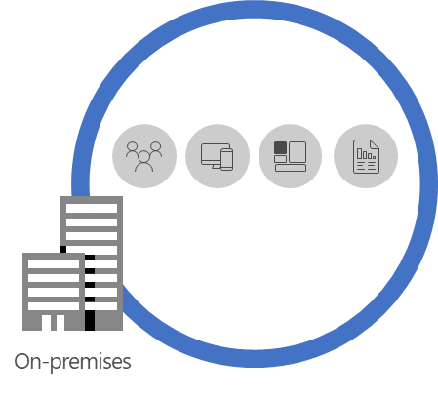
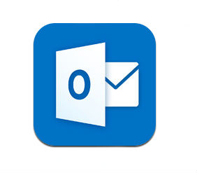


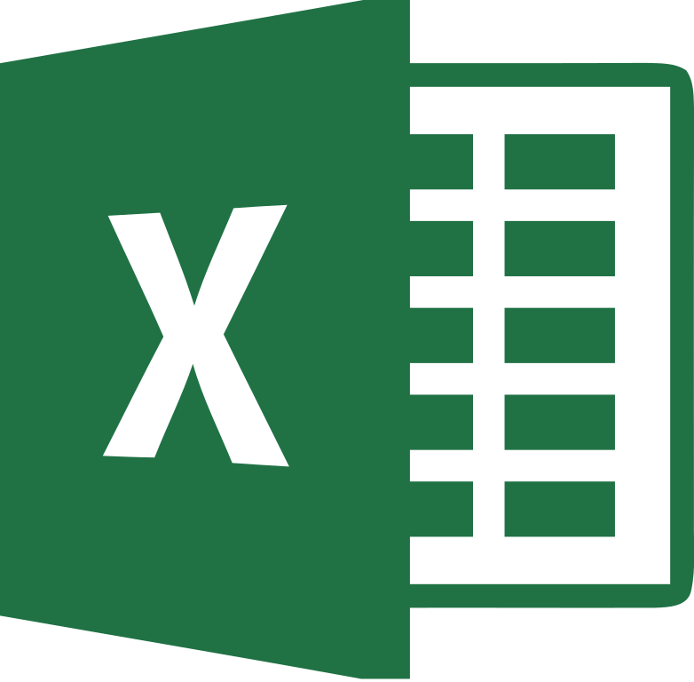
Discovery & classification across Microsoft services
Consistent Auto Classification across Microsoft services
Native integration in content pipeline and substrate
Deep Content Scanning with 90+ built-in sensitive types
Fully extensible scanning with custom type support
NEW GDPR template with EU sensitive types
NEW Custom sensitive type authoring and fine tuning
COMING SOON Exact Data Match based classification
COMING SOON Image classification with OCR
Coming Soon
AIP Scanner
Microsoft Cloud App Security
Azure Service
Service Integration
Client apps
On Premises
Data Classification Service (DCS)
Uniform content discovery & classification

Slide 18


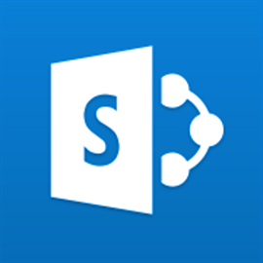
What is a sensitivity label?
Tag that is customizable,
readable by other systems,
and persistent.
It becomes the basis for applying and enforcing data protection policies.
In files and emails, the label is persisted as document metadata
CONFIDENTIAL
In SharePoint Online, the label is persisted as container metadata

Slide 19
Configuring and managing labels in the Security & Compliance Center

Slide 20
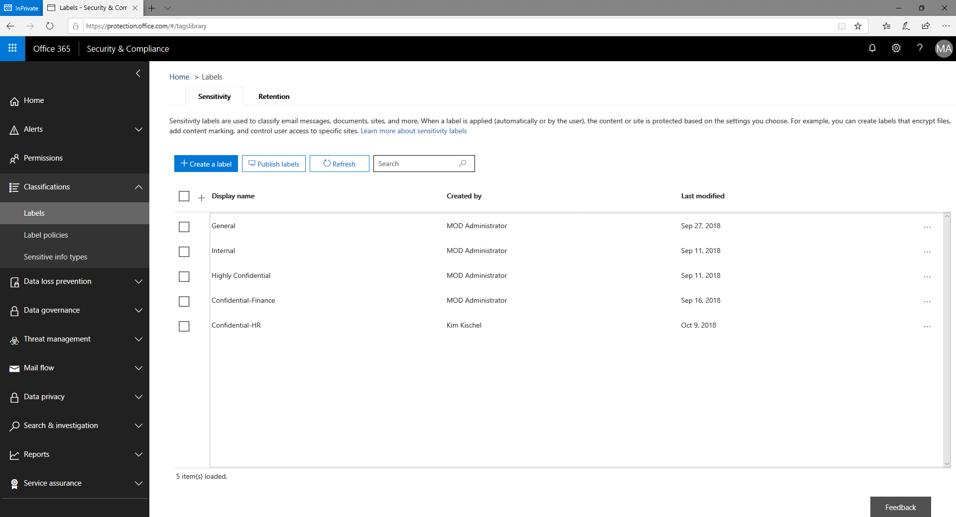

Slide 21
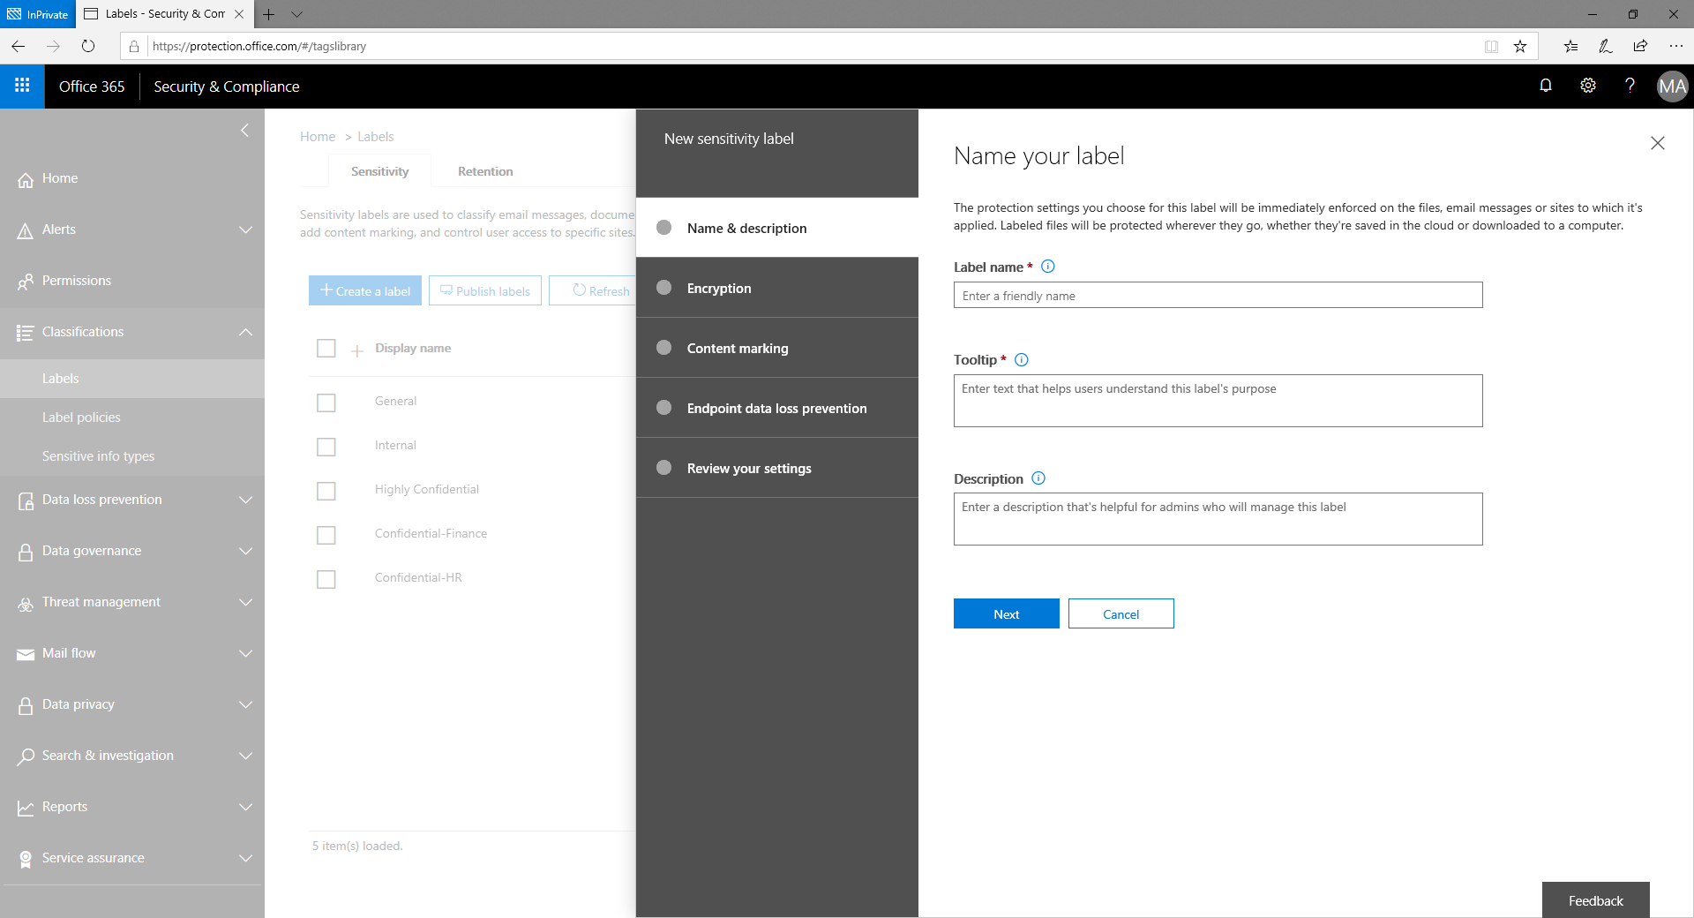

Slide 22


Slide 23
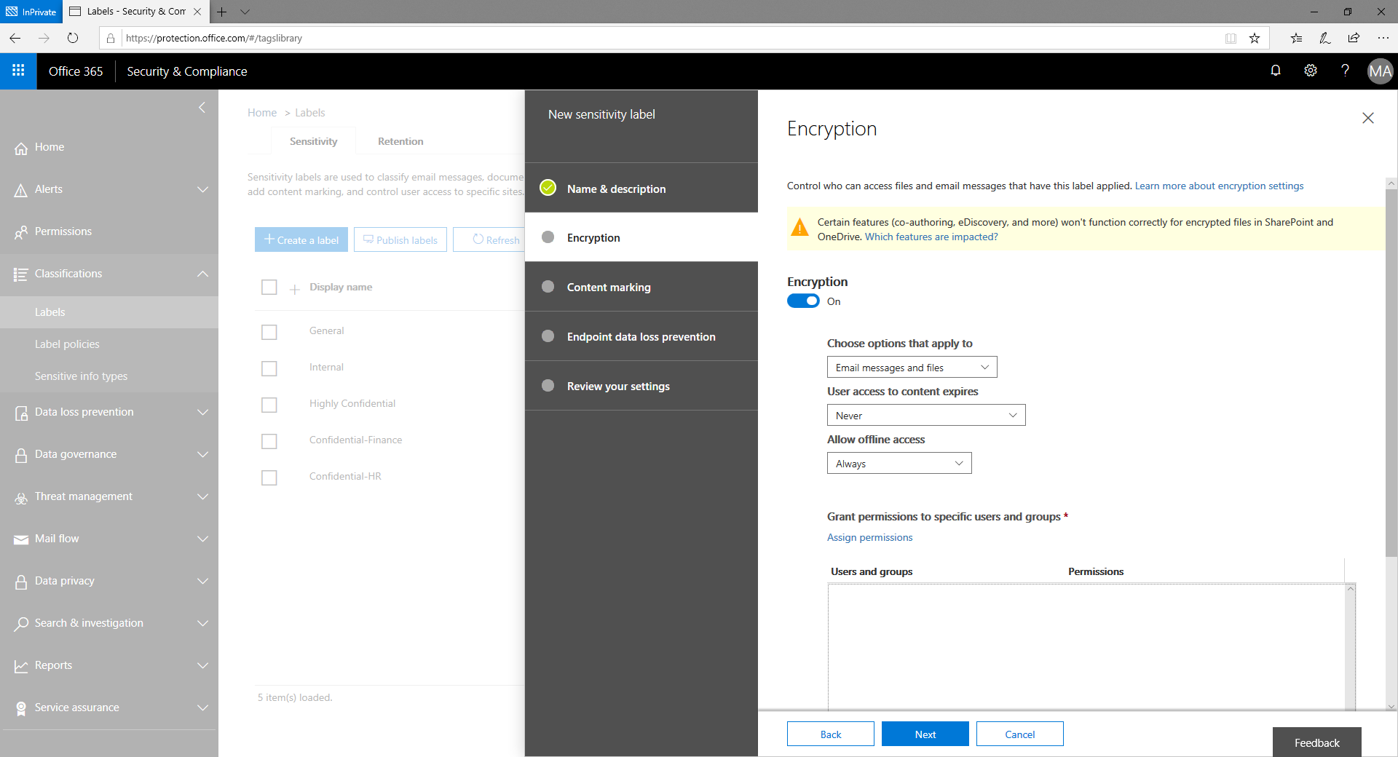

Slide 24
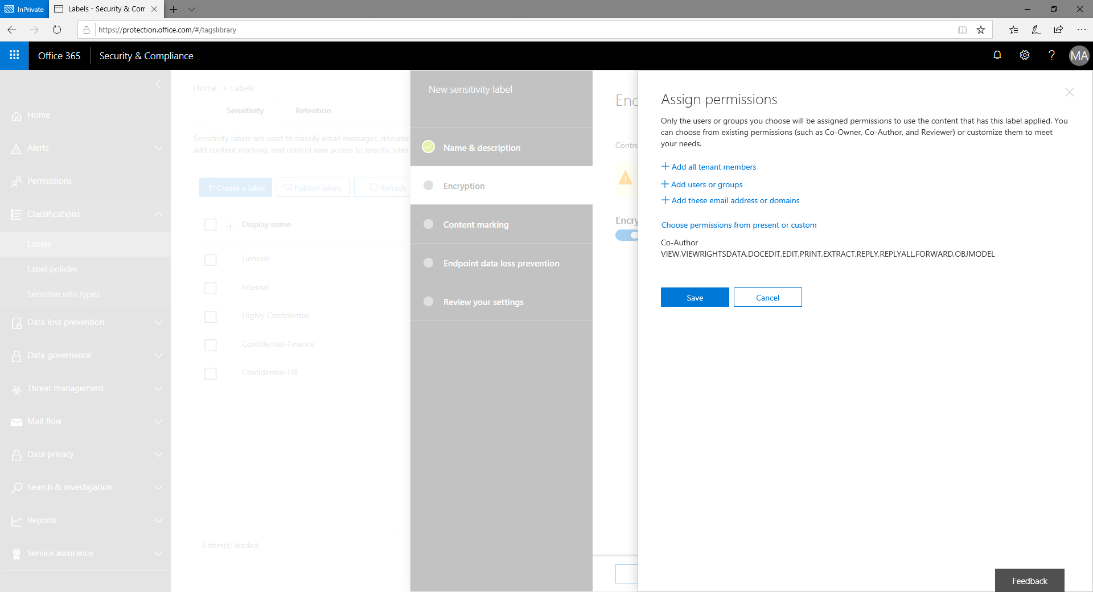

Slide 25
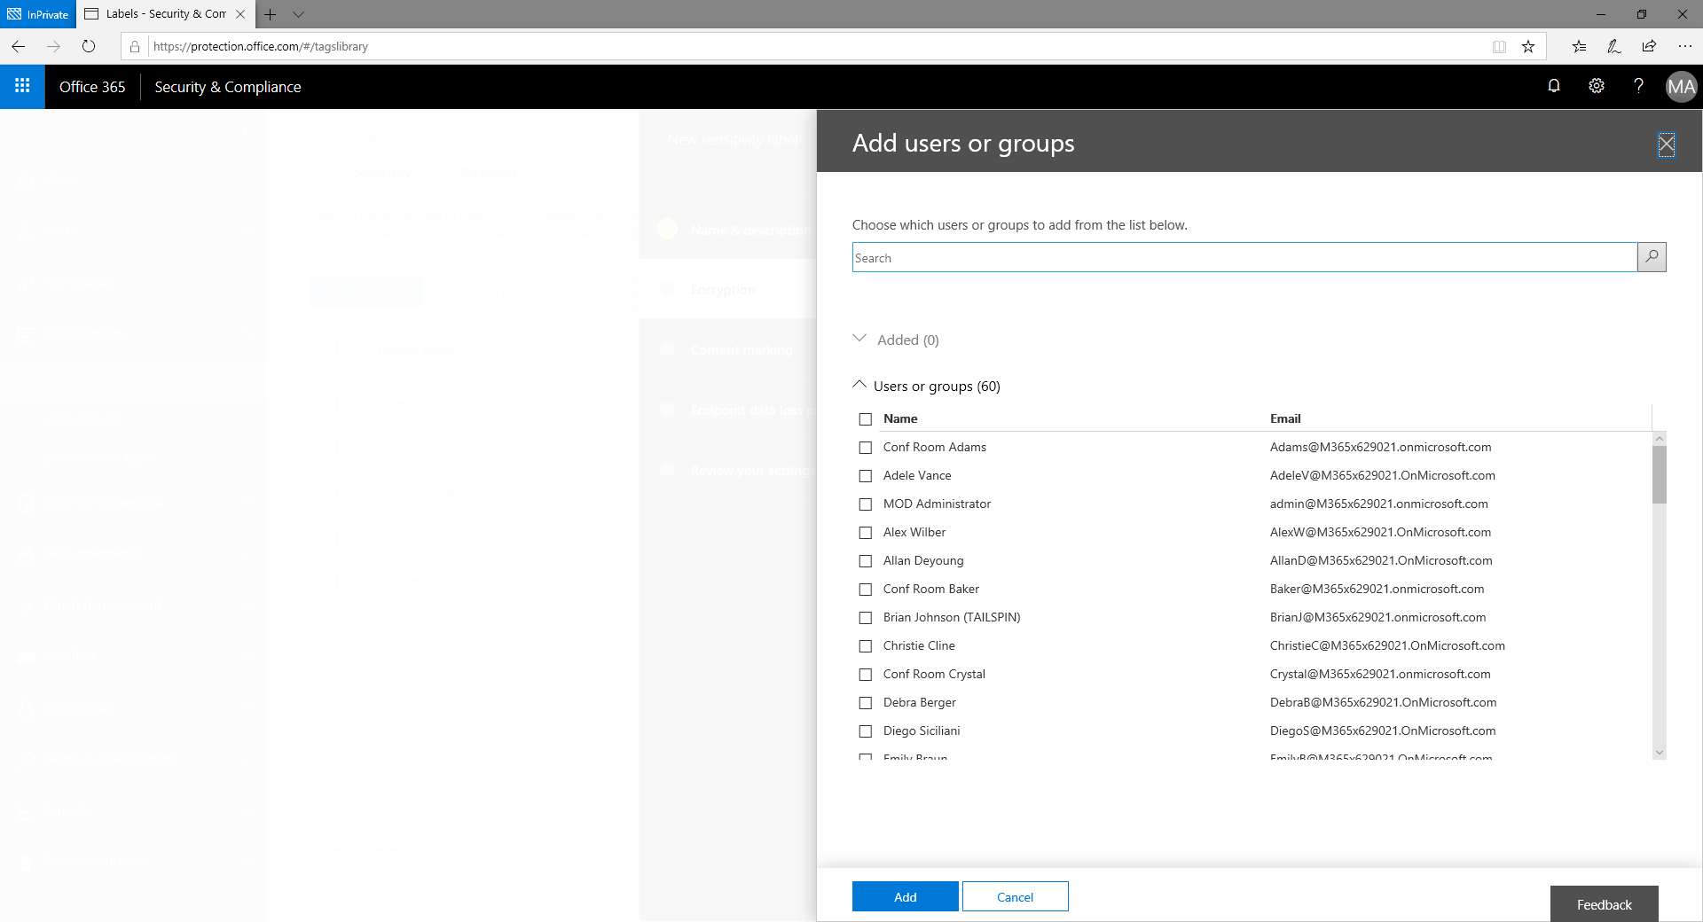

Slide 26
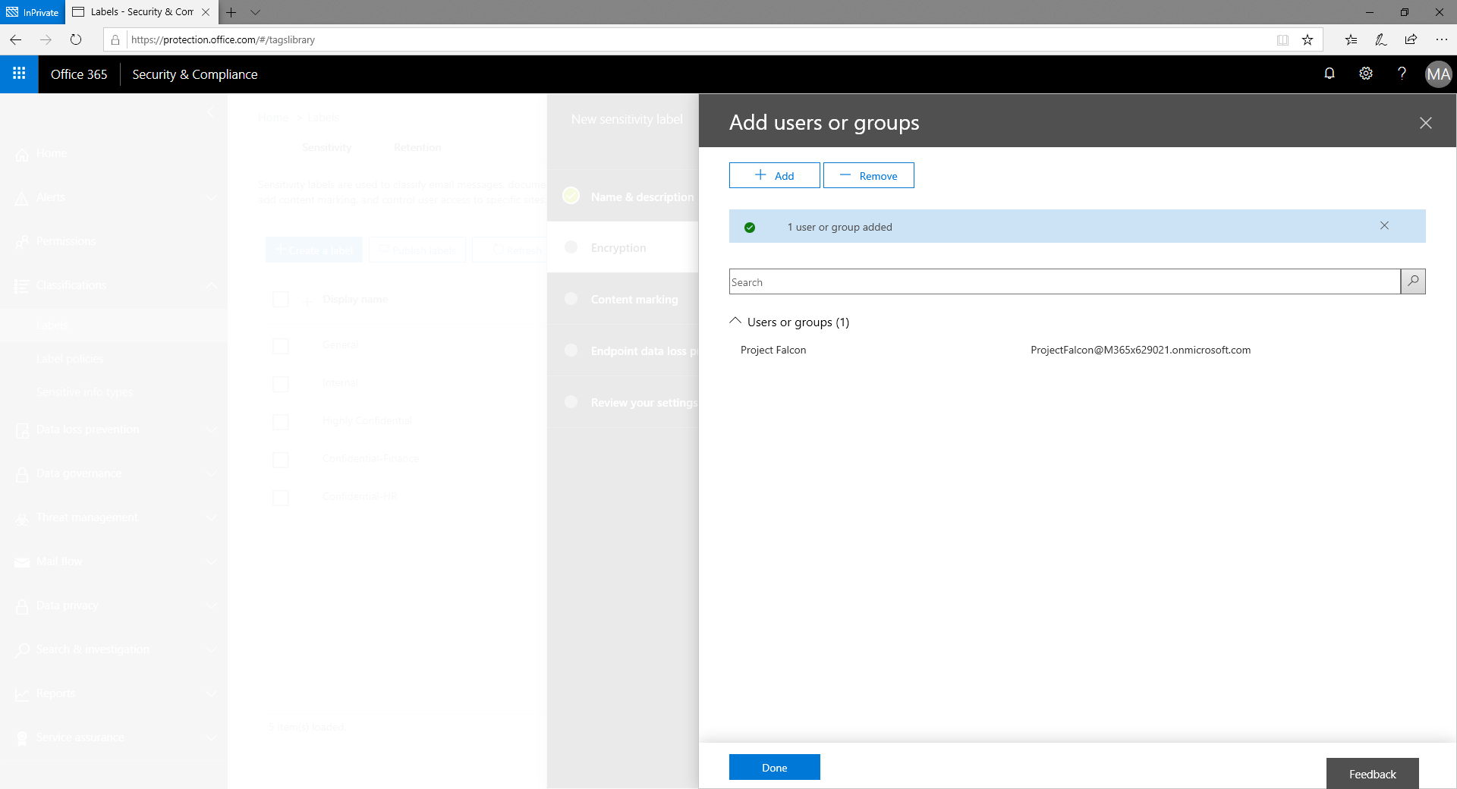

Slide 27


Slide 28
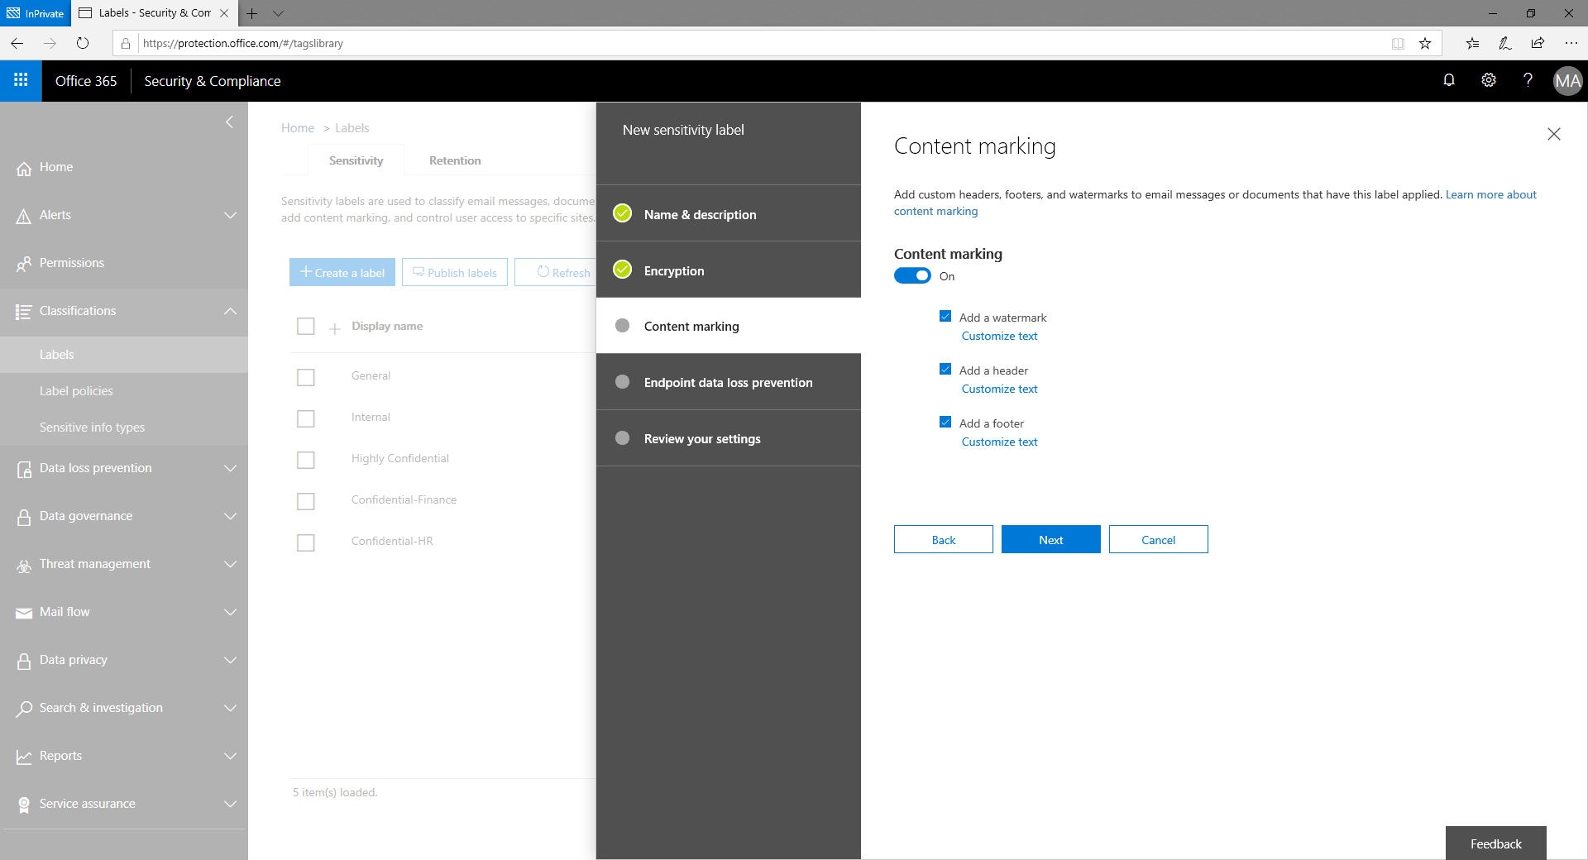

Slide 29
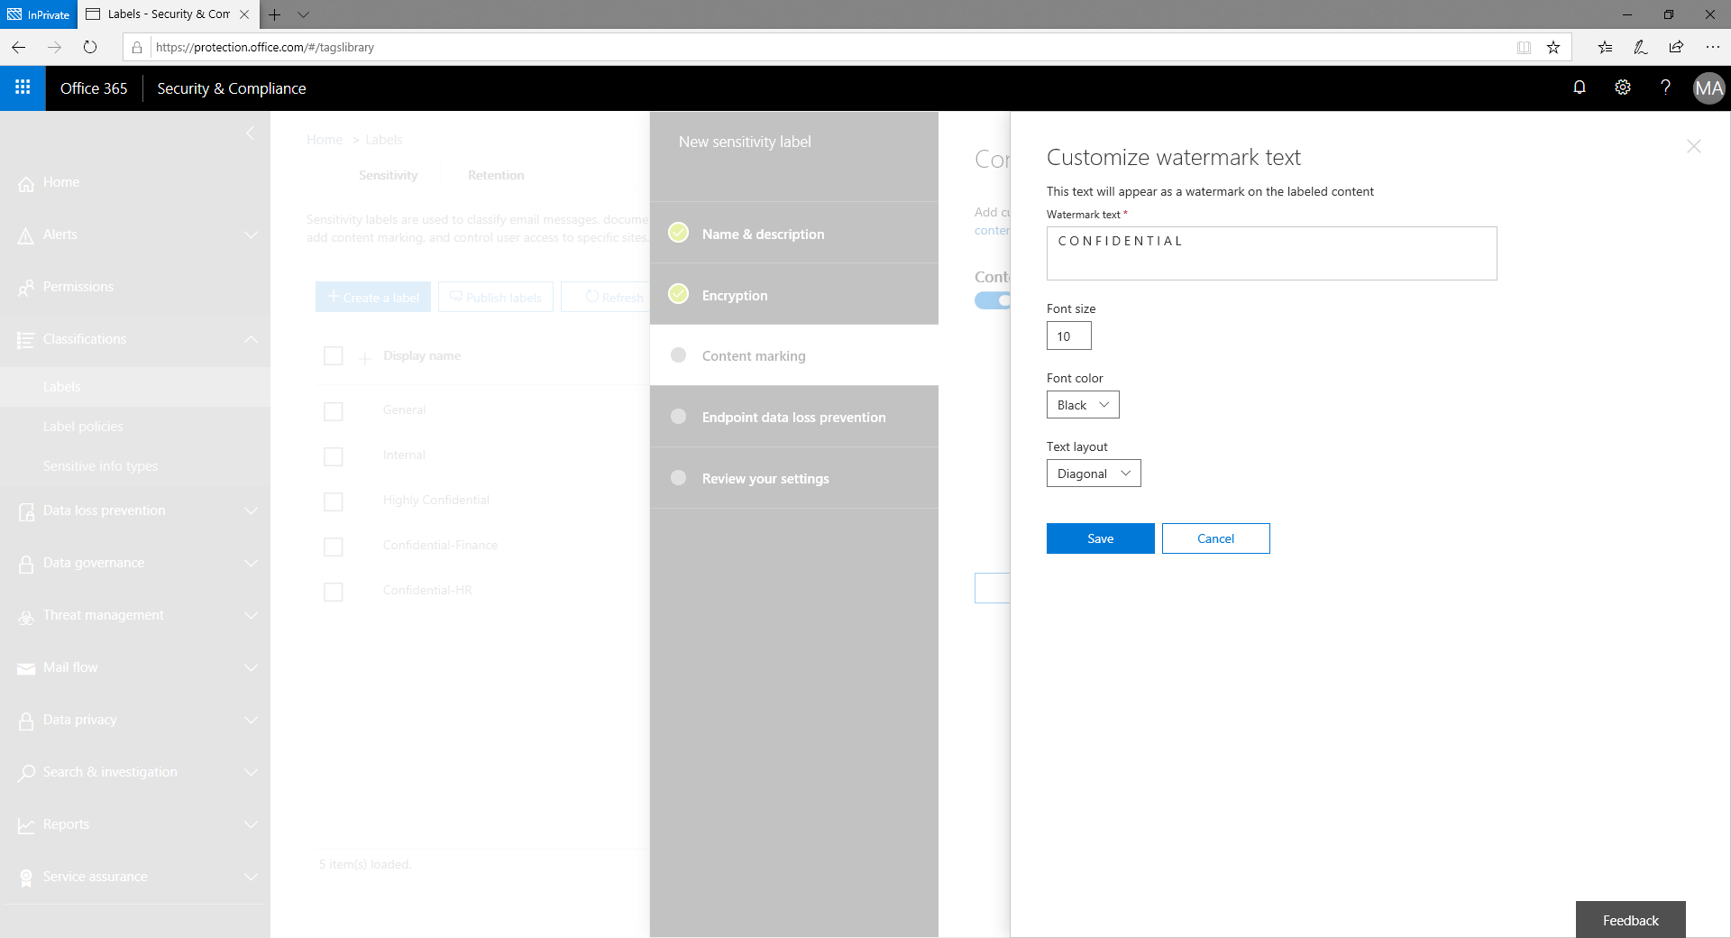

Slide 30
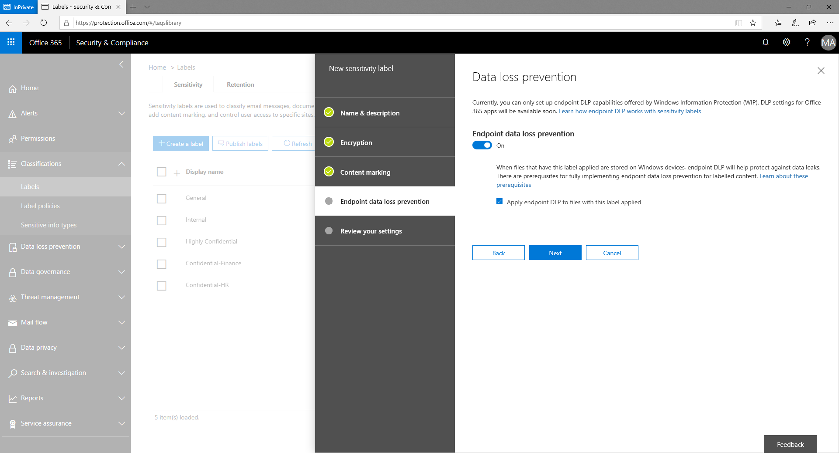

Slide 31
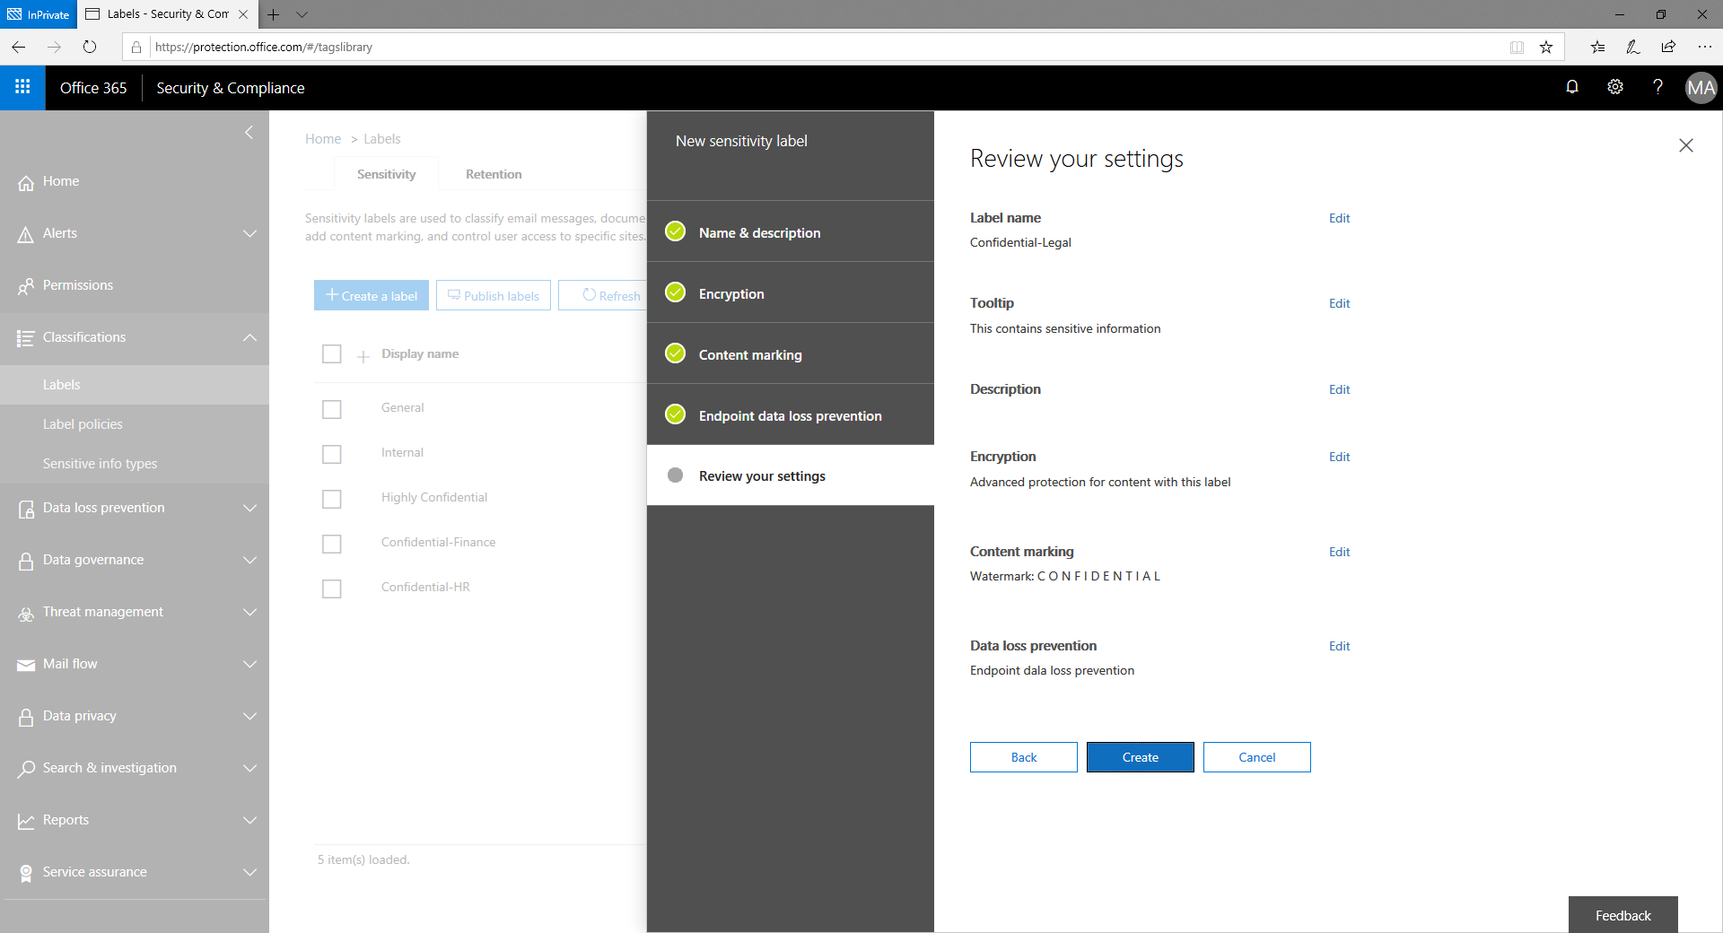

Slide 32
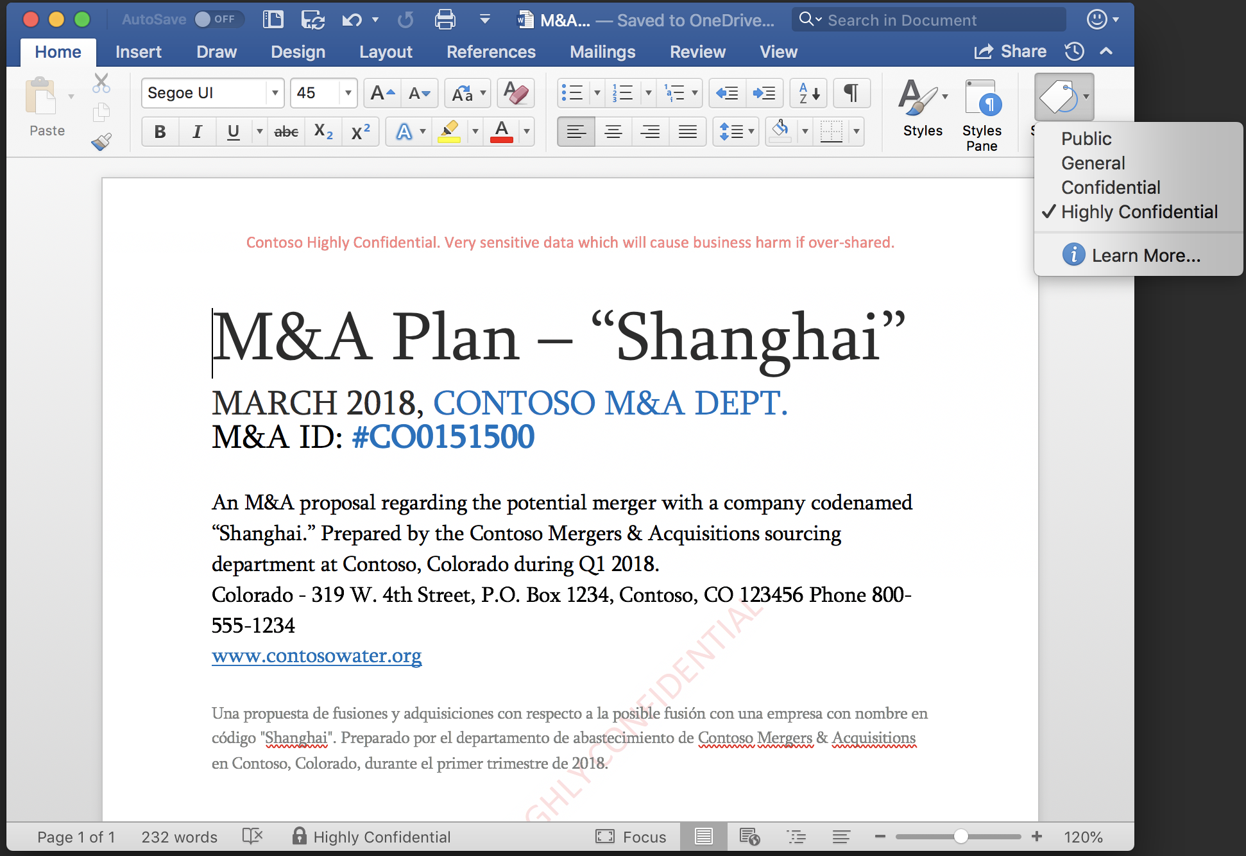
Native labeling experiences built into Office applications
Preview
Consistent and easy for users
Apply and update labels while working in Office apps – Word, PowerPoint, Excel and Outlook
Built-in
Integrated natively into Office apps; no plug-ins or add-ons required for latest Office 365 apps.
Broad platform support
Starting next week: Mac, iOS and Android public preview via Office Insider
Office on Windows and Outlook mobile public preview in early CY19
Azure Information Protection add-in available today

Slide 33
Sensitivity labeling in Office apps on Mac

Slide 34
Preview

Slide 35
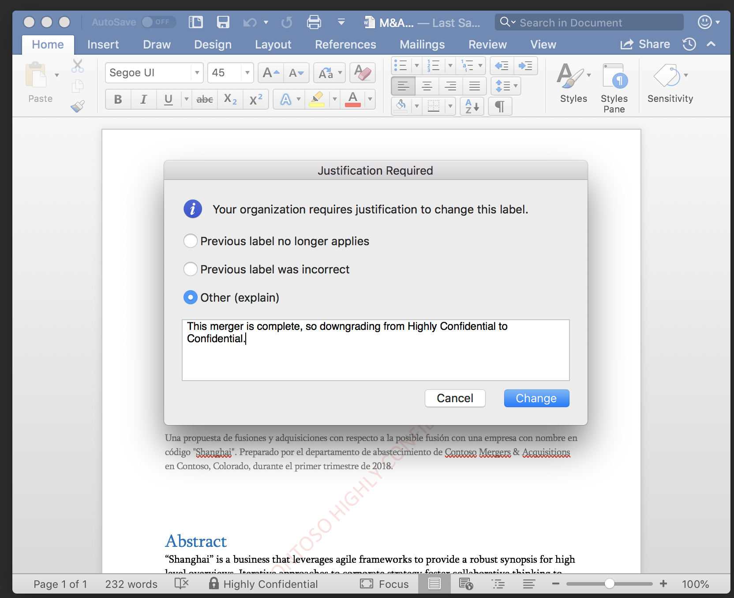
Preview

Slide 36
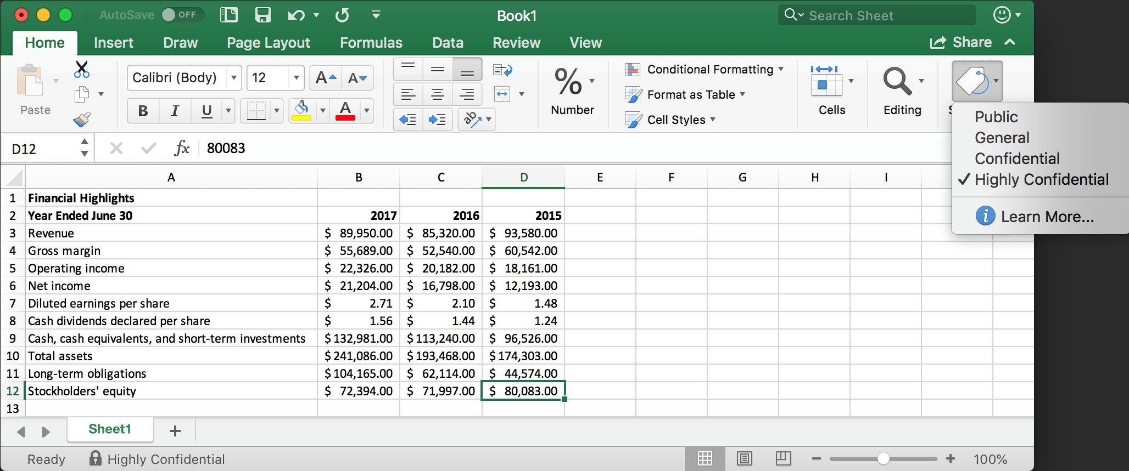
Preview

Slide 37
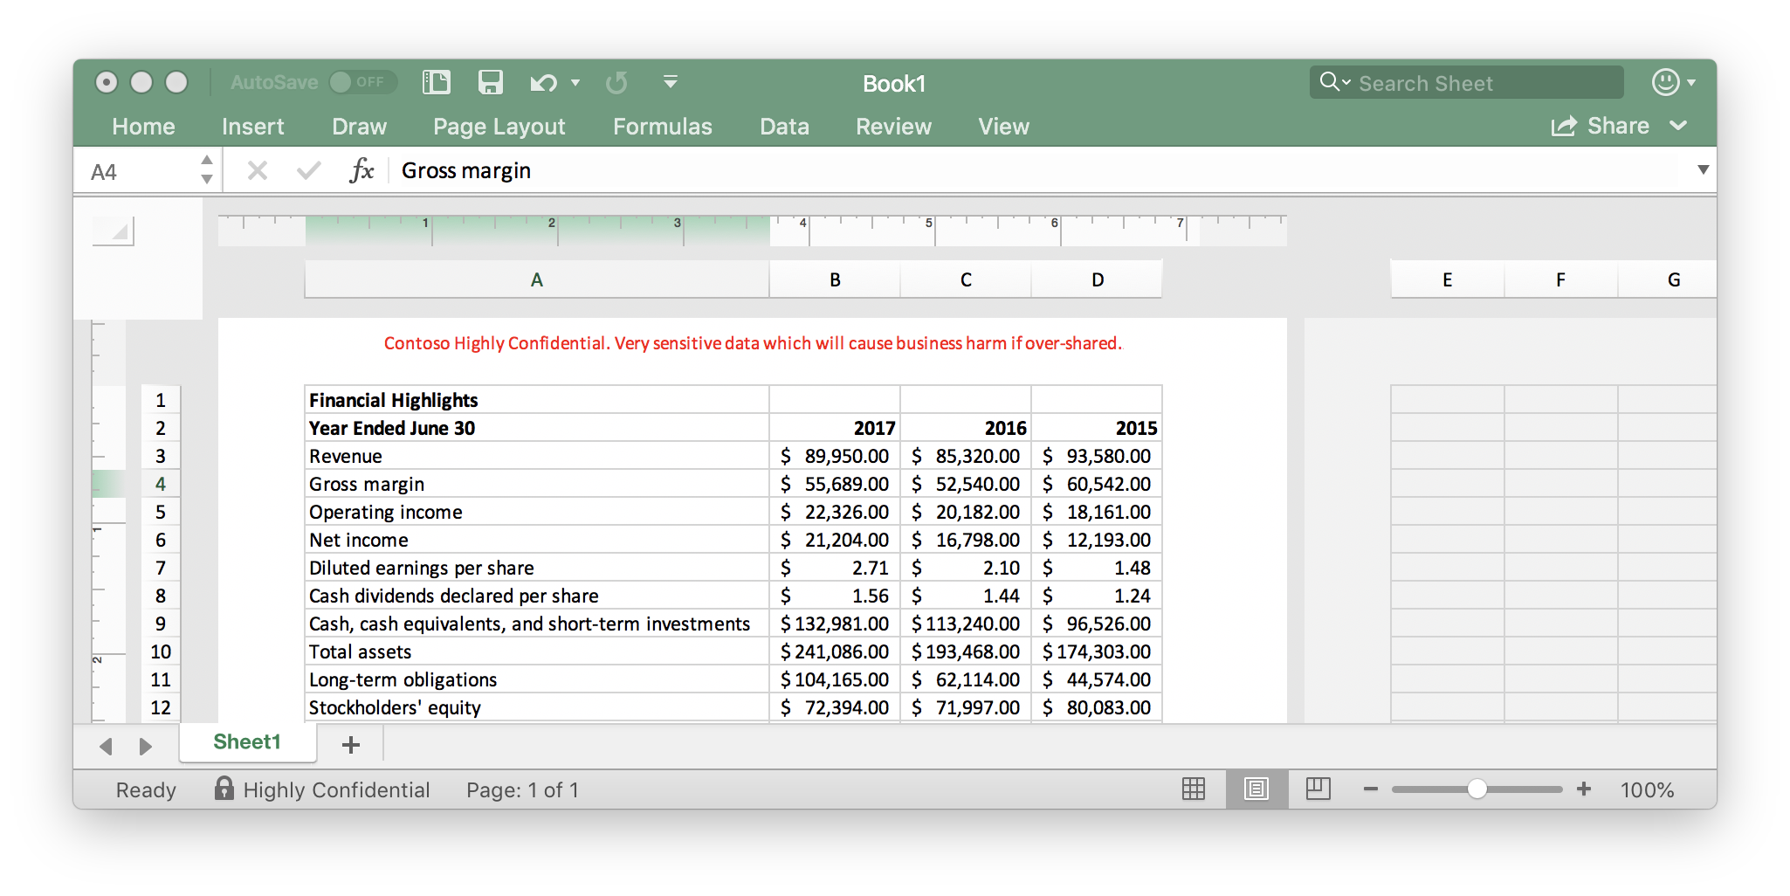
Preview

Slide 38
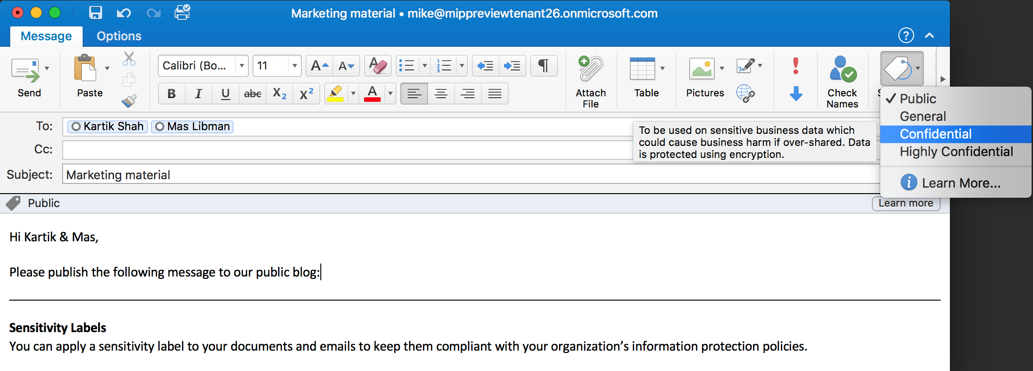
Preview

Slide 39
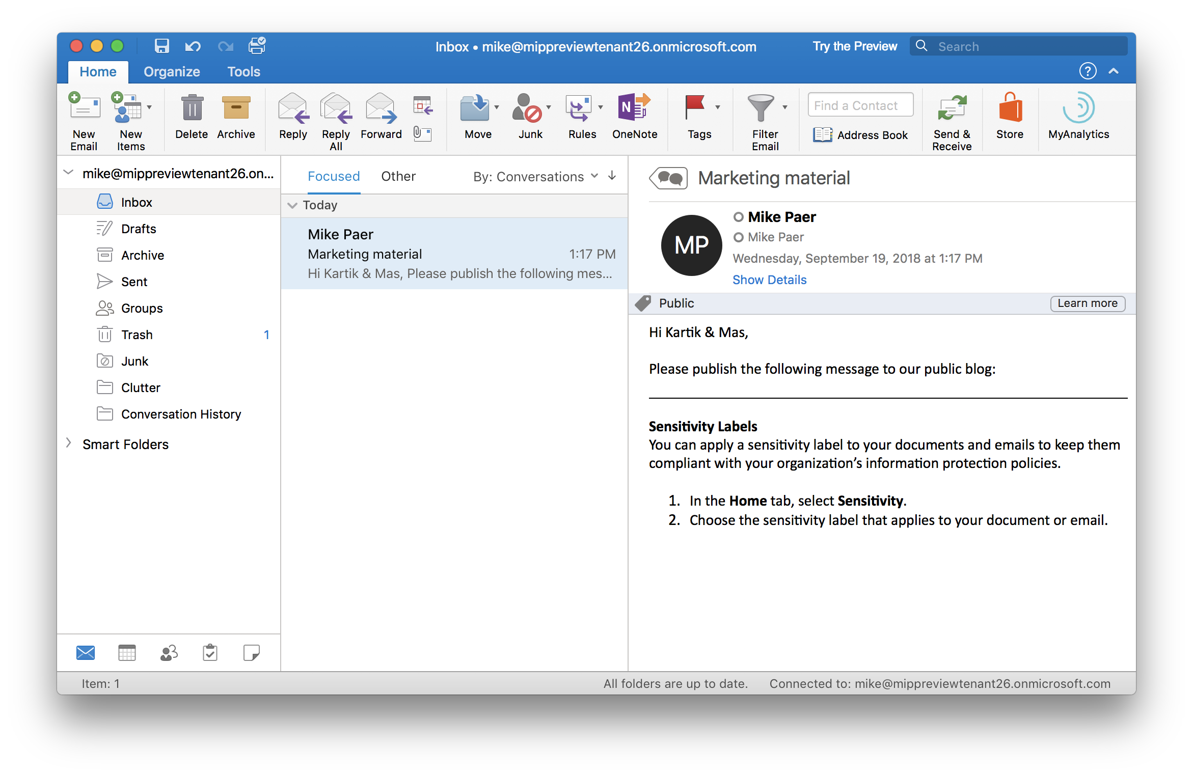
Preview

Slide 40
Sensitivity labeling in Office apps on iOS
Preview

Slide 41
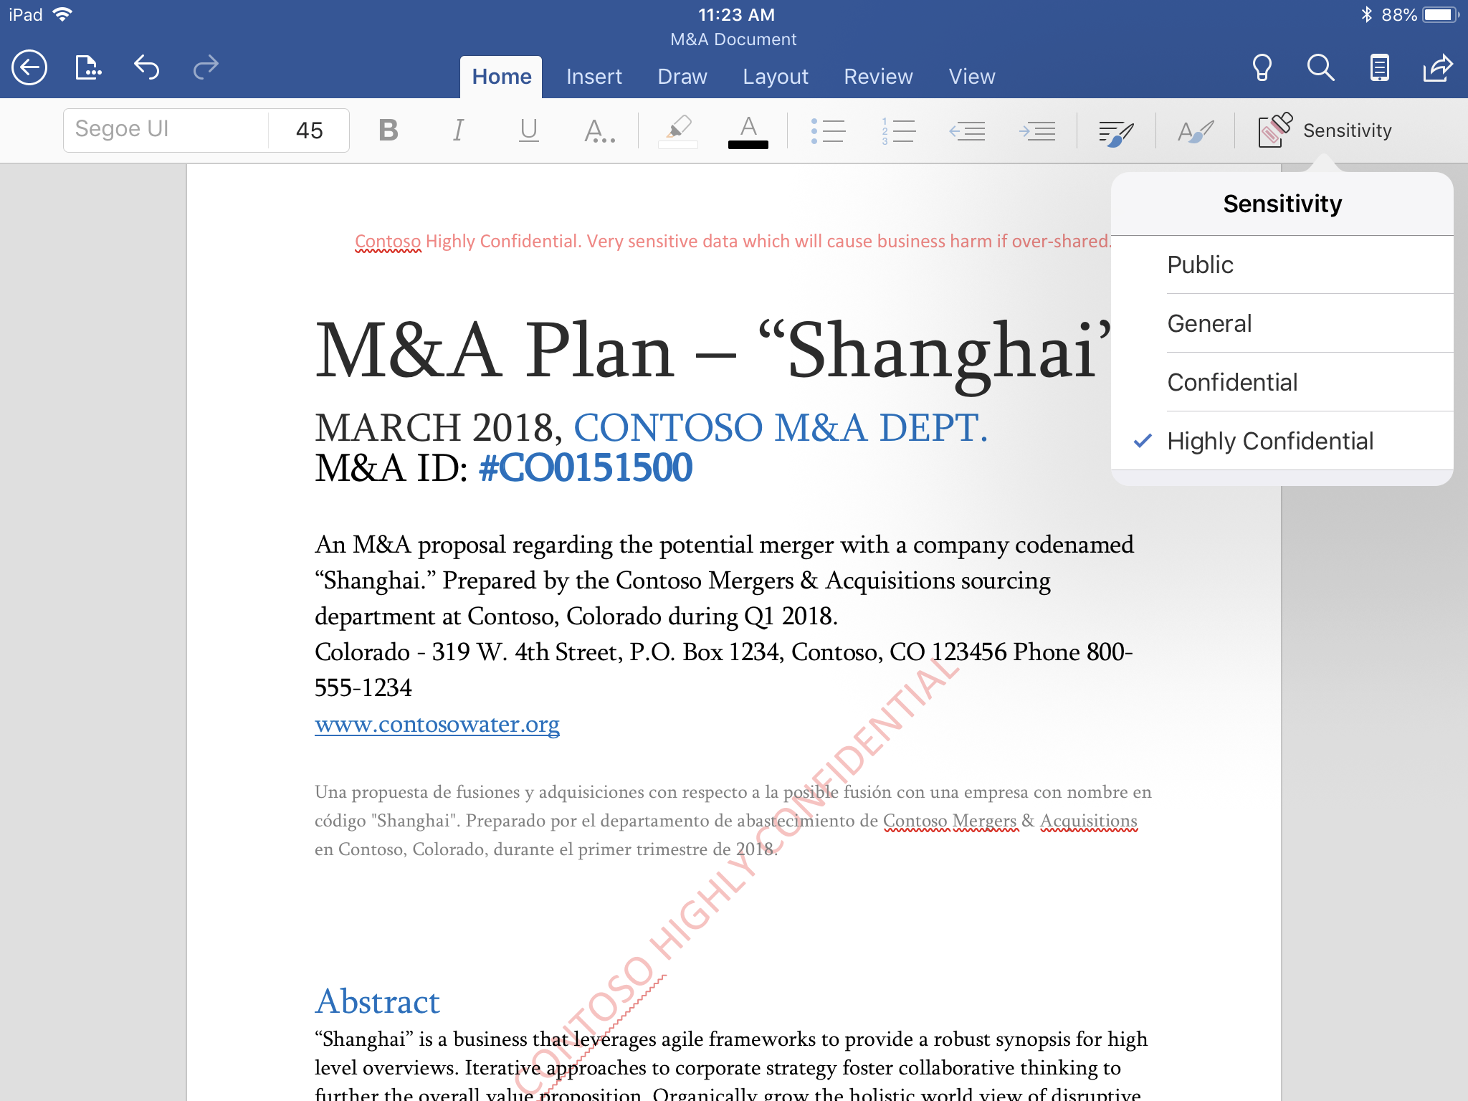
Preview

Slide 42
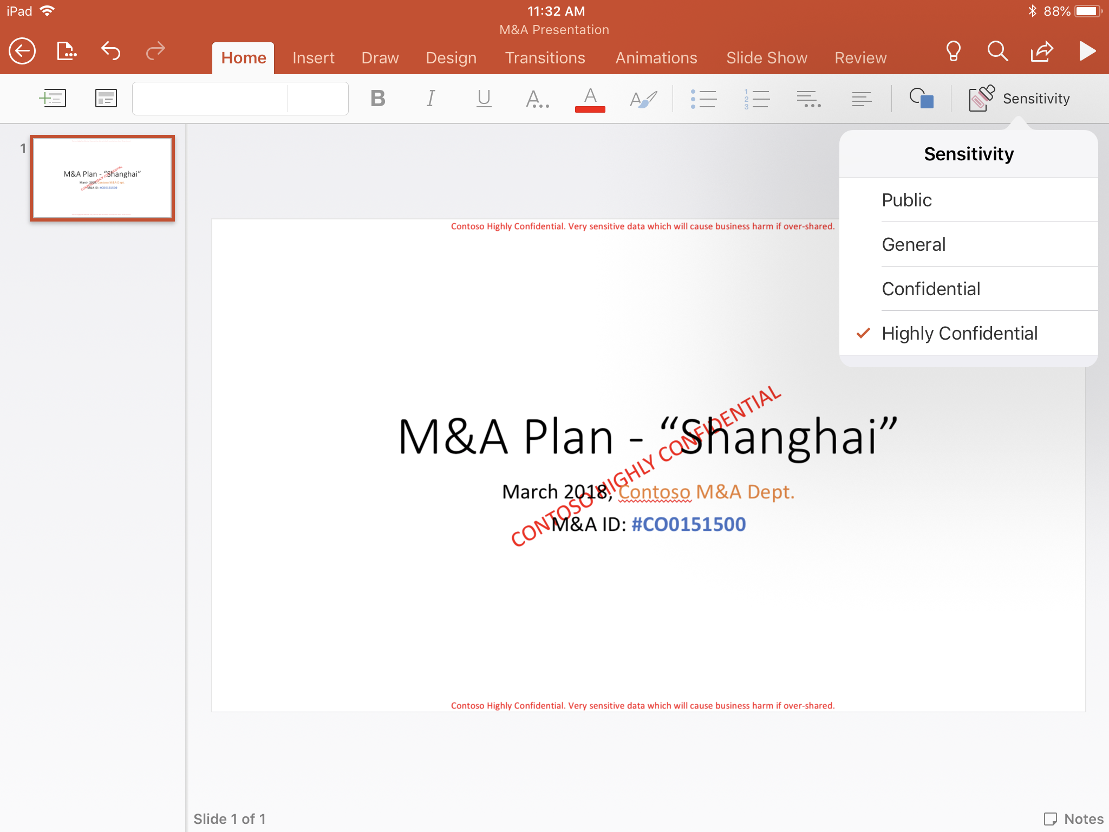
Preview

Slide 43
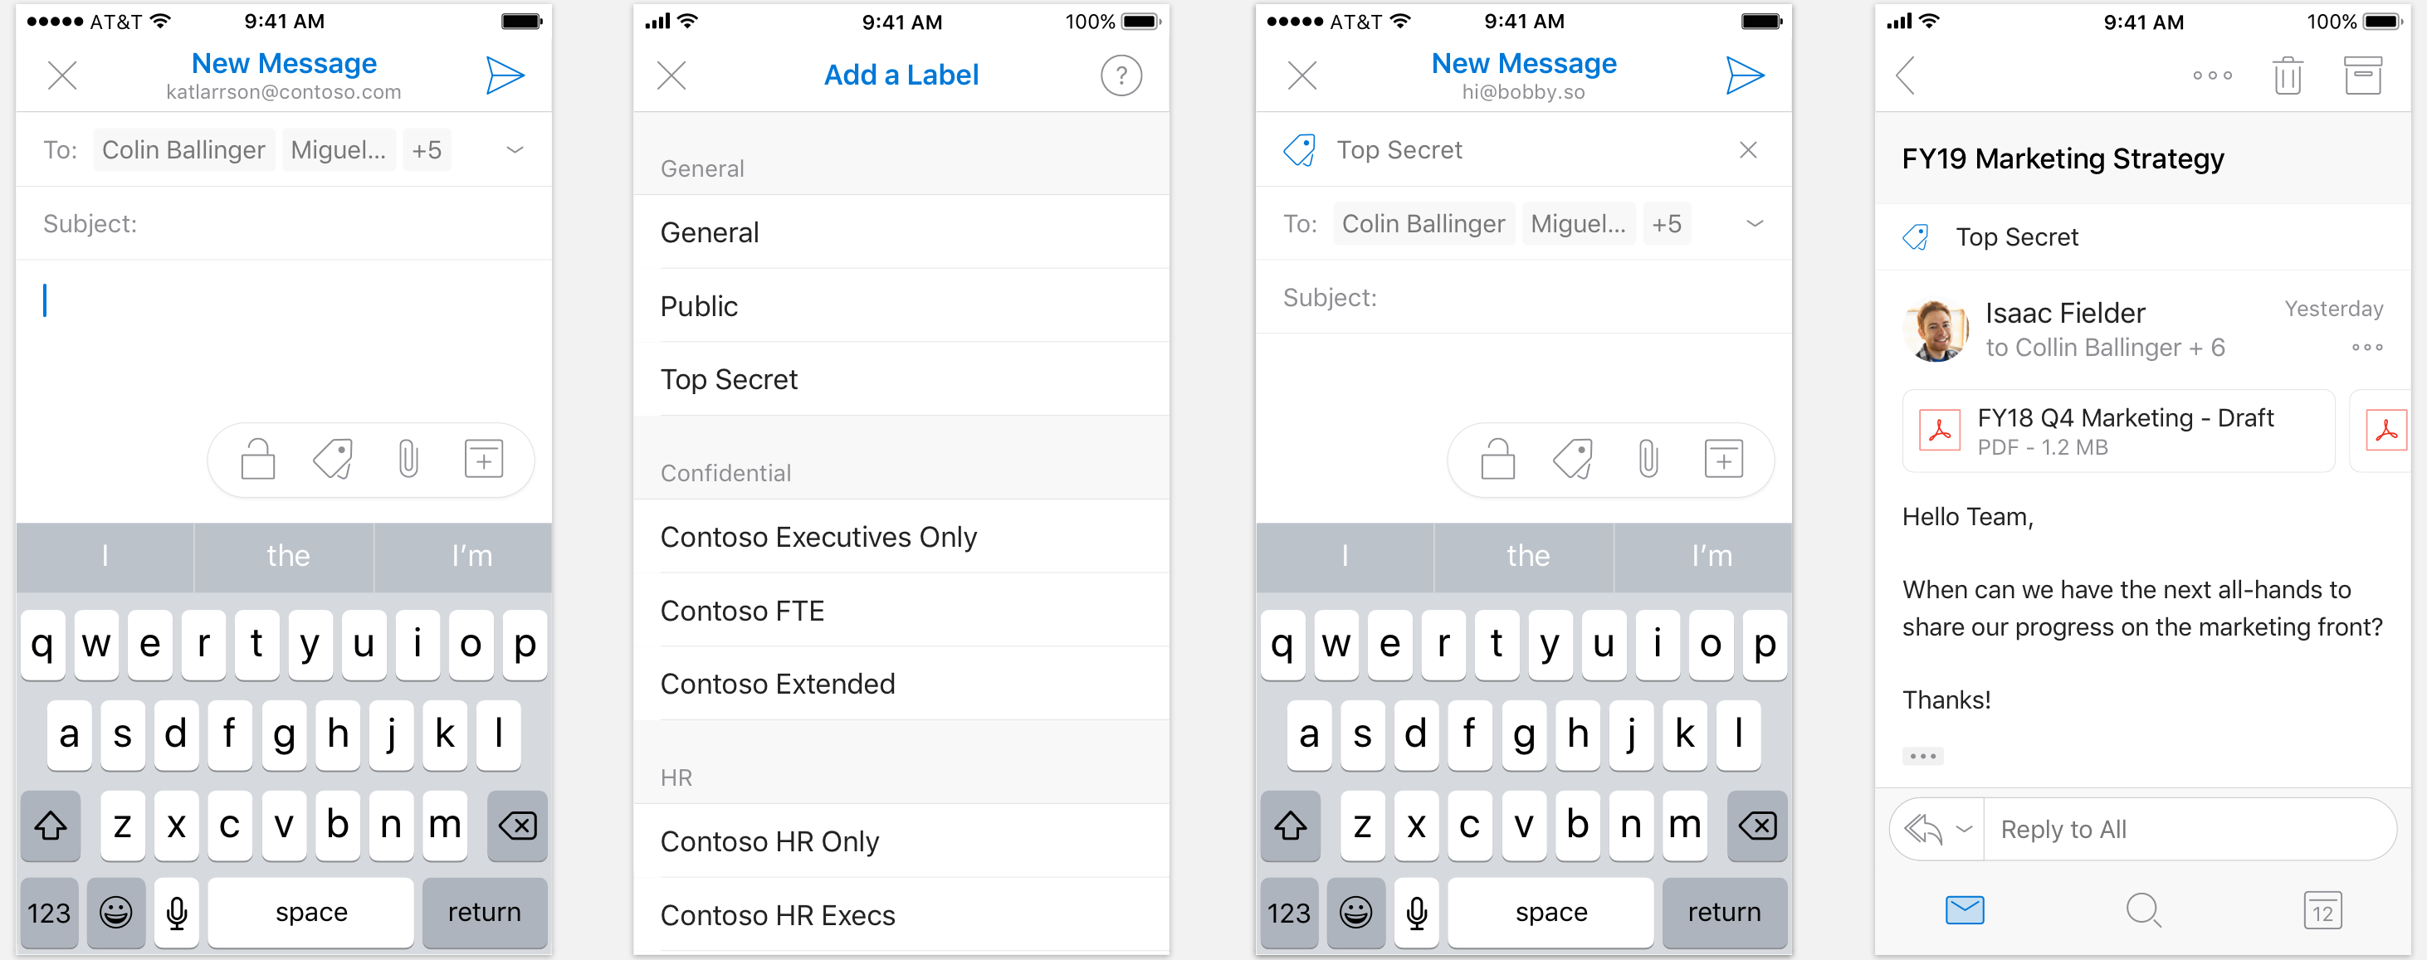
Preview in early CY19

Slide 44
Sensitivity labeling in Office apps on Android
Preview

Slide 45
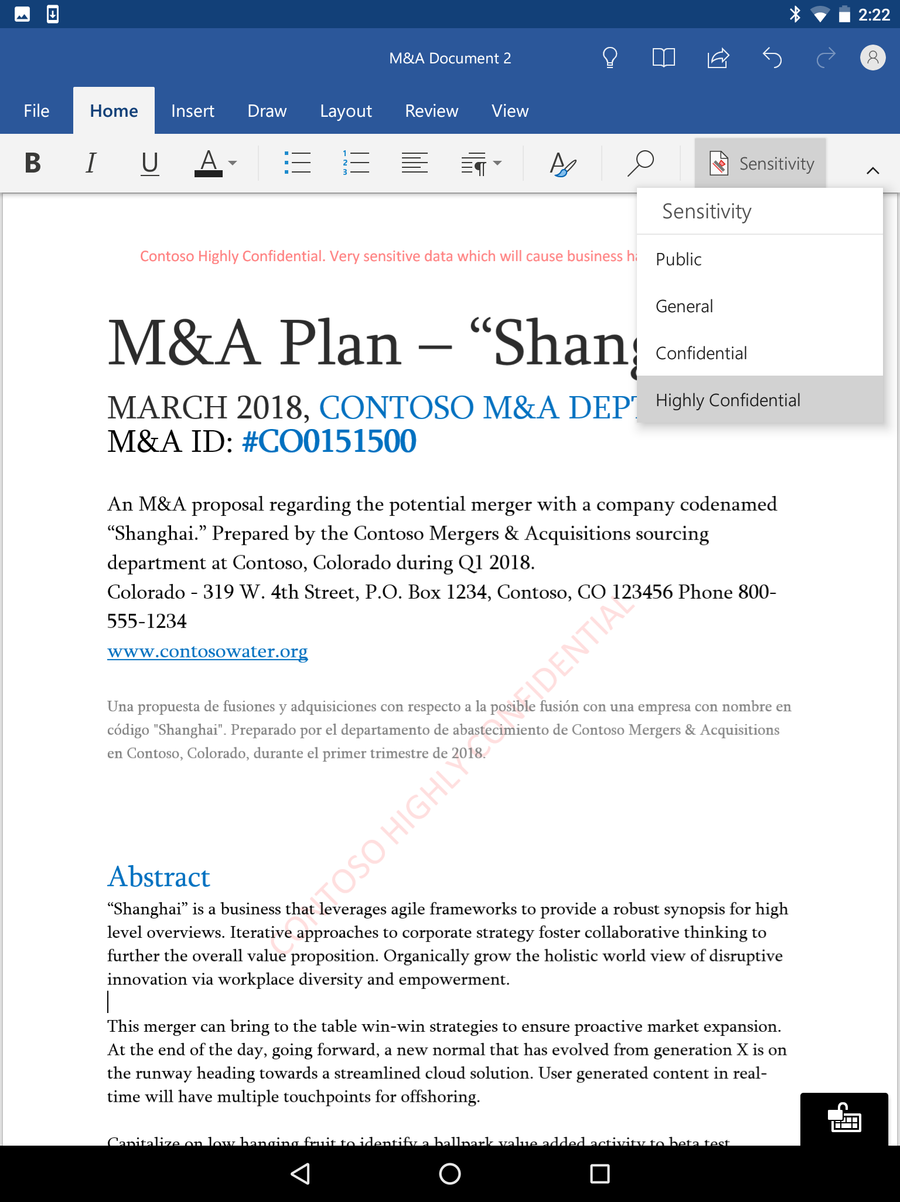
Preview

Slide 46
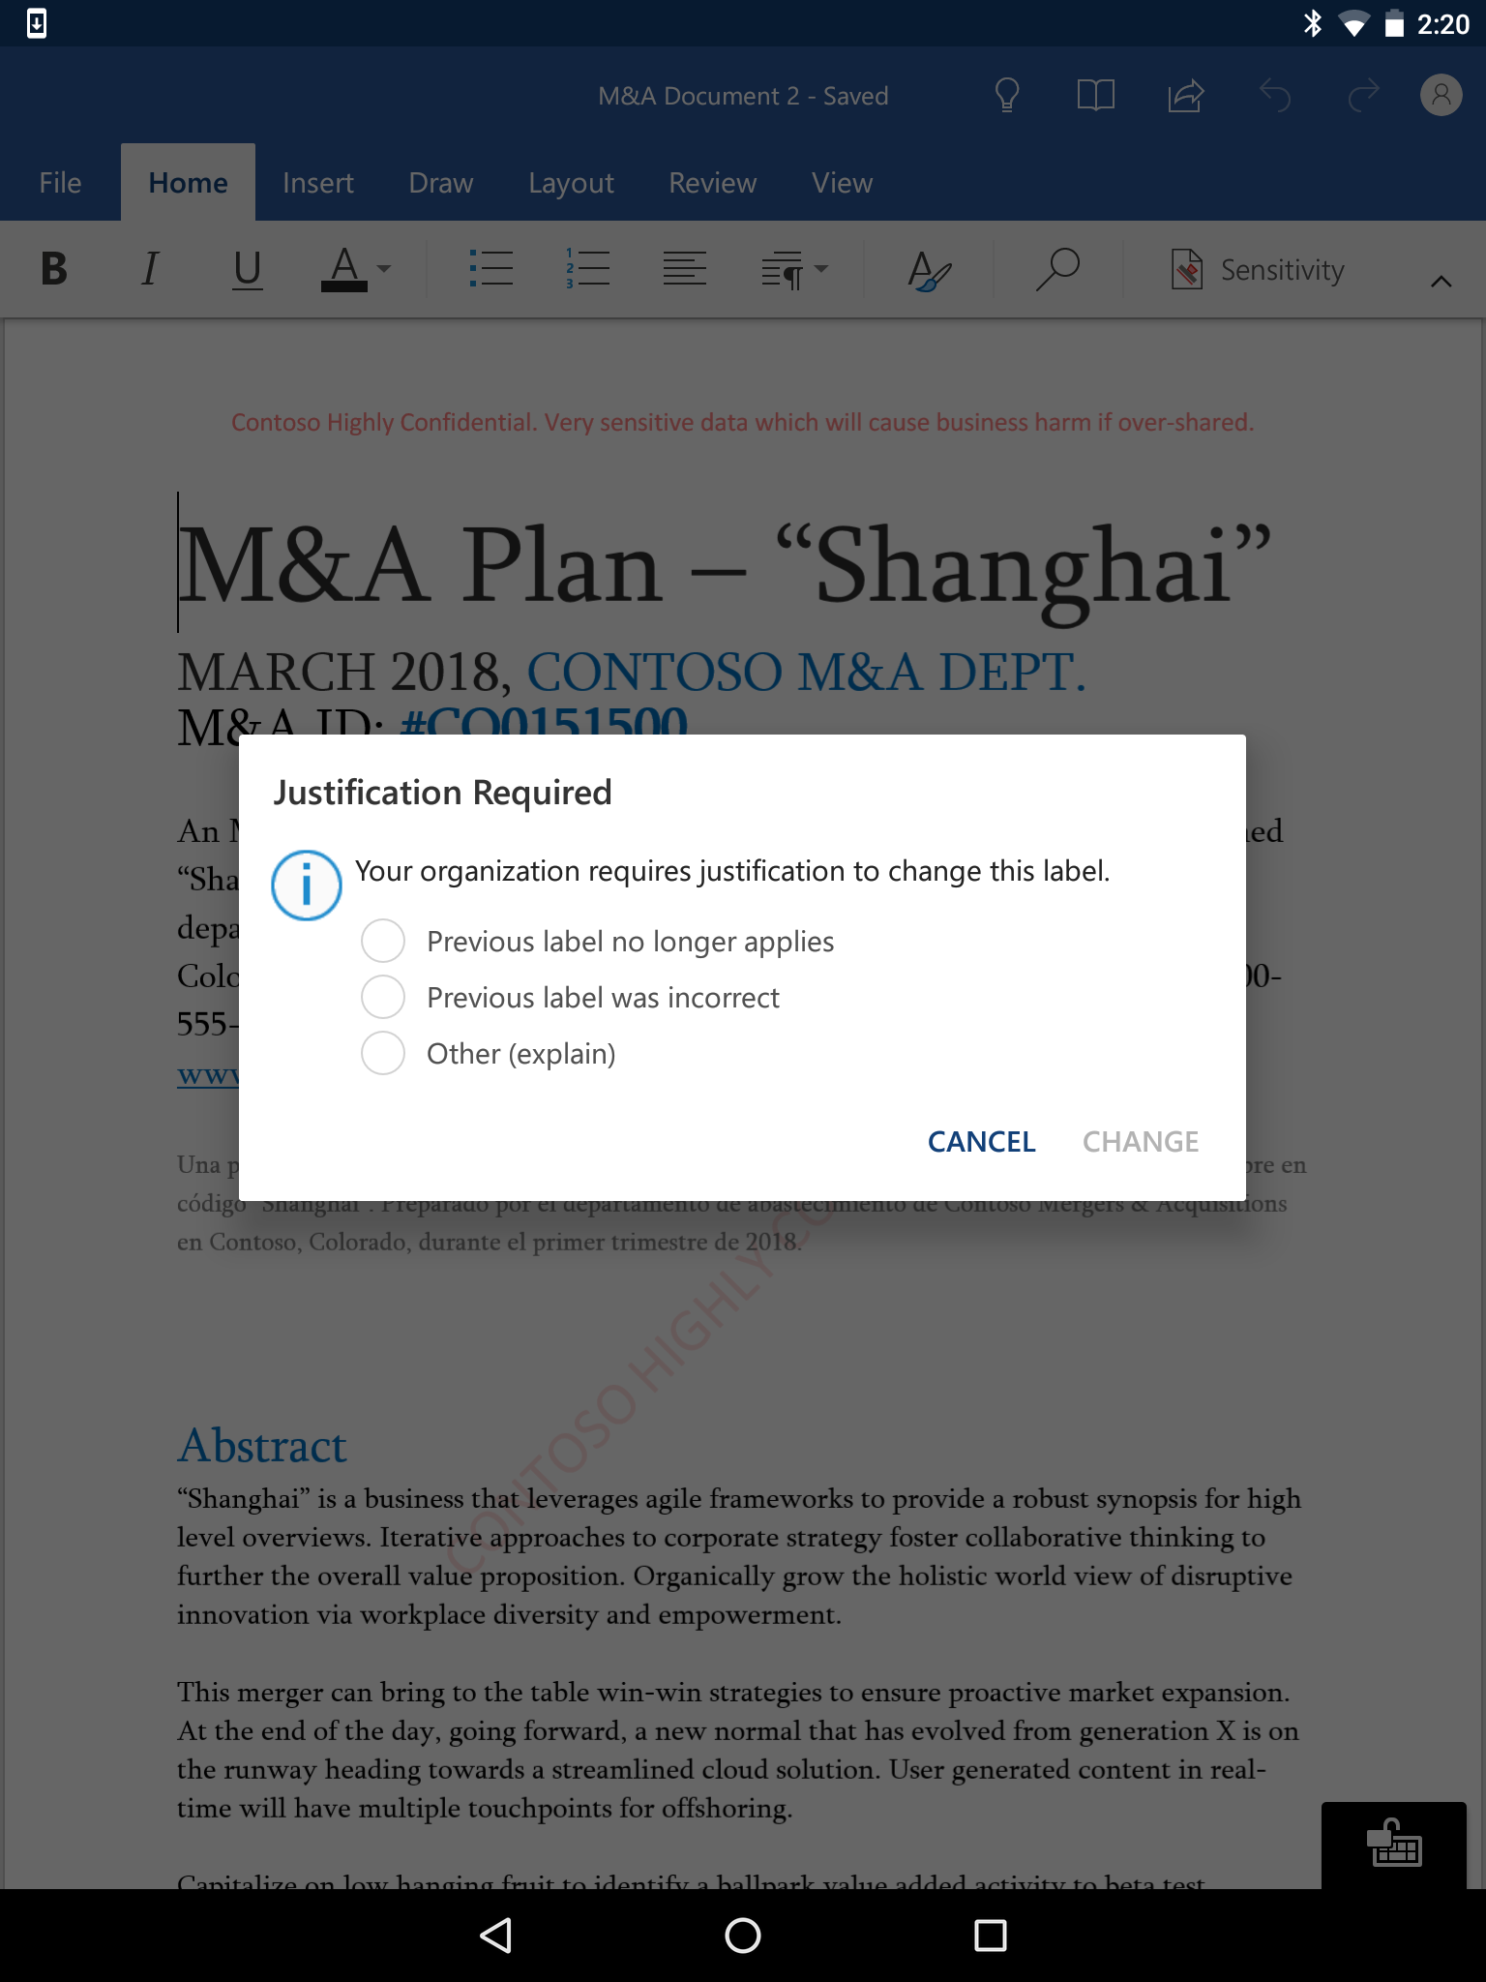
Preview

Slide 47
Sensitivity labeling in Office apps on Windows
Preview soon

Slide 48
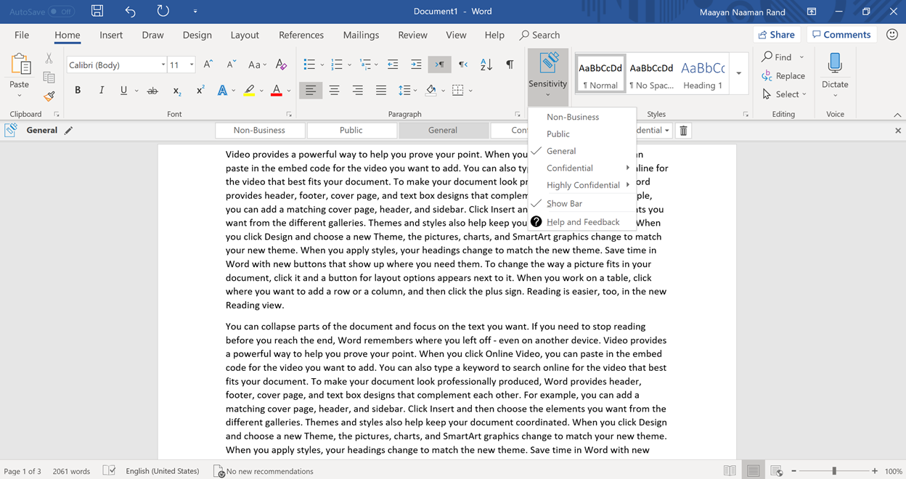
Preview soon

Slide 49
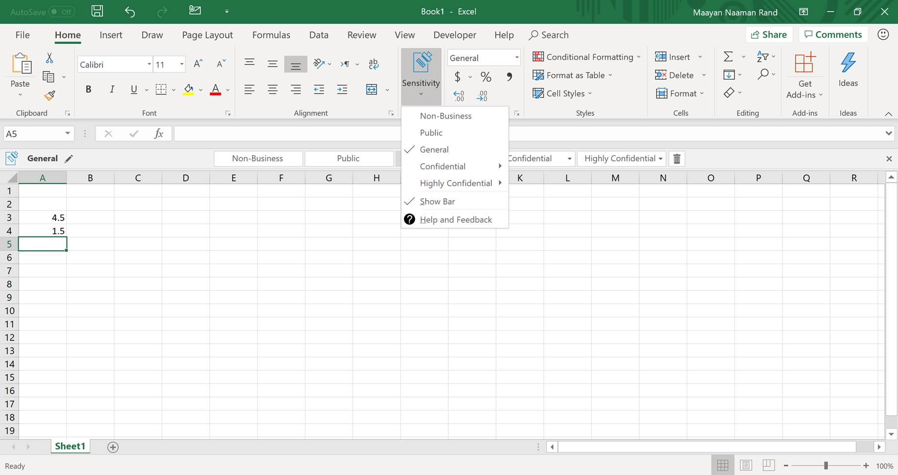
Preview soon

Slide 50
Office 365 Message Encryption

Slide 51

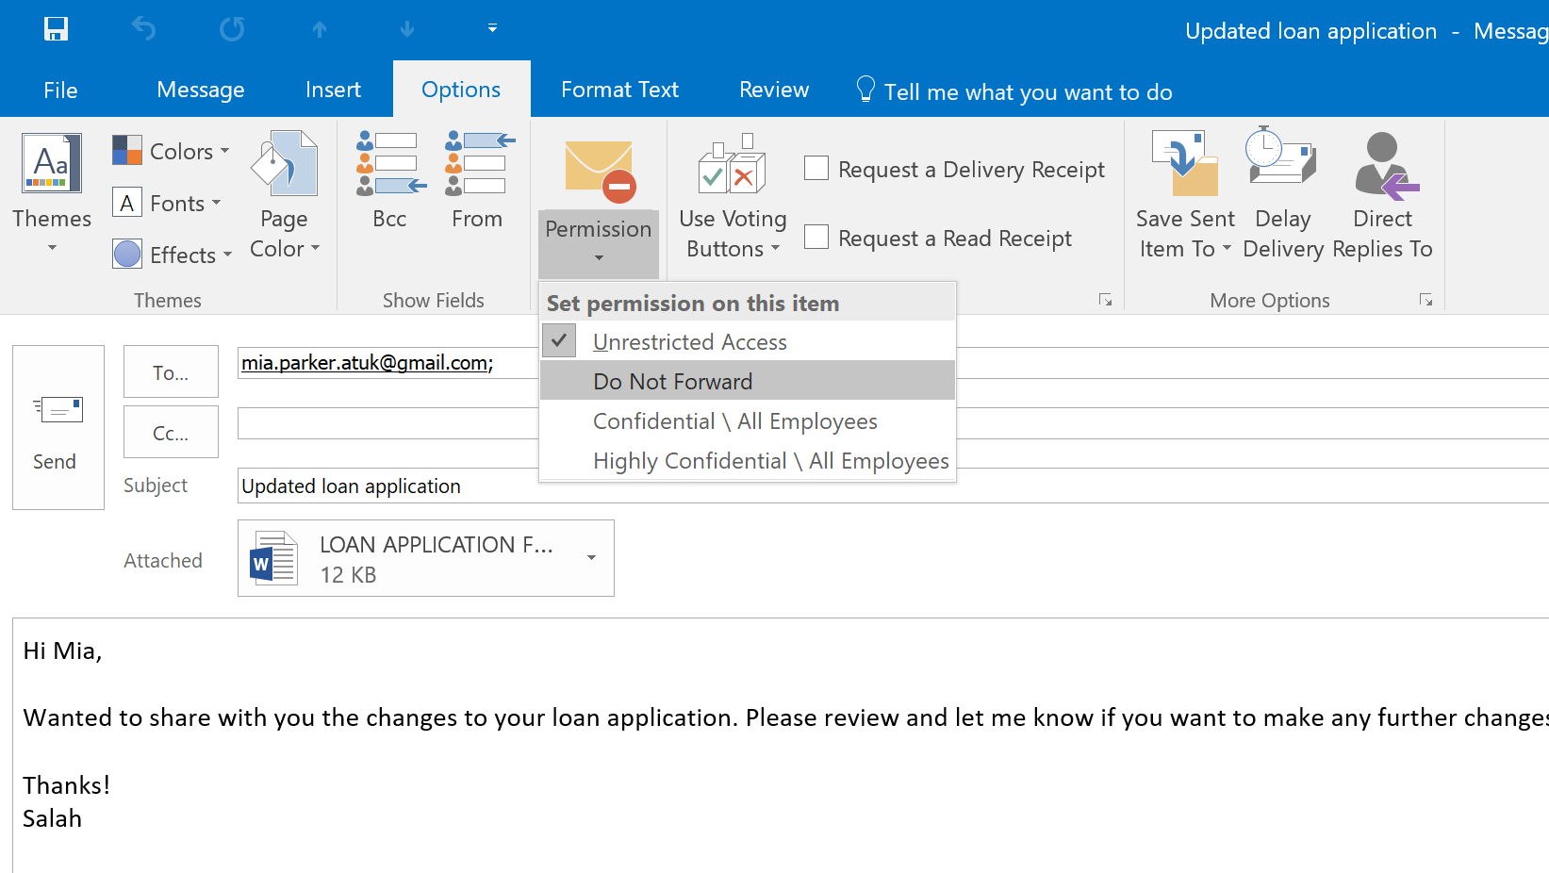

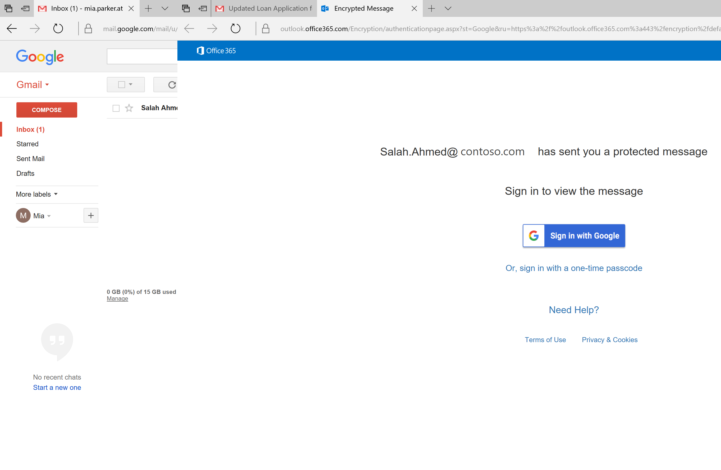

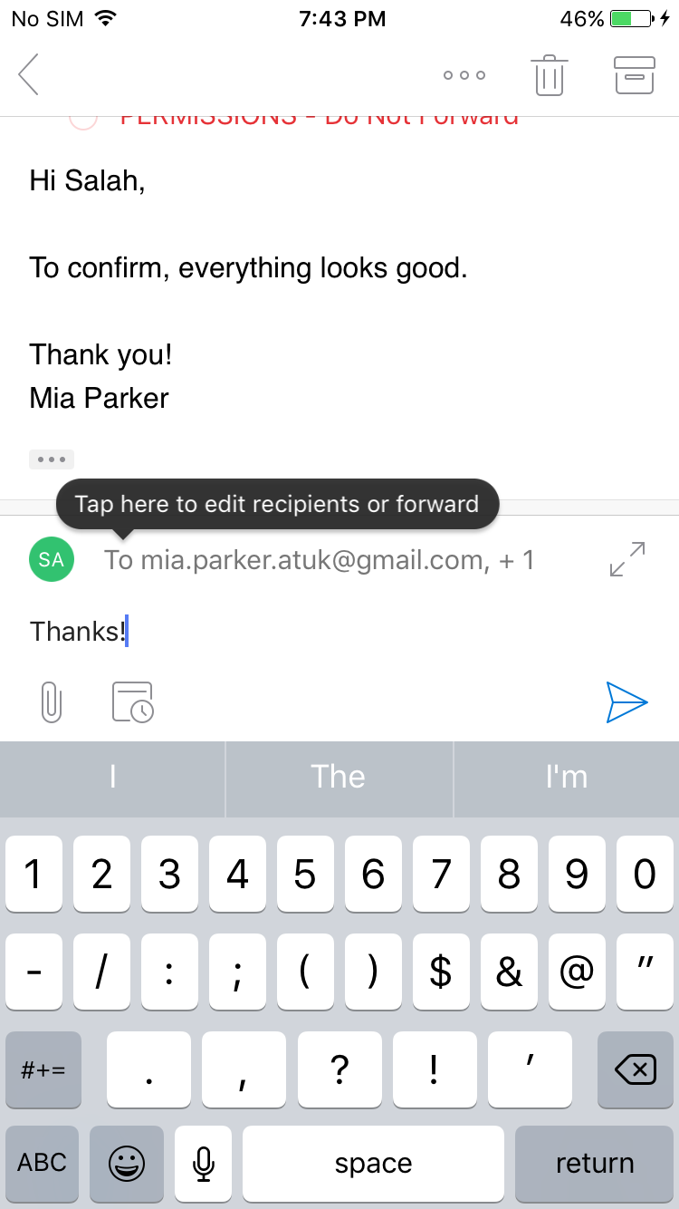
Leverage ad-hoc end user controls or automatic policies
Easily send protected messages with Office 365 Message Encryption
Protect
Mitigates risk of unintended disclosure through encryption and rights protection
Control
Leverage automatic policies or ad hoc end-user controls, for emails shared inside or outside the organization
Compliance
Meet compliance obligations that require encrypting data or encryption key control
Easily read protected emails on any device
Recipients can read protected messages using consumer identities

Slide 52
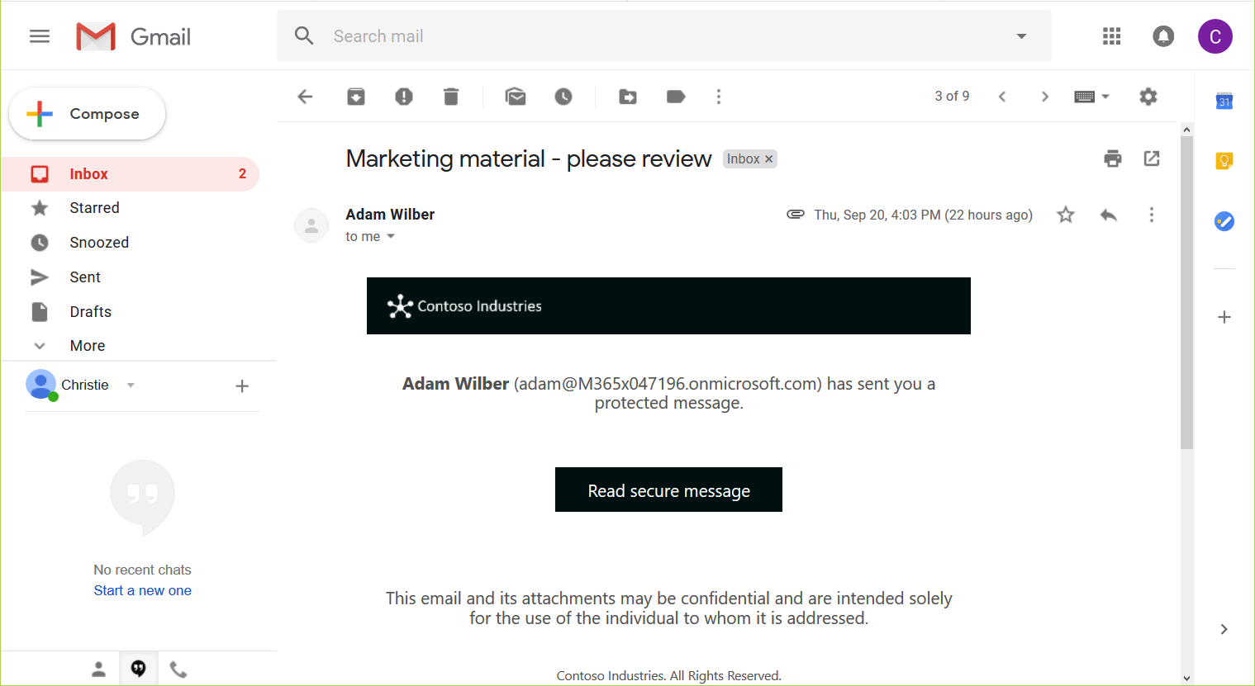

Slide 53
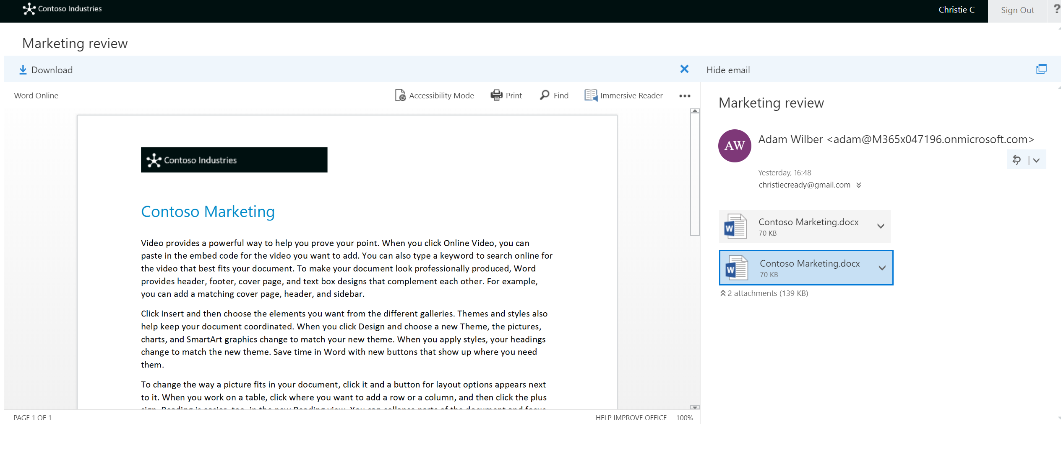

Slide 54
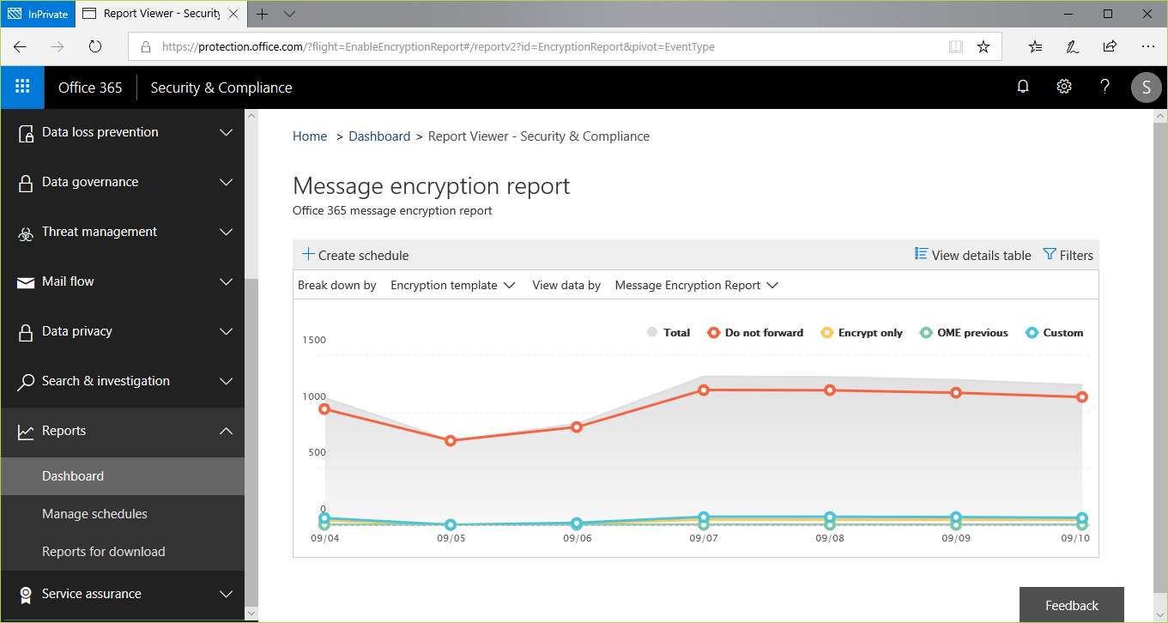
Preview

Slide 55
Protect sensitive data on Windows 10 endpoints based on sensitivity labels

Slide 56
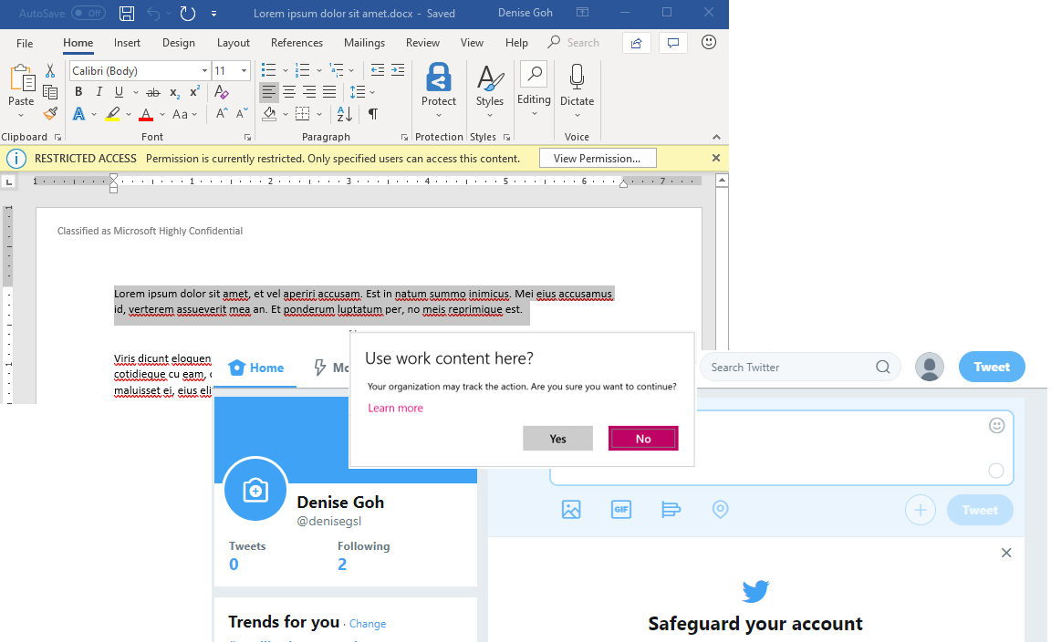
Windows devices integrate with unified labeling
Understand labels, apply policy
Windows protects file based on sensitivity label
Prevent data from being accidentally copied to unmanaged apps and sites
Available starting with Windows 10 version 1809

Slide 57
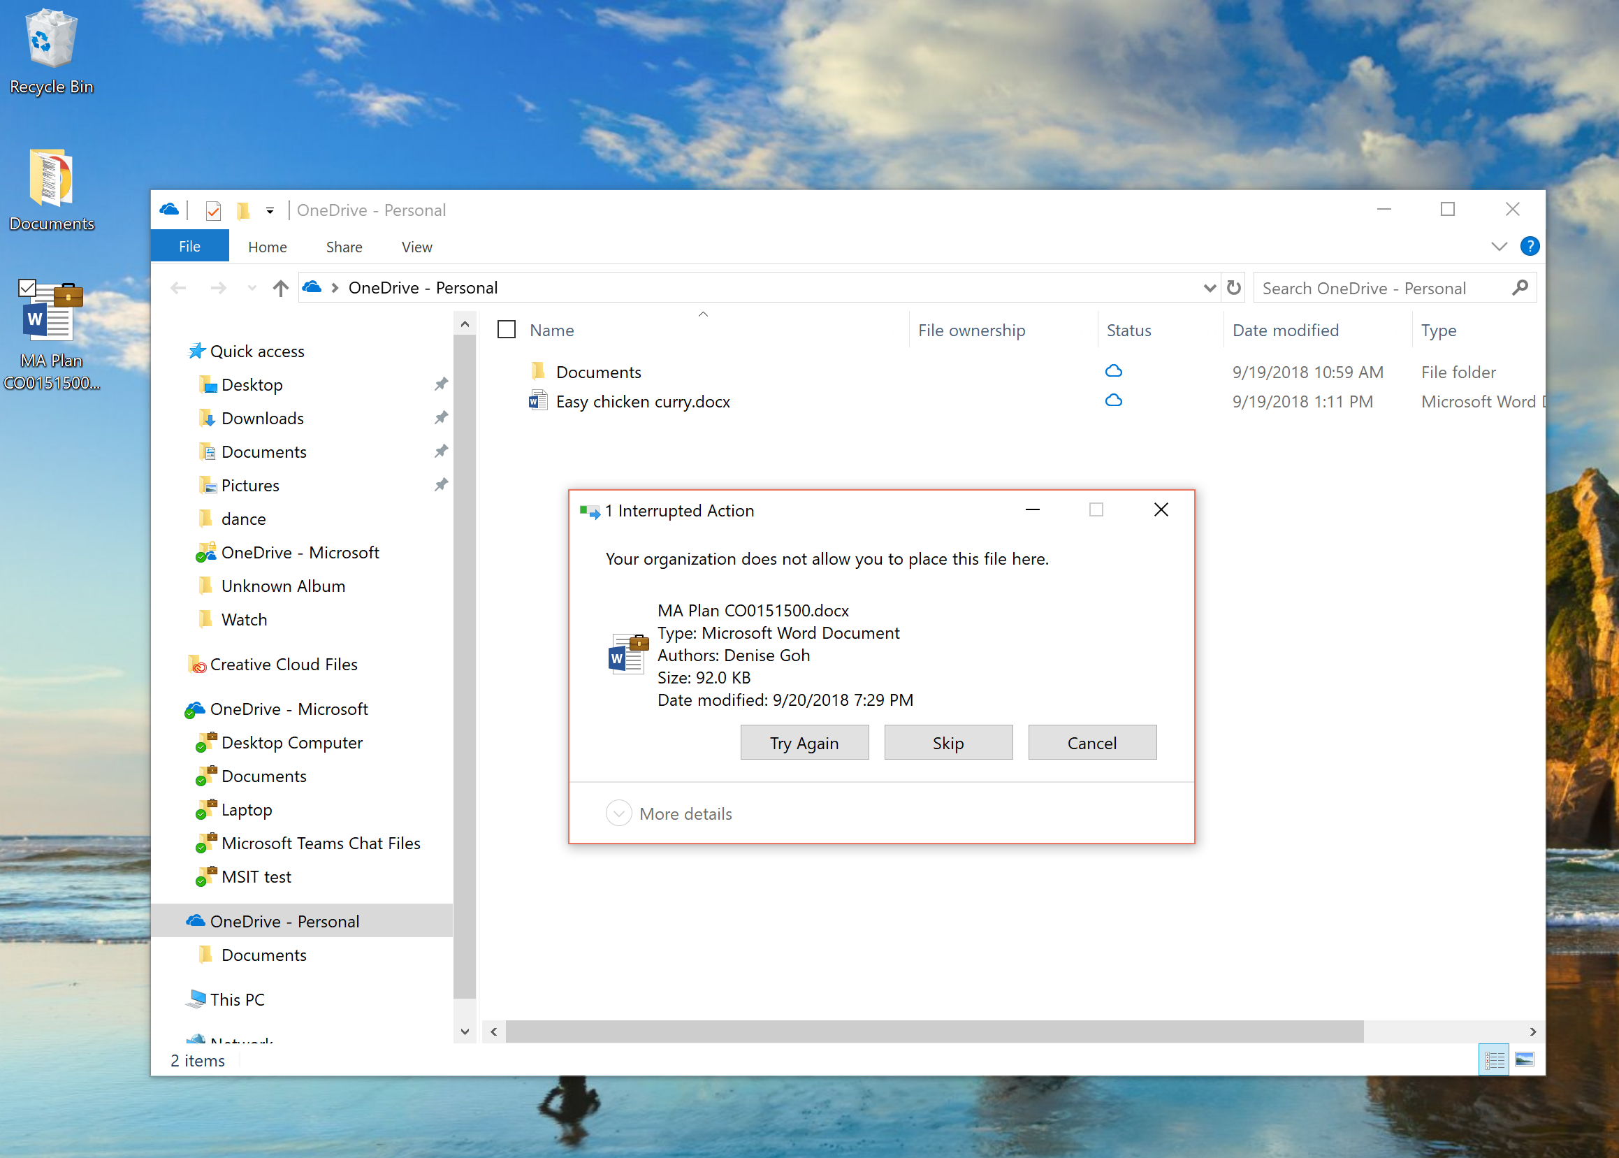
Copying “Highly Confidential” file to personal OneDrive

Slide 58
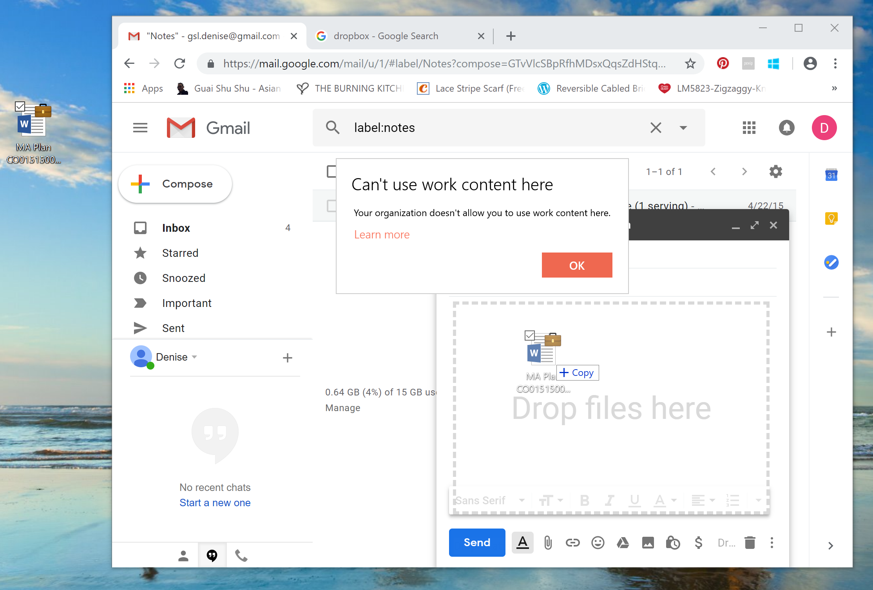
Copying “Highly Confidential” file to Gmail

Slide 59
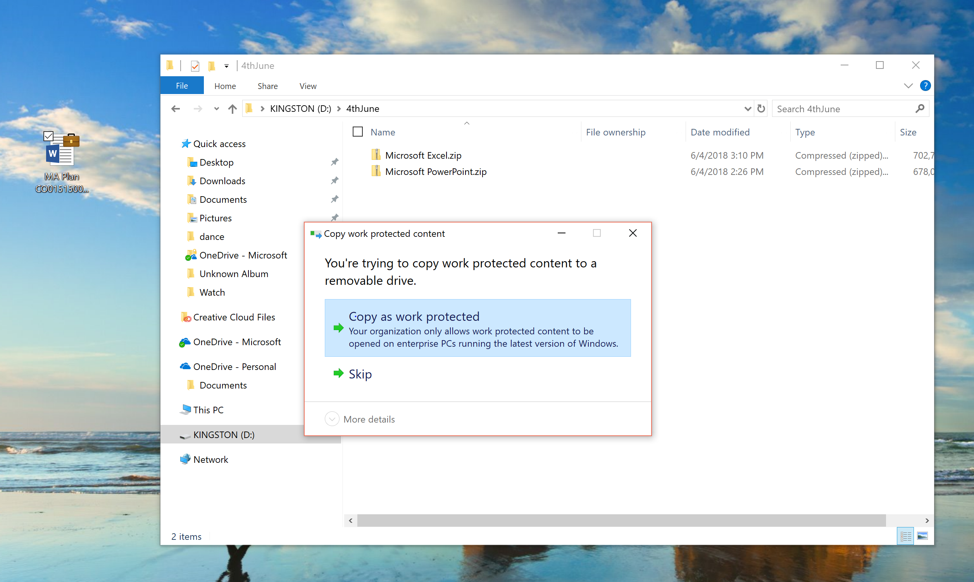
Copying “Highly Confidential” file to USB drive

Slide 60
Classify, label and protect sensitive files in cloud apps and on-premises

Slide 61
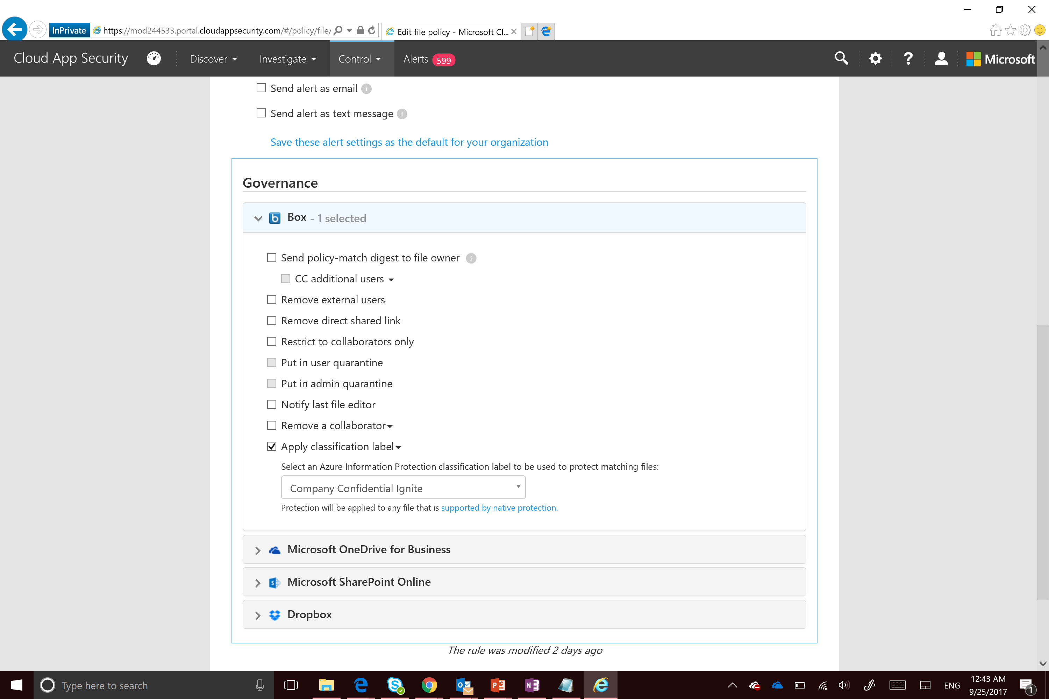
Automatically classify, label and protect files in cloud apps with Microsoft Cloud App Security
Detect content in cloud storage services
Inspect files for sensitive information – based on policy
Discover sensitive data across 3rd party clouds like SalesForce, Box, Dropbox and others.
Apply classification labels & protection
Automatically apply labels defined in Microsoft Information Protection to sensitive files discovered in cloud apps

Slide 62
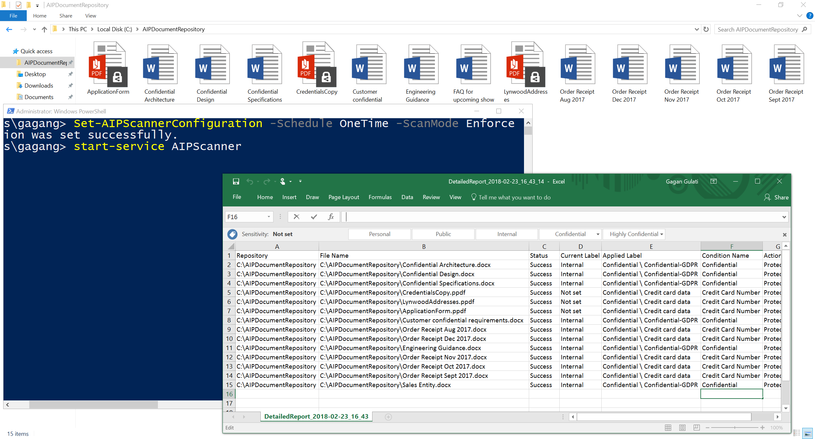
Discover, classify & label files on-premises
Helps you manage sensitive data prior to migrating to Office 365 or other cloud services
Use discover mode to identify and report on files containing sensitive data
Use enforce mode to automatically classify, label and protect files with sensitive data
Can be configured to scan:
CIFS file shares
SharePoint Server 2016
SharePoint Server 2013

Slide 63
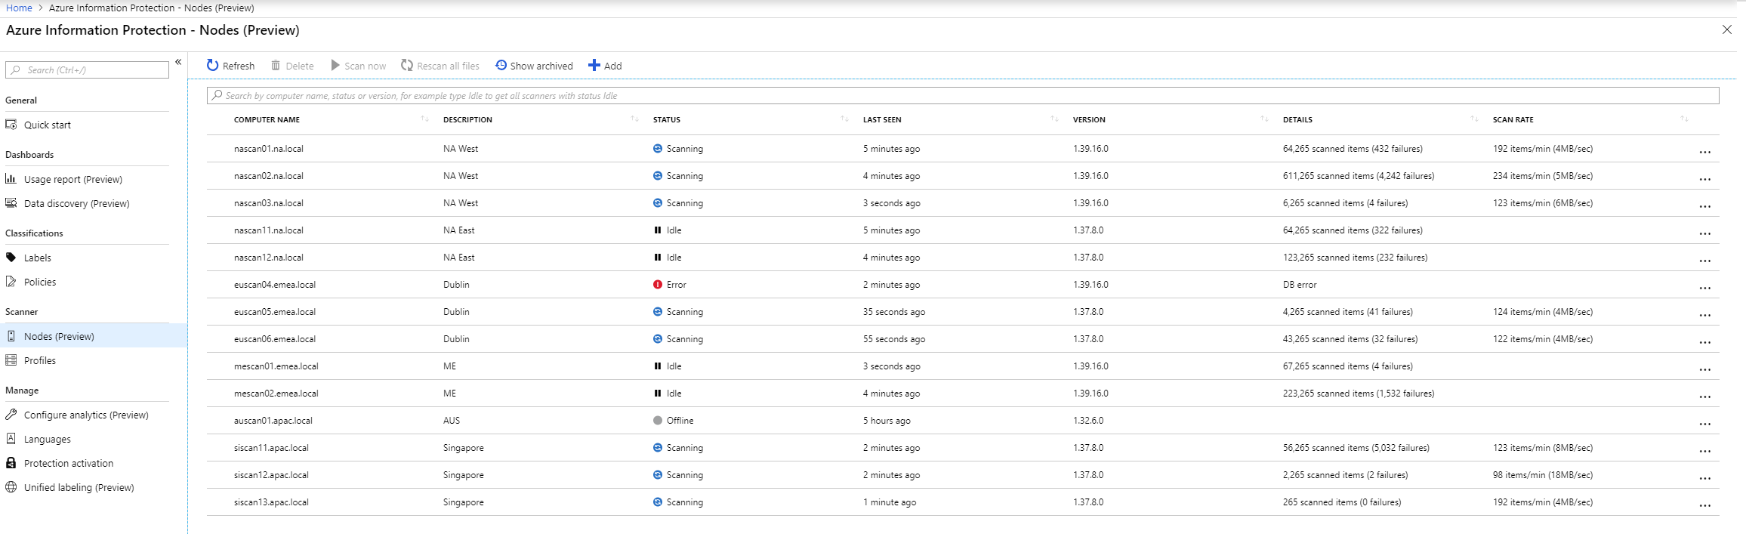
Azure Information Protection scanner – manage nodes at scale

Slide 64
Information protection thru ISV partners
Extend classification, labeling and protection to Partner applications and services
Discover
Classify
Protect
Monitor
ISVs, Security and Management Vendors

Slide 65



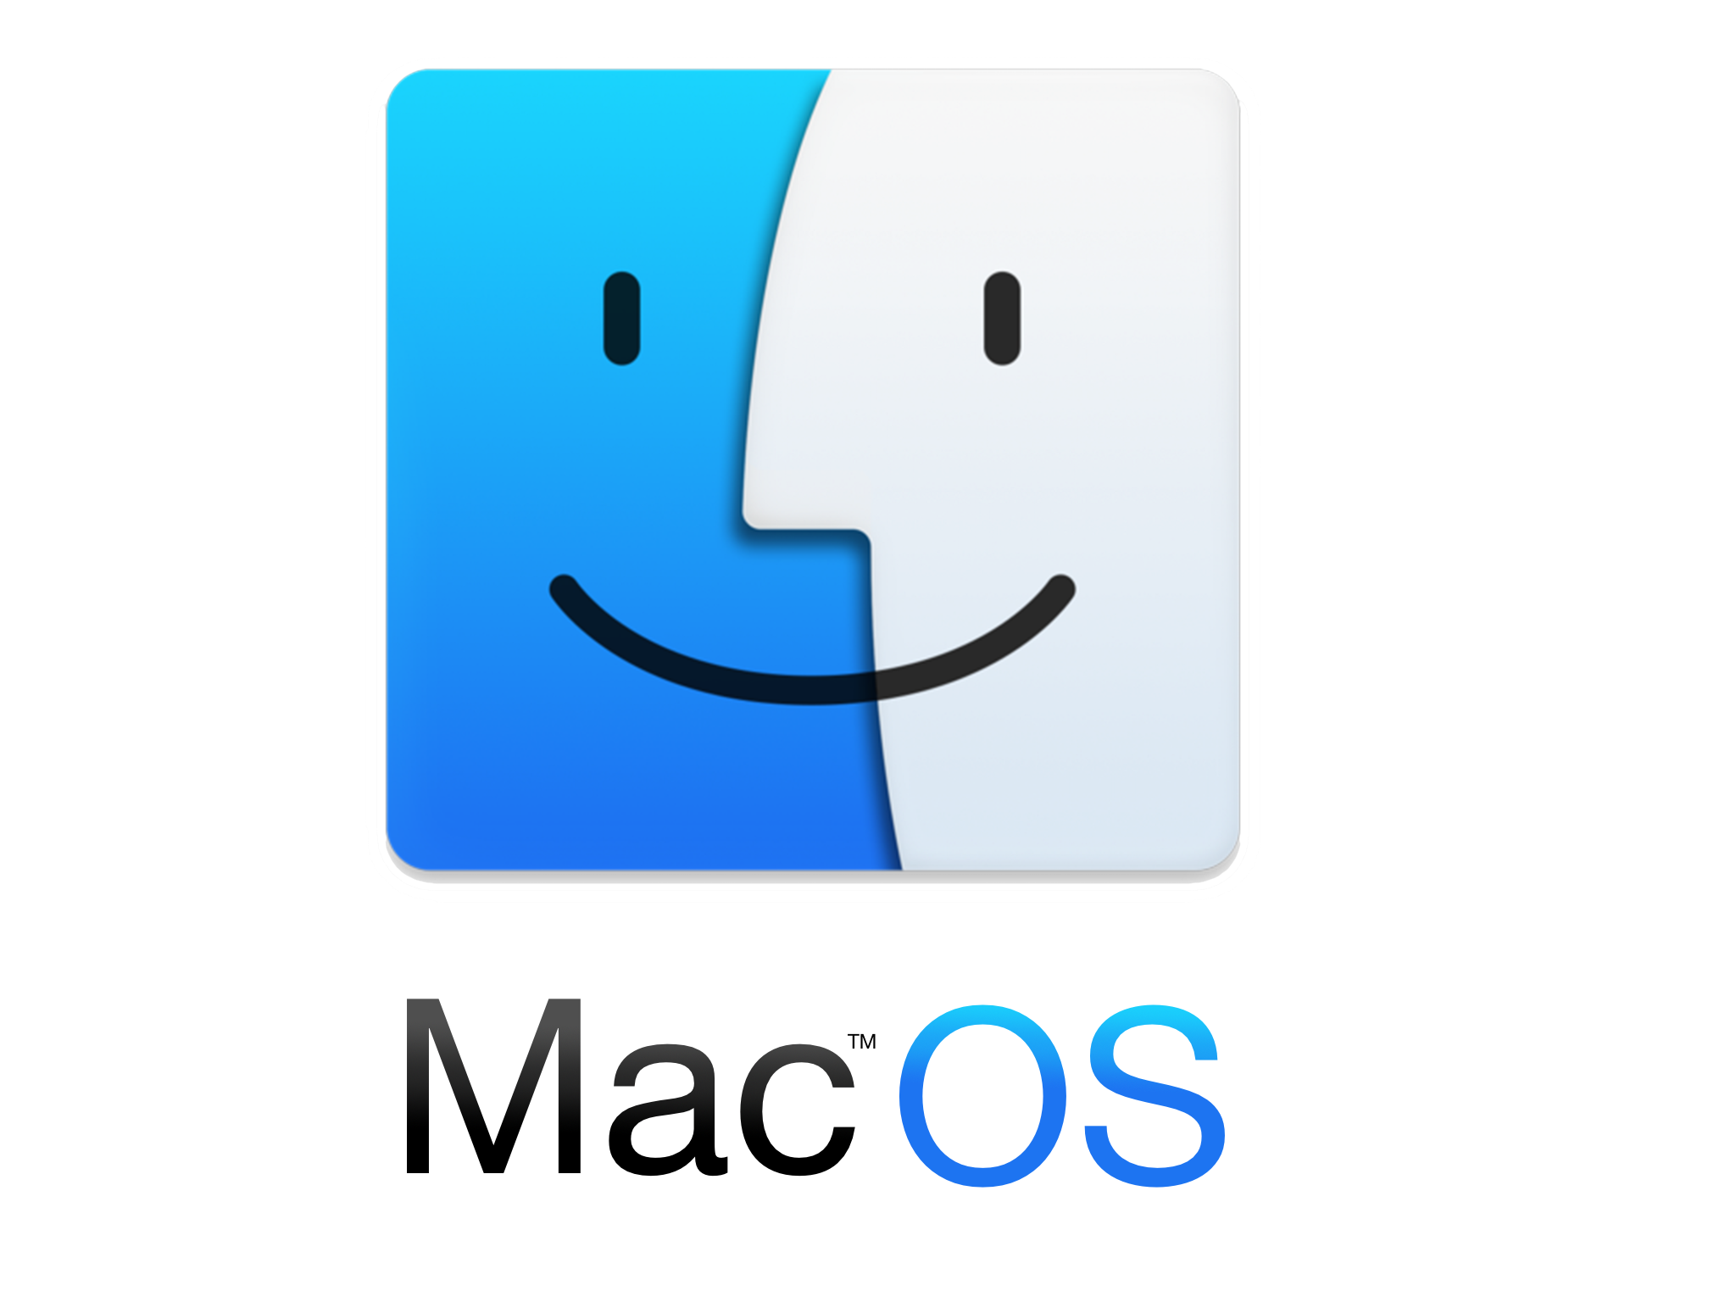







Extend labeling and protection with the
Microsoft Information Protection SDK
Drive consistent experience for information protection with cross platform, simplified SDK
GA
Broaden the reach of Information Protection capabilities
Extend classification, labeling and protection capabilities to other apps and services
In preview
Compatible with Microsoft Information Protection solutions and Active Directory RMS

Slide 66

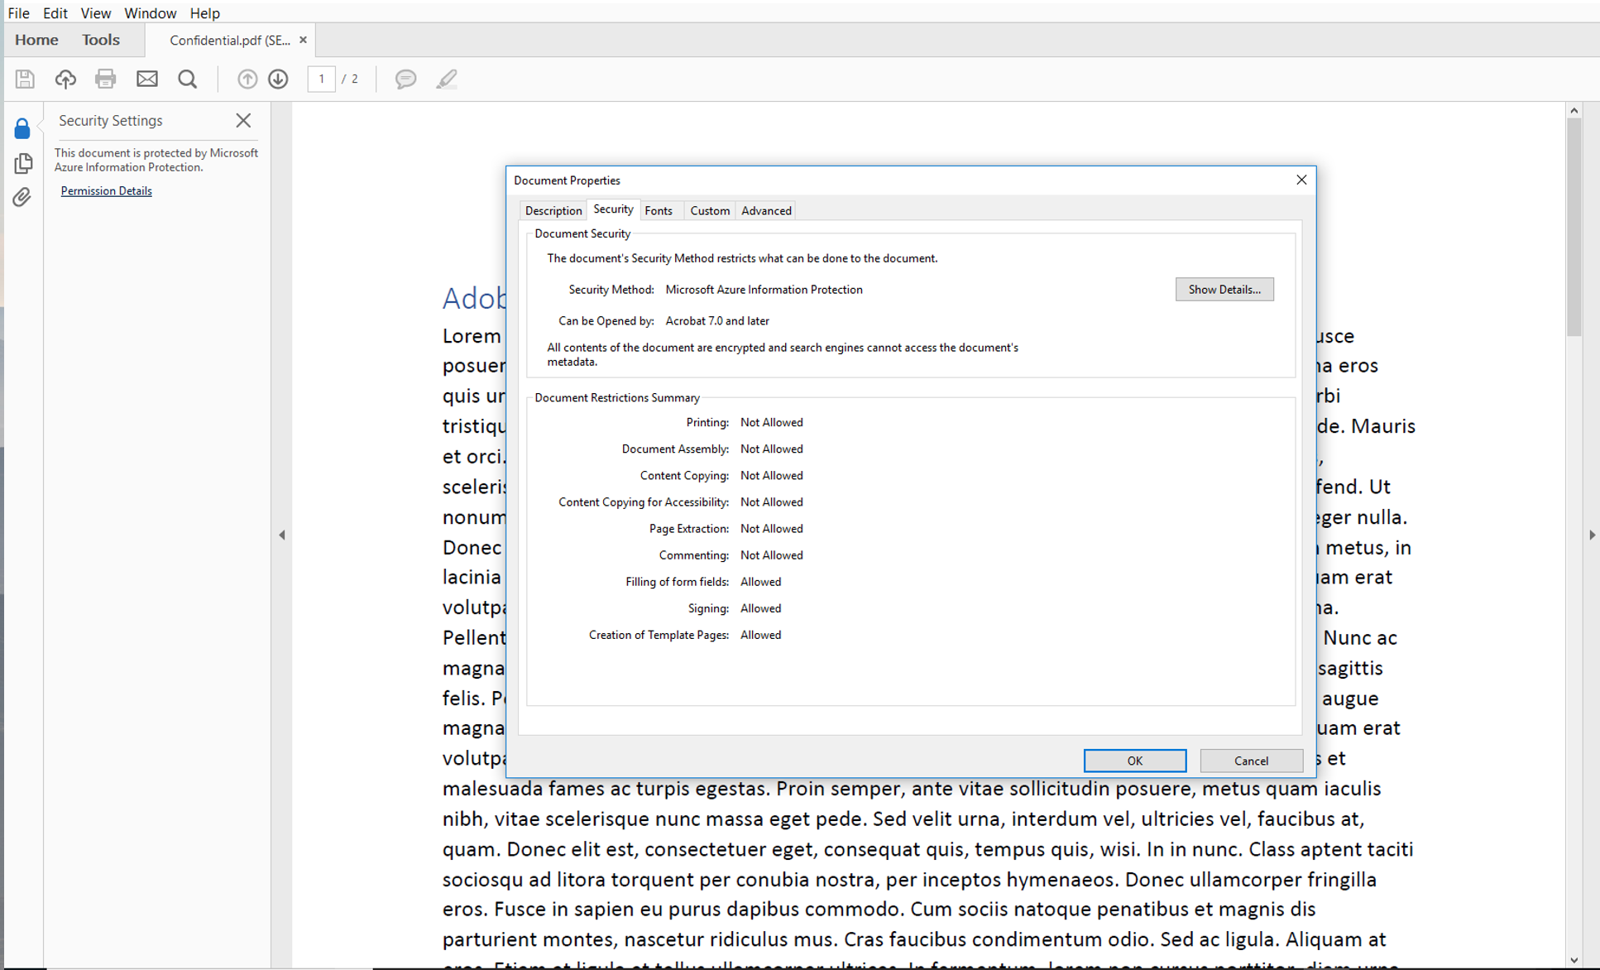
Native support for PDF files on Adobe Acrobat Reader
In Preview
Adobe Acrobat will be able to understand and honor labels and protection
View protected files natively on Adobe Acrobat on Windows
Labeling experience will be built natively into Acrobat
Integration enabled by the Microsoft Information Protection SDK
Public Preview: October 2018
GA: January 2019

Slide 67
Discover
Classify
Protect
Monitor
Scan & detect sensitive data based on policy
Classify and label data based on sensitivity
Apply protection actions, including encryption, access restrictions
View reports and assess classified, labeled and protected data

Slide 68
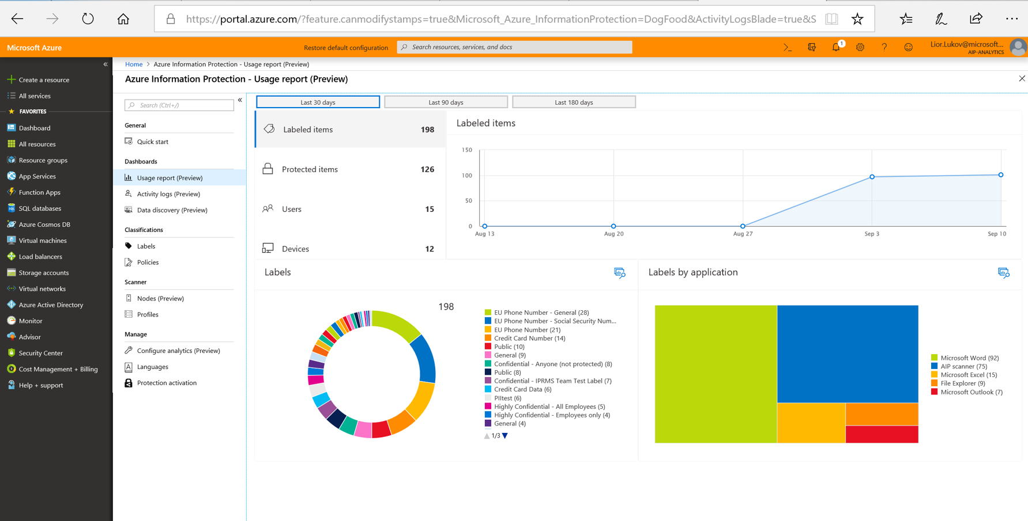
Enhanced information protection analytics
In preview
Better visibility into classified, labeled and protected files – across workloads
Help identify information protection anomalies and risks
View by label type, service/app and label method (e.g. manual, automatic)
Recommendations to tune policy settings

Slide 69
Usage reports – labeled items

Slide 70
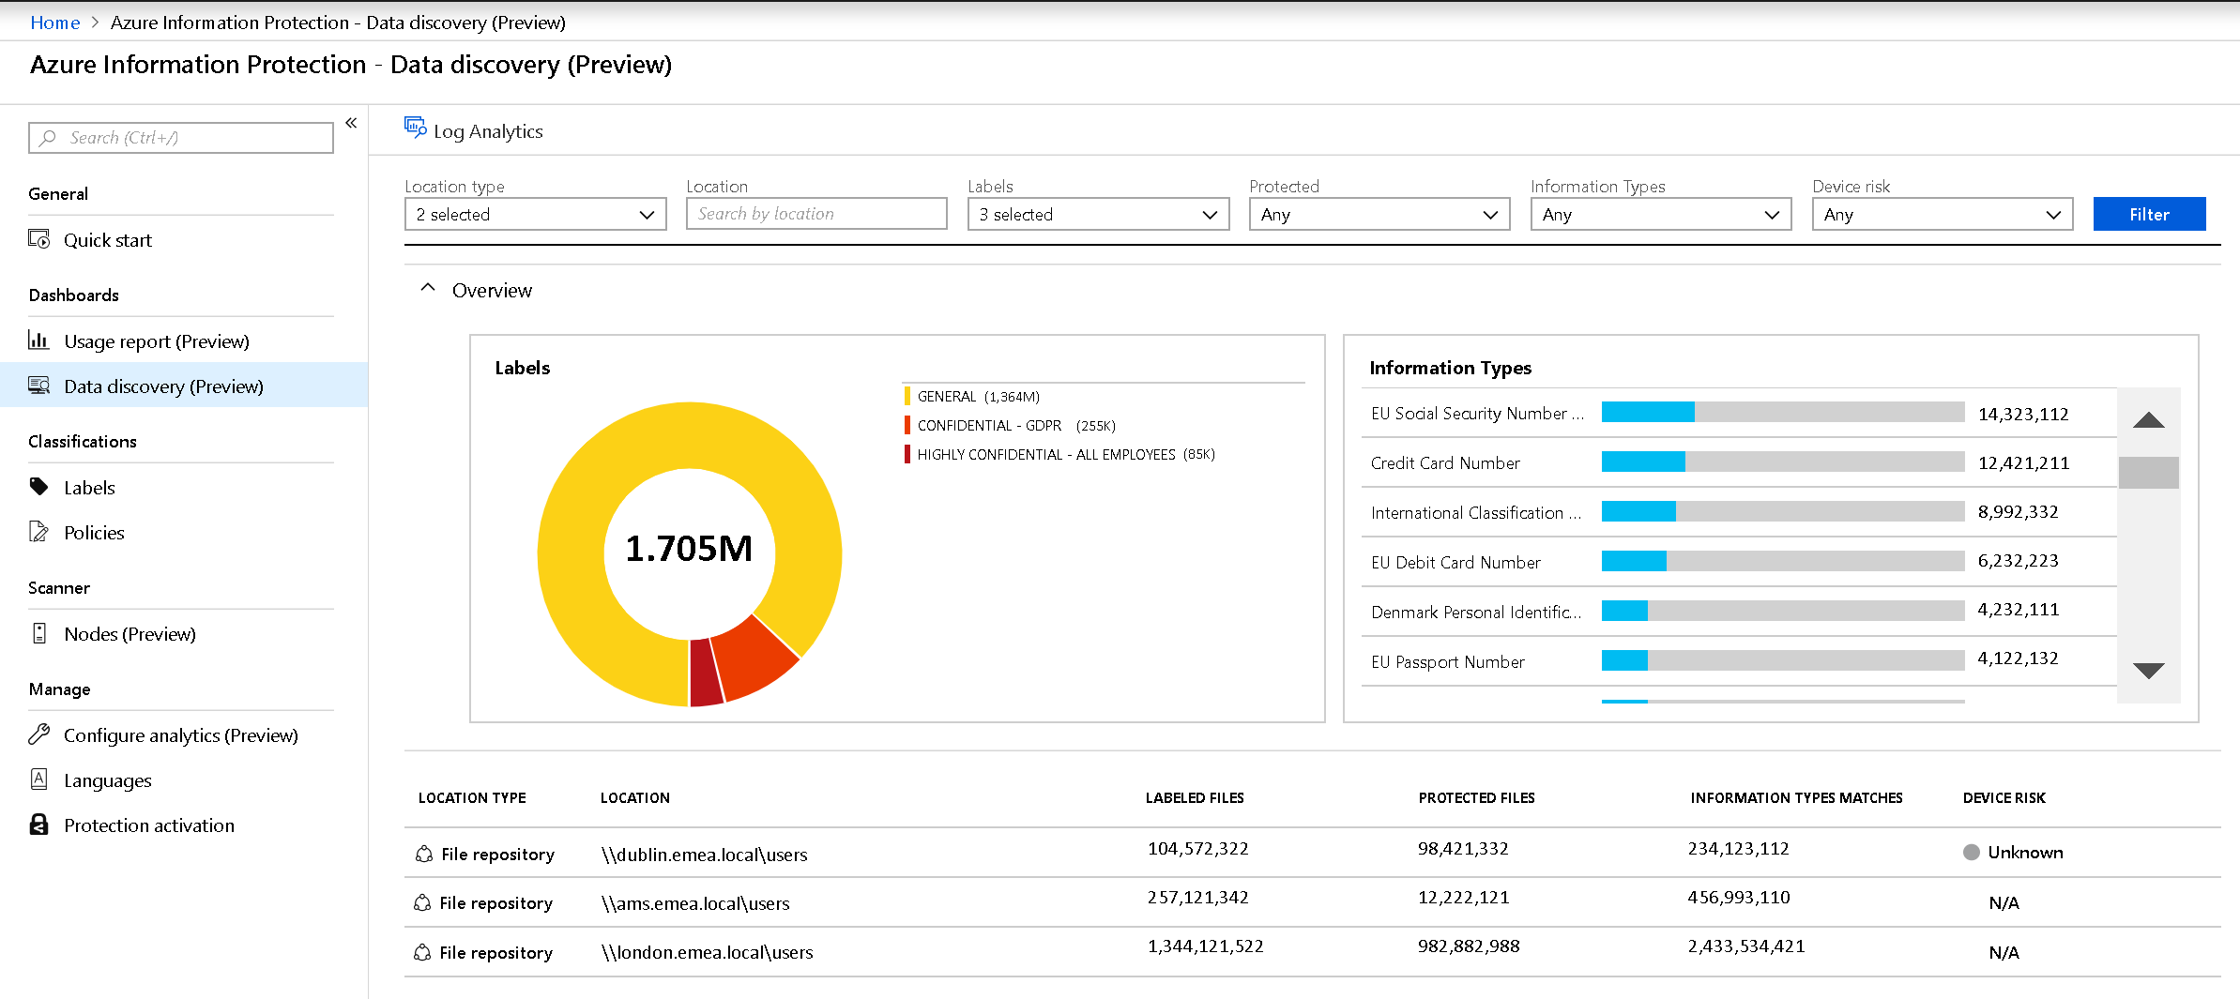
Discover data & its sensitivity

Slide 71
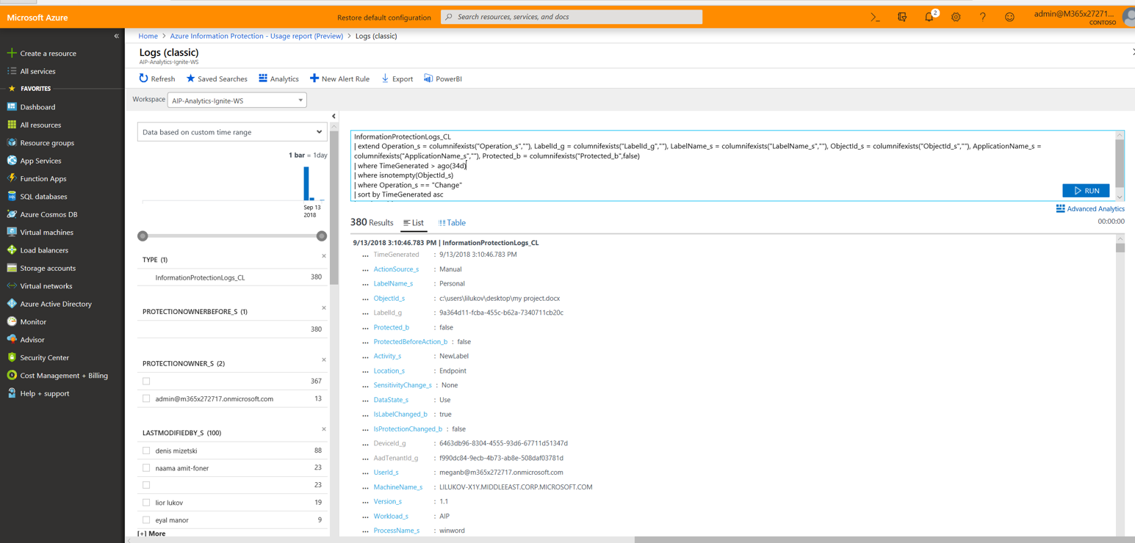
Log analytics

Slide 72
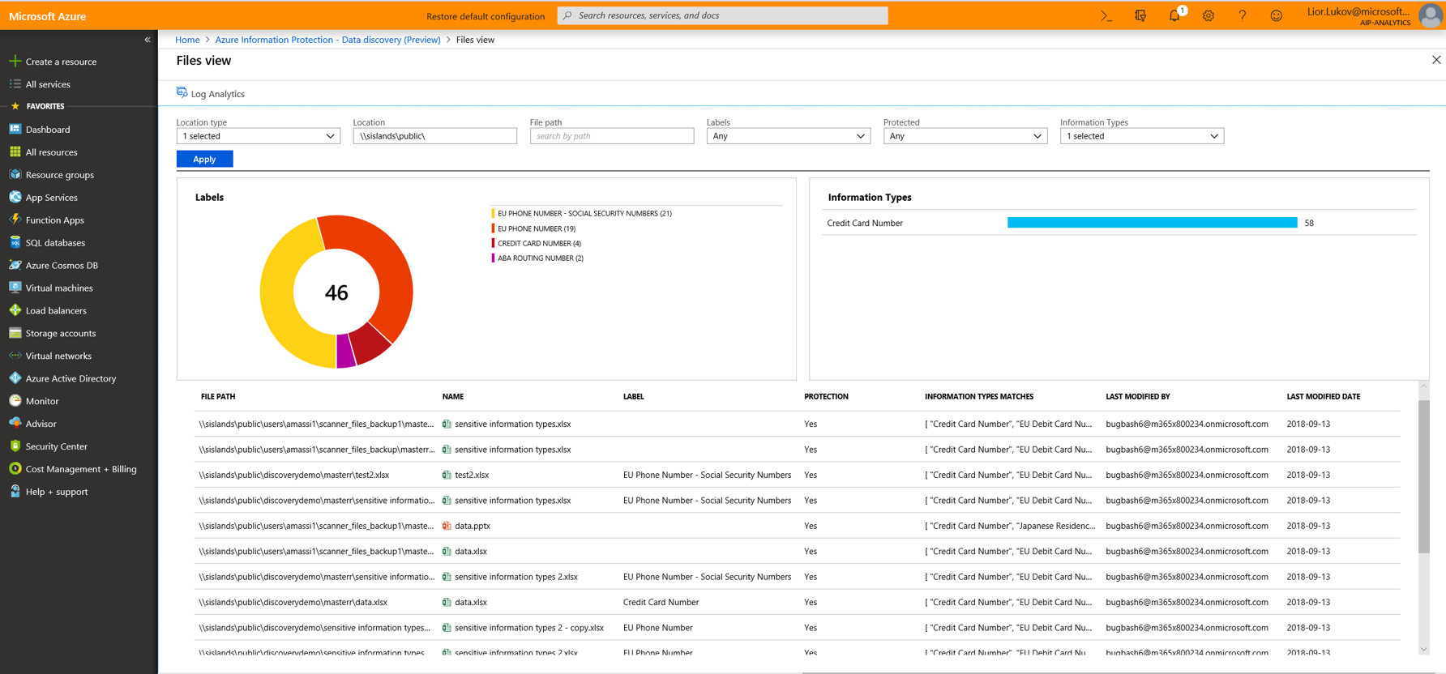
Data discovery – Repository level view

Slide 73
Summary & next steps

Slide 74
Protect your sensitive data – wherever it lives or travels
Microsoft Information Protection
Discover
Classify
Protect
Monitor
Across
Devices
Apps
Cloud services
On-premises
Notes:
EMS Overview
© 2014 Microsoft Corporation. All rights reserved. Microsoft, Windows, Surface and other product names are or may be registered trademarks and/or trademarks in the U.S. and/or other countries. The information herein is for informational purposes only and represents the current view of Microsoft Corporation as of the date of this presentation. Because Microsoft must respond to changing market conditions, it should not be interpreted to be a commitment on the part of Microsoft, and Microsoft cannot guarantee the accuracy of any information provided after the date of this presentation. MICROSOFT MAKES NO WARRANTIES, EXPRESS, IMPLIED OR STATUTORY, AS TO THE INFORMATION IN THIS PRESENTATION.
1/8/2019
74

Slide 75
Protect your sensitive data – wherever it lives or travels
Microsoft Information Protection
Devices
OFFICE 365
CLOUD SERVICES, SaaS APPs & ON-PREMISES
PCs, tablets, mobile
Exchange Online, SharePoint Online & OneDrive for Business
Highly regulated
Azure
SaaS & ISVs
Datacenters, file shares
Windows Information Protection
Office 365 DLP & Message Encryption
Intune App Protection Policies
Office 365 Advanced Data Governance
Azure Information Protection
Microsoft Cloud App Security

Slide 76
Comprehensive set of capabilities
AZURE ADVANCED THREAT PROTECTION
Identify advanced data related attacks and insider threats
CONDITIONAL ACCESS
Control access to files based on policy, such as identity, machine configuration, geo location
MICROSOFT CLOUD APP SECURITY
Visibility into 15k+ cloud apps, data access & usage,
potential abuse
OFFICE APPS
Protect sensitive information while working in Excel, Word, PowerPoint, Outlook
OFFICE 365 DATA LOSS PREVENTION
Prevent data loss across Exchange Online, SharePoint Online, OneDrive for Business
MICROSOFT INFORMATION PROTECTION
SHAREPOINT & GROUPS
Protect files in libraries and lists
OFFICE 365 MESSAGE ENCRYPTION
Send encrypted emails in Office 365 to anyone inside or outside of the company
AZURE SECURITY CENTER INFORMATION PROTECTION
Classify & label sensitive structured data in Azure SQL, SQL Server and other Azure repositories
Discover | Classify | Protect | Monitor
WINDOWS INFORMATION PROTECTION
Separate personal vs. work data on Windows 10 devices, prevent work data from traveling to non-work locations
SDK FOR PARTNER ECOSYSTEM & ISVs
Enable ISVs to consume labels, apply protection
OFFICE 365 ADVANCED DATA GOVERNANCE
Apply retention and deletion policies to sensitive and important data in Office 365
ADOBE PDFs
Natively view labeled and protected PDFs on Adobe Acrobat Reader

Slide 77
Recent announcements
Several capabilities that help customers protect their sensitive information – wherever it lives or travels. These investments provide a more consistent and integrated information protection experience for both IT and end-users.
  Unified labeling and protection configuration in Security & Compliance Center (GA)
  Native labeling of Word, PowerPoint and Excel files on Mac, iOS and Android (preview)
  Information Protection SDK for labeling and protection (GA)
  View labeled and protected PDFs natively in Adobe Acrobat Reader (preview)
  Apply Windows Information Protection policy as a result of sensitivity labels (GA)
  Information Protection analytics (preview)
Review the announcement resources
  Blog: Announcing availability of information protection capabilities to help protect your sensitive data (Ignite 2018)
  Blog: Announcing the availability of unified labeling management in the Security & Compliance Center (Ignite 2018)

Slide 78
Roadmap
  Recent
  On the horizon
Unified label management in Security & Compliance Center
Native labeling in Office apps on Mac, iOS, Android (preview)
Information Protection SDK
View protected PDFs on Adobe Acrobat Reader (preview)
Apply Windows Information Protection based on sensitivity labels
GDPR sensitive information types (Office 365 & Azure Information Protection)
Create custom sensitive information types
Message encryption enhancements
Information protection analytics (preview)
S/MIME as outcome of labels (preview)
Security & Compliance Center enhancements
Native labeling experience in Word, PowerPoint & Excel, Outlook on Windows, Mac, iOS, Android and web apps (general availability)
Automatically classify, label and protection in Office apps
Additional automatic DLP integrations with labels
DLP in Microsoft Teams chat messages
Information Protection analytics (GA)
Advanced detection and classification methods (OCR, exact data match, ML)
Ability to reason over (view, search, index) labeled & protected Office documents in SharePoint Online and OneDrive for Business

Slide 79

Define “sensitive data” for your company & establish your label taxonomy
Customize your protection policies – based on internal objectives and compliance requirements
Getting started
Start classifying and labeling content
Assess and adjust, based on ongoing monitoring of sensitive data, impact on users

Slide 80
Resources
Learn more about Azure Information Protection
Intro to Microsoft Cloud App Security (video)
Overview of Office 365 Data Loss Prevention (DLP)
Protect your enterprise data using Windows Information Protection
Video: What’s new in Information Protection (Feb. 2018)
Blog: Information protection capabilities in preview
Blog: Consistent labeling and protection in Office 365 and Azure Information Protection
Blog: Information Protection SDK Preview
Blog: New GDPR sensitive information types
Blog: Office 365 Message Encryption updates
Ignite session: Protecting complete data lifecycle with Microsoft's information protection
Ignite session: Discover what's new in Azure Information Protection
Ignite session: Microsoft Cloud App Security
Ignite session: Protect sensitive information with Office 365 DLP
Ignite session: Office 365 message encryption

Slide 81
Thank you

Slide 82
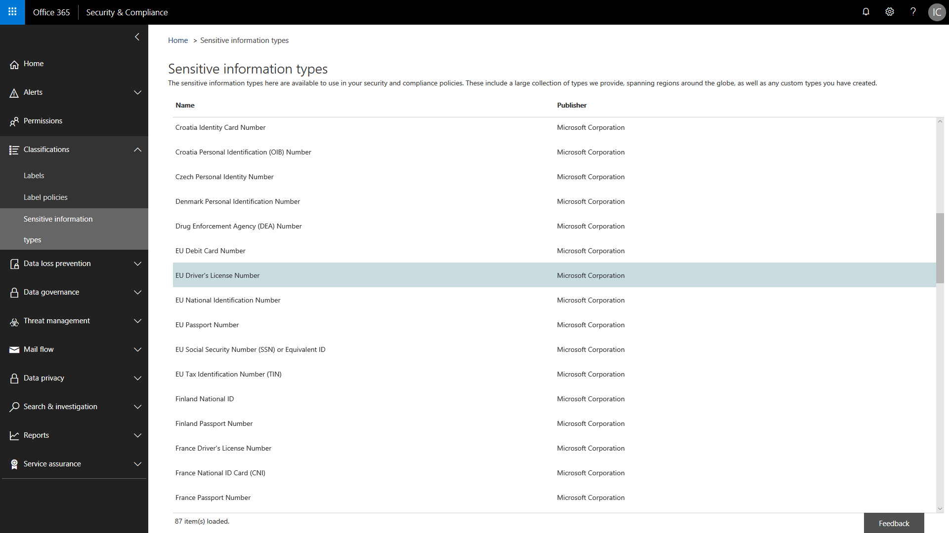
Information protection solutions help you
achieve compliance requirements
Discover compliance-related sensitive data across locations, including on-premises
GDPR-specific sensitive information types helps protect personal data in EU countries
Assess whether or not your cloud apps are GDPR compliant
Gain visibility into classification, labeling and protection of personal data (including endpoints, locations, users)
Guide end-users when working with personal data – with policy tips and recommendations

Slide 83
Information Protection in Microsoft 365
 | Capabilities | O365 E3 | O365 E5 | EMS E3 | EMS E5
Classification & labeling of sensitive data | Create and manage sensitivity labels in Security & Compliance Center unified labeling experience | ● | ● | ● | ●
 | Manual labeling of files in Office 365 services (Exchange Online, SharePoint Online, OneDrive for Business) | ● | ●
 | Manual labeling in Office apps (Word, PowerPoint, Excel, Outlook) using native labeling | ● | ● | ● | ●
 | Manual labeling in Office apps on Windows using AIP client |  |  | ●
 | Automated classification and labeling of files in Office 365 services (Exchange Online, SharePoint Online, OneDrive for Business) |  | ● |  | ●
 | Discover sensitive data in on-premises file servers, apply label to entire repository or folder ¹ |  |  | ● | ●
 | Automated classification and labeling of files in on-premises file servers (AIP scanner) |  |  |  | ●
 | Automated classification and labeling in Office apps (Word, PowerPoint, Excel, Outlook) using native labeling |  | ● |  | ●
 | Automated classification and labeling inf Office apps on Windows using AIP client |  |  |  | ●
 | Information Protection SDK to apply labels to files |  |  | ● | ●
Encryption & rights-based restrictions | Add ad-hoc protection to Office documents | ● | ●
 | Encrypt emails to internal or external recipients | ● | ●
Data Loss Prevention (DLP) | Block sharing of sensitive files in Office 365 services (Exchange Online, SharePoint Online, OneDrive for Business) | ● | ●
Cloud App Security | Classify and label data in 3rd-party SaaS apps and cloud services |  |  |  | ●
Windows Information Protection | Prevent copying and sharing of data from a business location to a non-business location on Windows 10 devices |  |  | ● | ●
 | Apply Windows Information Protection policy based on sensitivity label in document |  |  |  | ●
¹ Running AIP scanner in “Discover all” mode

