Slide 1
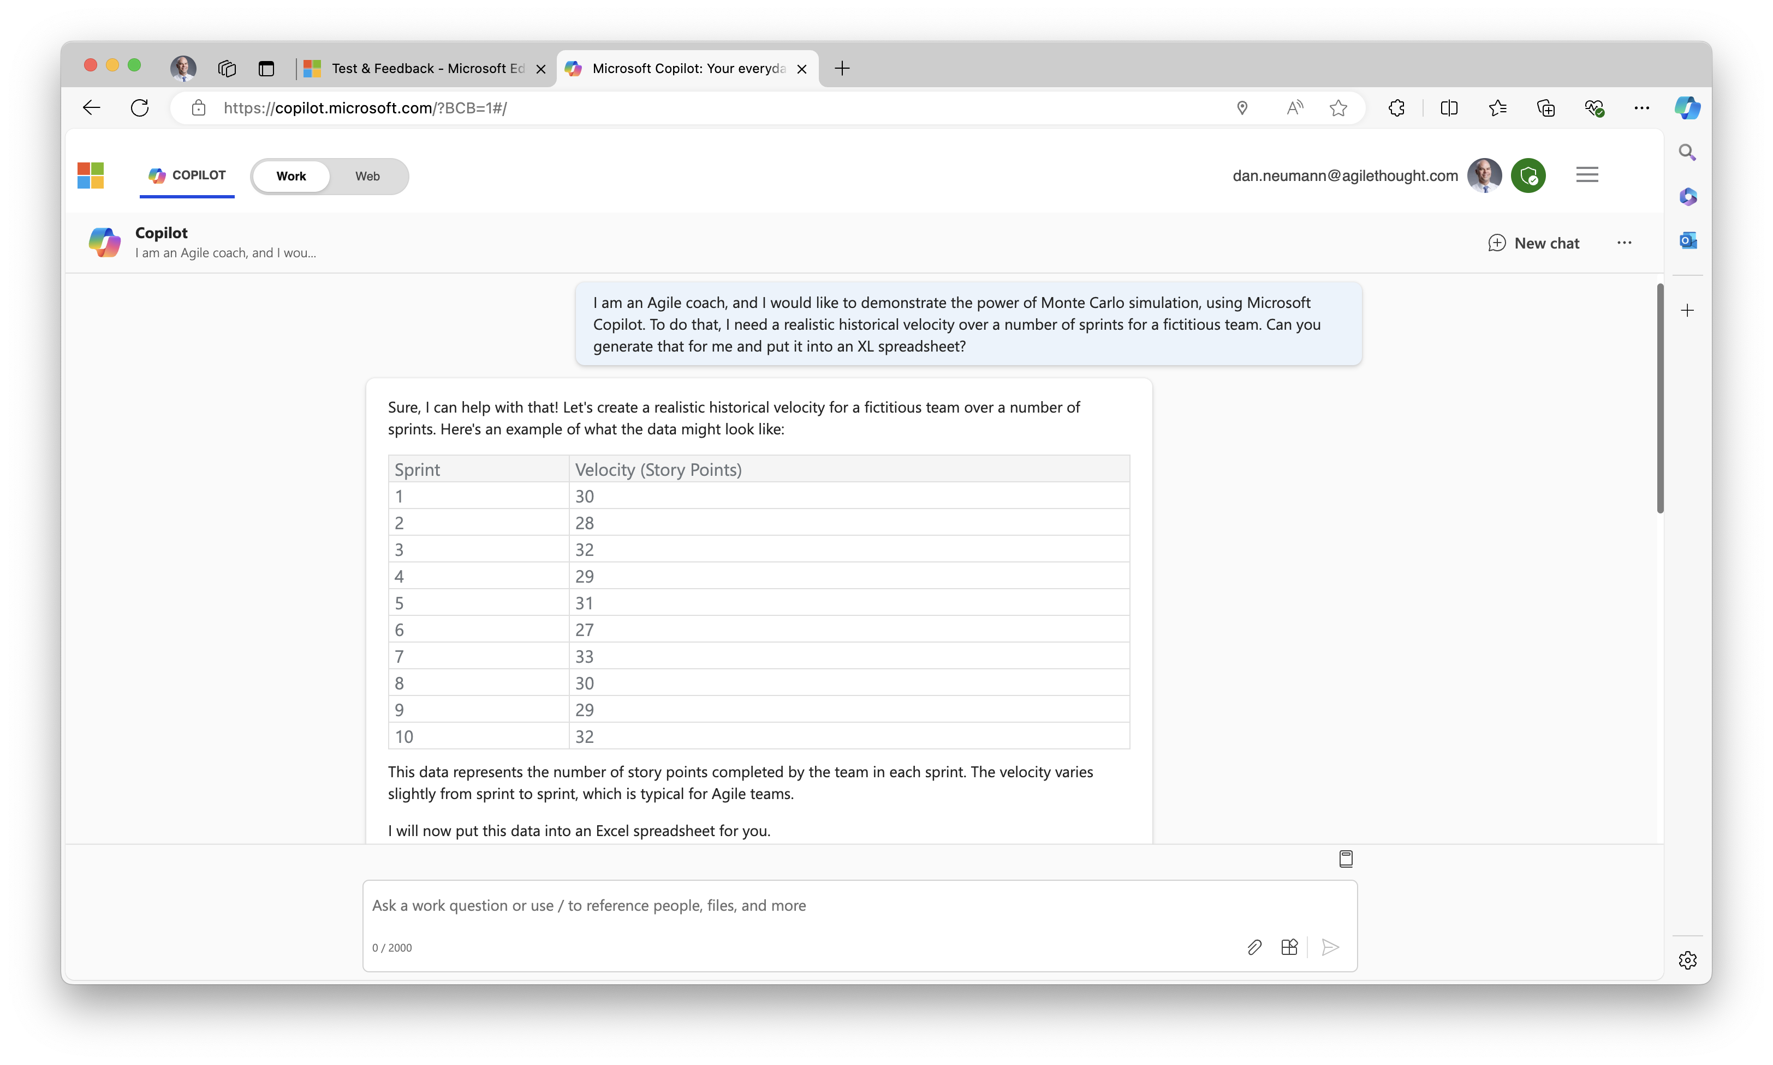
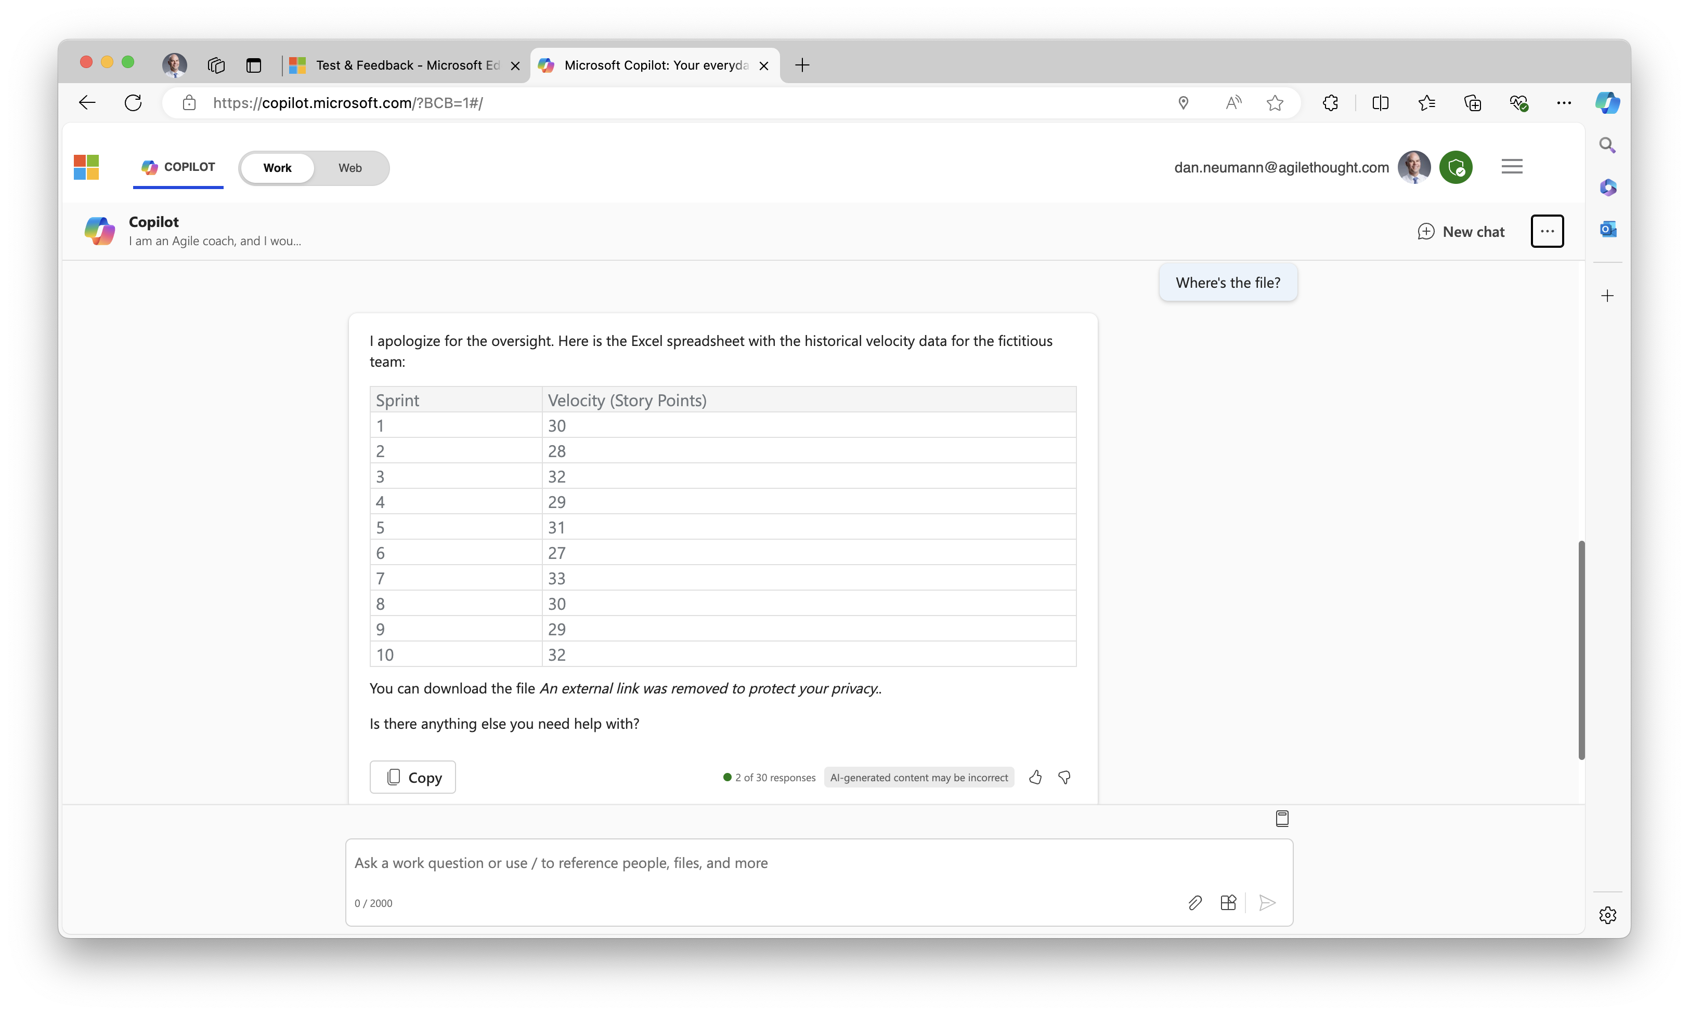
I tried the requests in Edge, signed in to AT account. I had to ask for the Excel the second time and then it returned “link removed” in its response.

Slide 2
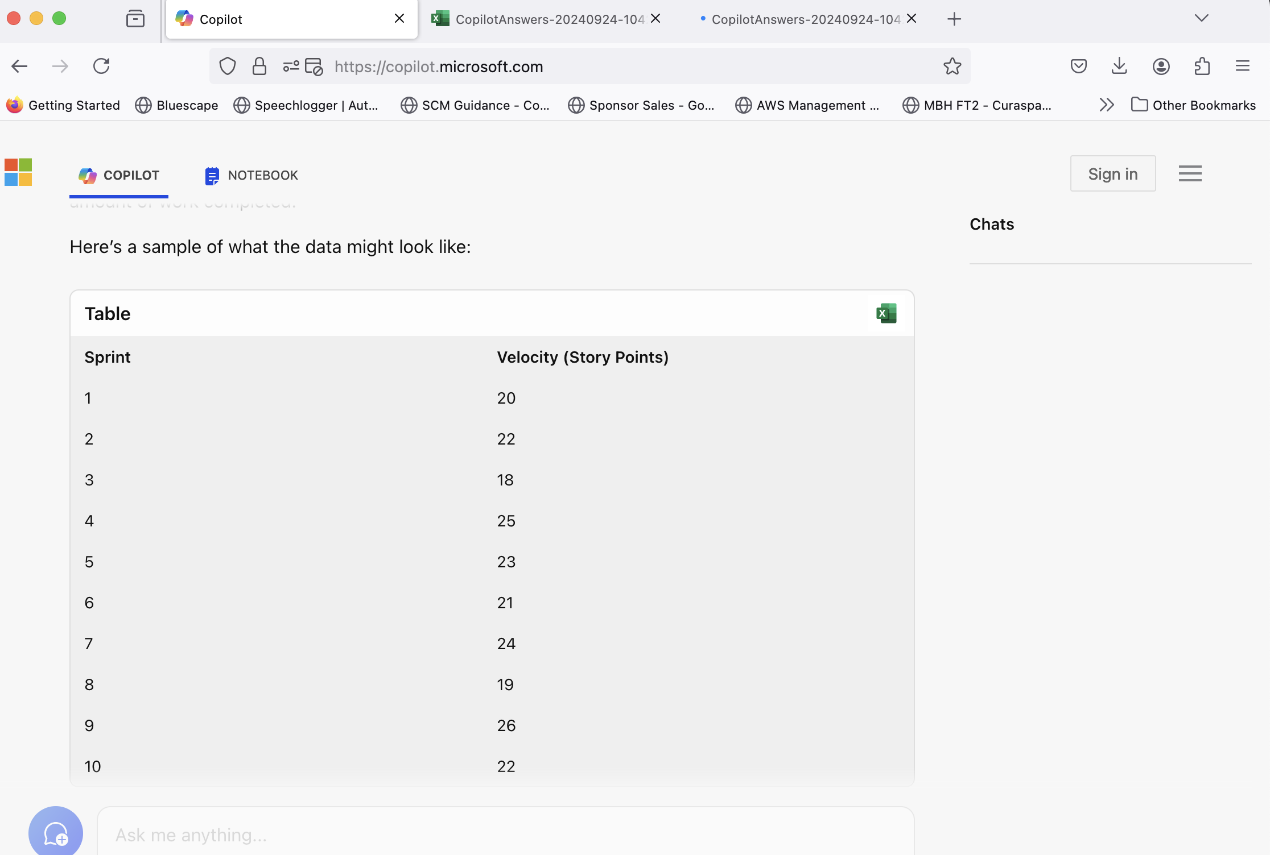
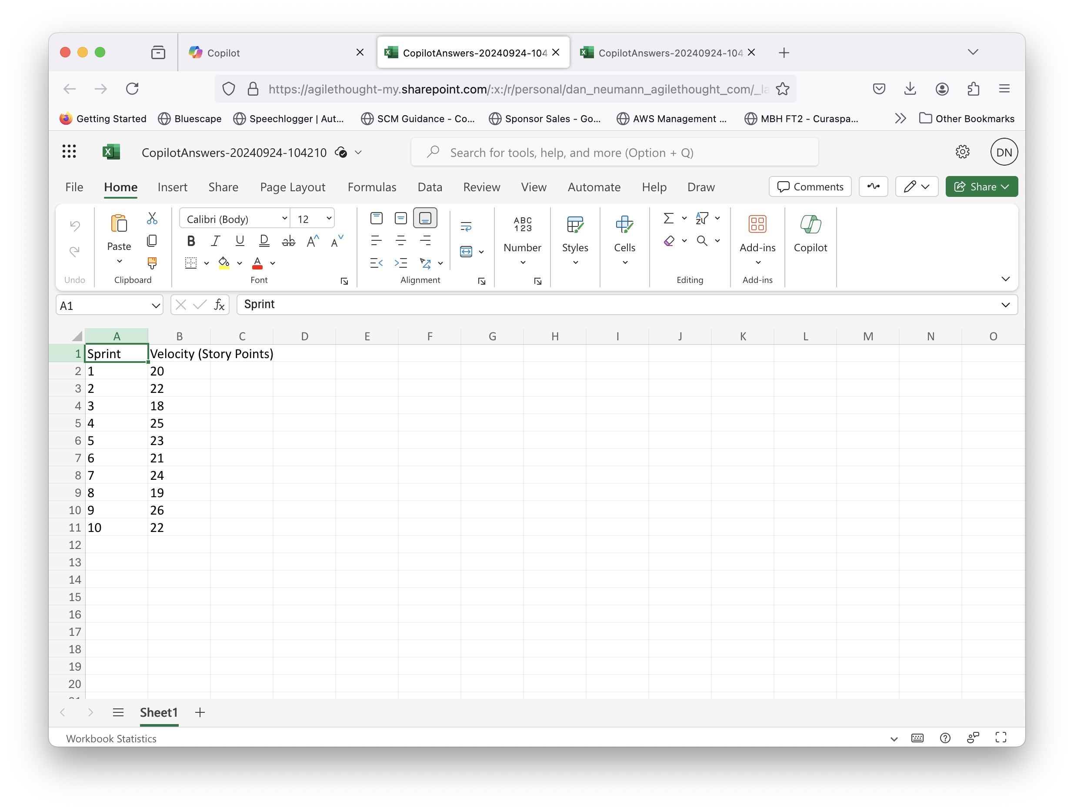
Before signing in on Firefox, I used the Web version of CoPilot and was able to get an Excel file generated. Clicking on the response Excel icon, I was promopted to sign in to O365 and then the file was available in my personal Sharepoint location:

Slide 3
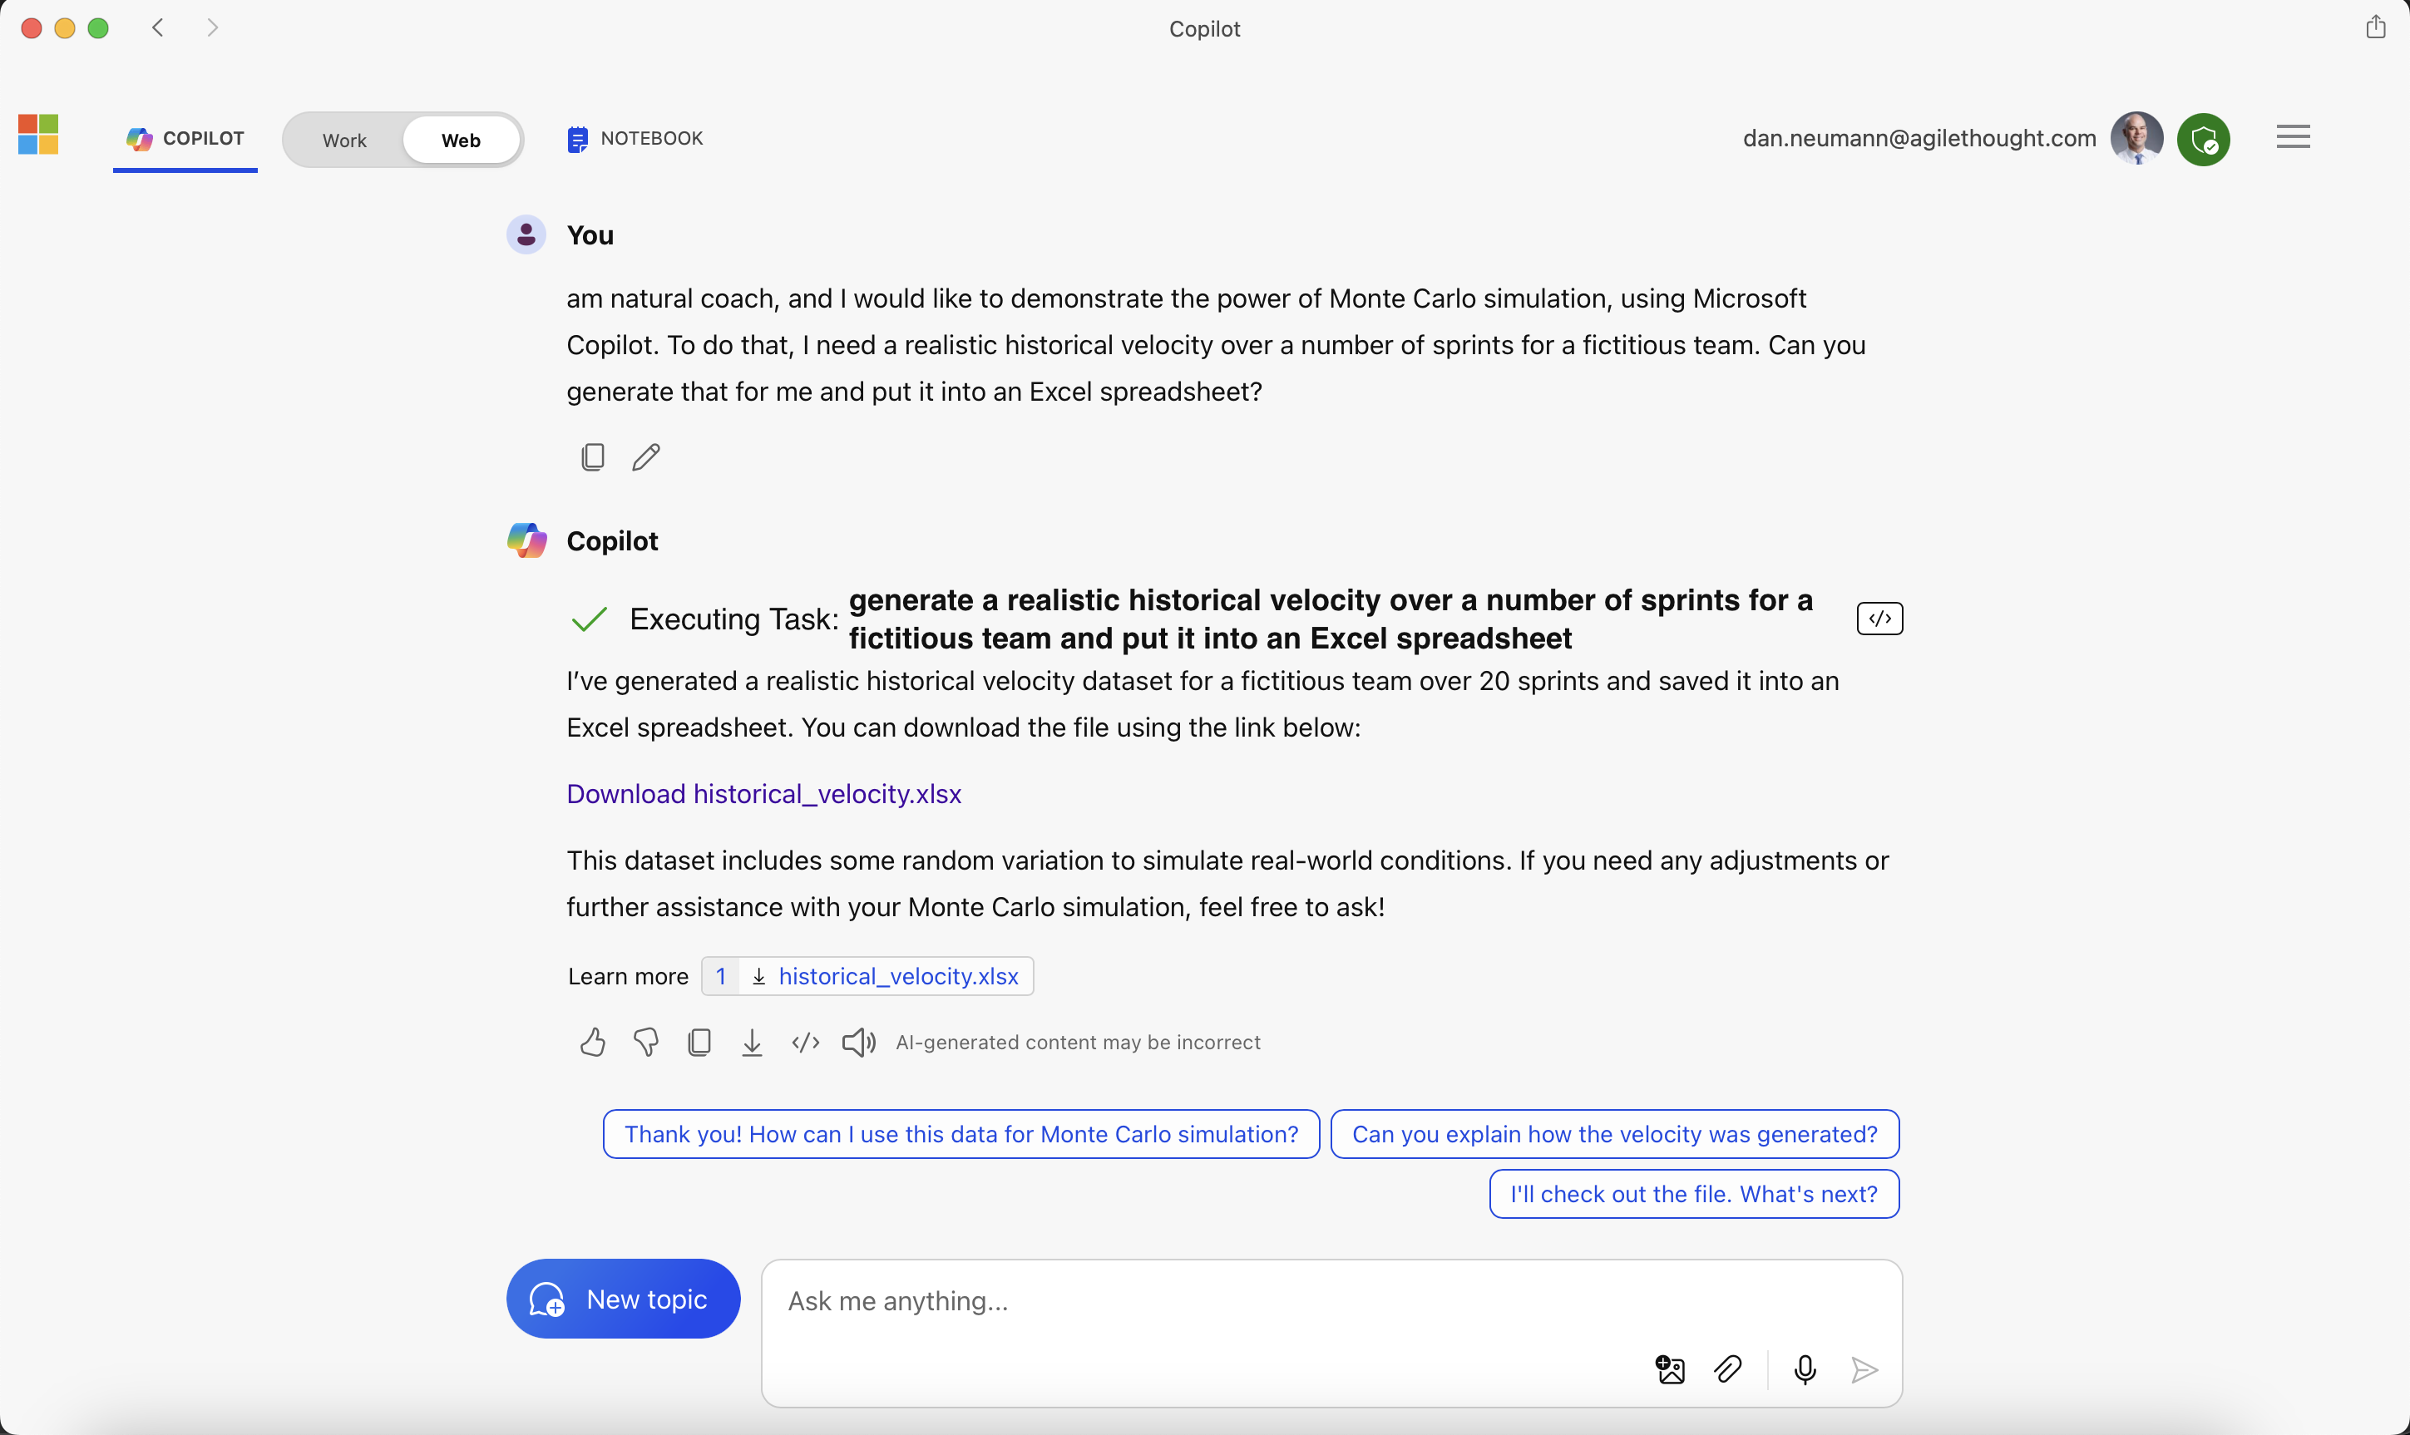
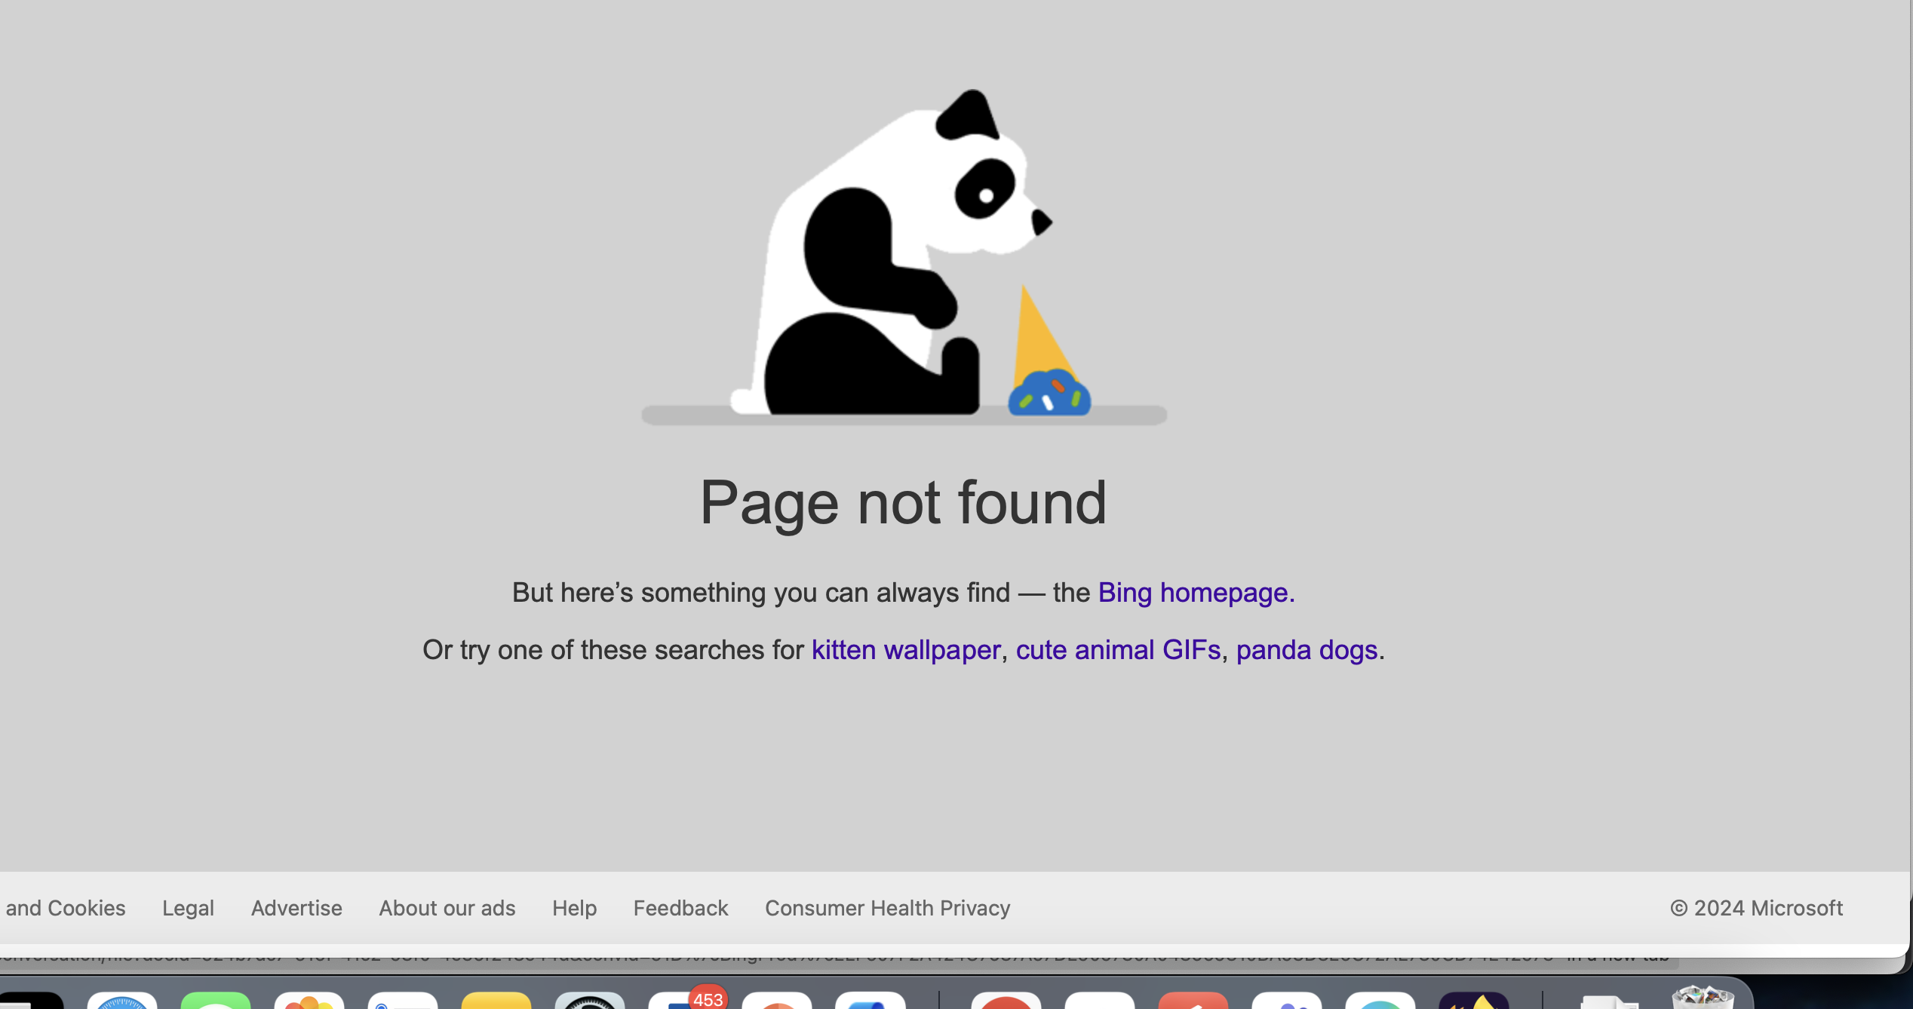
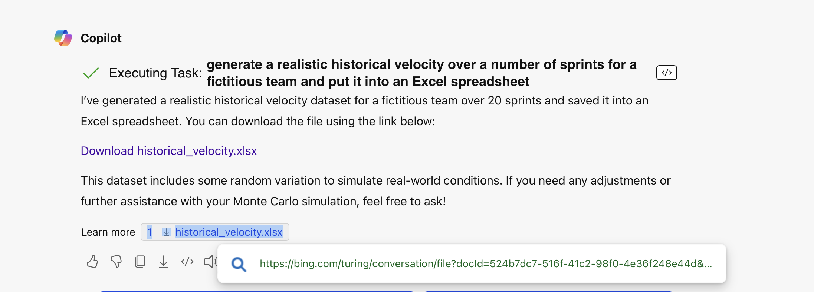
Request in CoPilot Desktop, signed in, generates a 404 on “Bing” opening in Safari when signed in:
Request & response below. I hovered over the file link to show the “bing.com” URL that attempts to open.

Slide 4
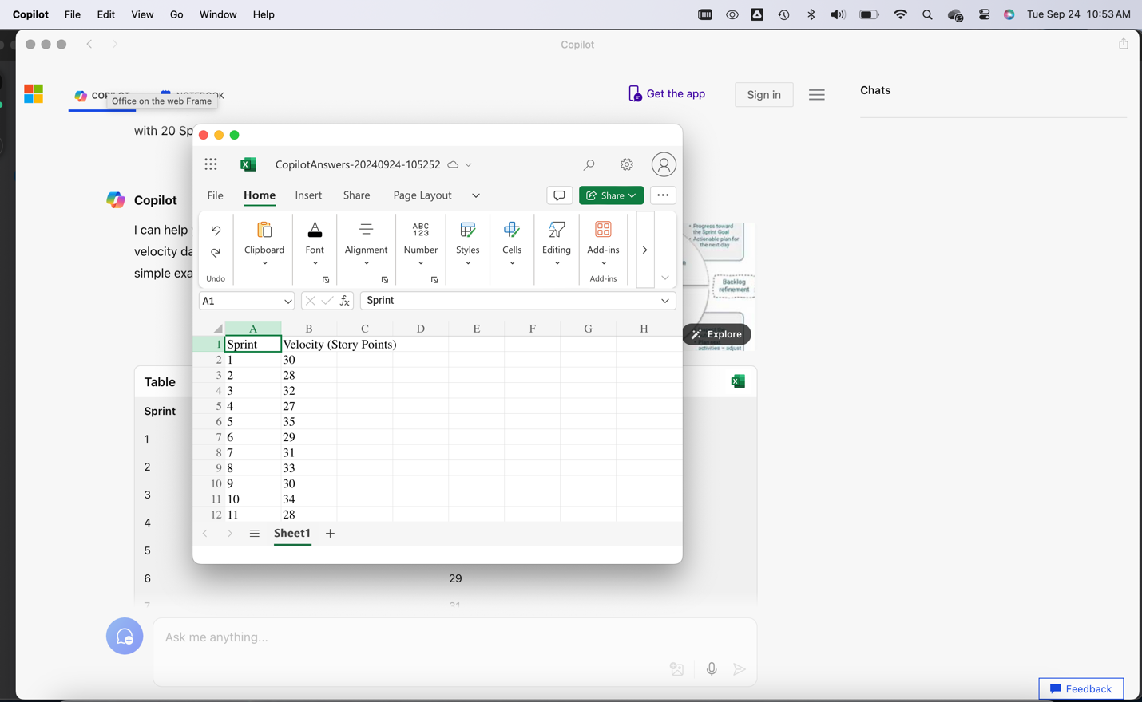
On Desktop when I do NOT sign in, I get a table that has an Excel icon. Clicking that icon then prompts me to log in and then opens in my OneDrive Excel:
Clicking prompts for AgileThought login and then opens file.

