Slide 1



Microsoft Q&A Product Champions Program
Welcome Deck

Slide 2

CONTENTS
Welcome & Introduction
Program Overview
Community Guidelines & Privacy
Levels and Tiers
Level Requirement
Rewards & Recognition
Getting Started
Staying Connected
Final Remarks
Questions & Contact

Slide 3


Welcome
To The Program

Slide 4

Welcome to the Product Champions Program — a community-driven initiative designed to recognize and support contributors across Microsoft Q&A. Whether you're just starting out or are already an experienced helper, this program provides a clear path to grow your impact, connect with others, and unlock opportunities to grow as a contributor.
–You’re joining a movement that celebrates helpfulness, consistency, and collaboration across the Microsoft Community.

Slide 5


Community Guidelines
& Privacy

Slide 6
Respect & Safety
We’re committed to maintaining a safe, inclusive, and respectful environment. Please follow these guidelines:
Be kind and constructive in your responses
Respect user privacy — never share personal info
Report any inappropriate behavior or content
Use the “Report” button or contact the CET team directly
Don't engage trolls. Trolls intentionally SPAM forums, intentionally steer topics off track, and a host of other unproductive activities.
Helpful Links: Getting Started Microsoft Q&A
Know Code of Conduct & Terms of Use
Products Champion Program

Slide 7

Let's discuss levels and tiers

Slide 8
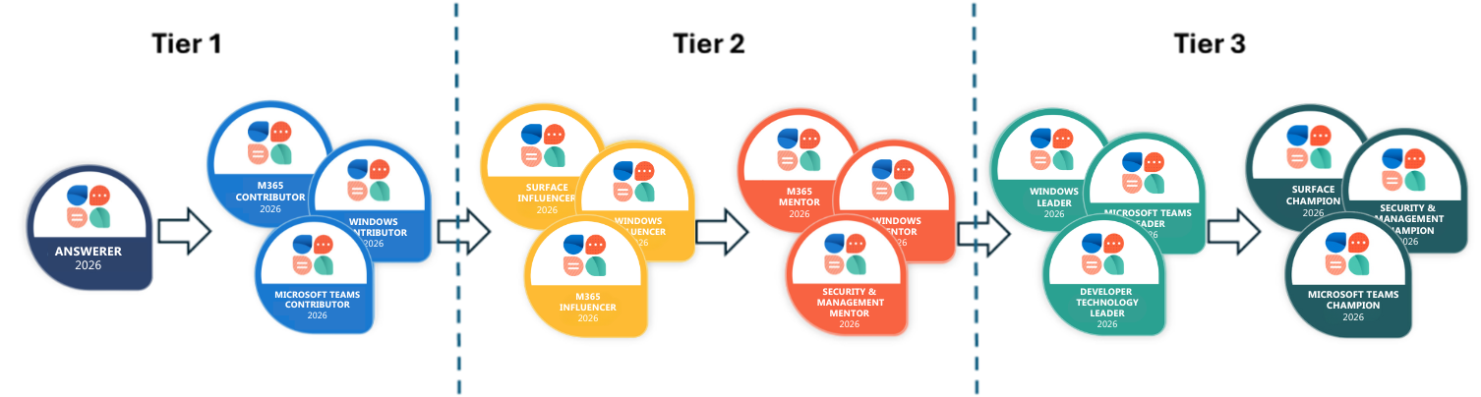
Product Tracks and Levels
The Product Champions Program is organized into six product tracks, and every participant is automatically enrolled in all tracks. After achieving the Answerer level in tier 1, you’ll follow a defined progression through six levels.
As you grow, you’ll move through six distinct levels — from Answerer to Champion — determined by your participation, helpfulness, and engagement.
Product Tracks
Windows
Microsoft Teams
Surface
Microsoft 365
Developer Technologies
Security & Management
Products Champion Program

Slide 9
Level Requirements
Levels | Yearly Answers | Monthly Engagement
Answerer | 20 | 0
Contributor | 40 | 5
Influencer | 100 | 10
Mentor | 240 | 20
Leader | 365 | 30
Champion | Top 20 EOY | 0
Progress is based on the number of yearly answered threads in Q&A , with monthly consistency helping maintain engagement throughout the program.
Products Champion Program

Slide 10
How to Move Up in the Program
You can move up as quickly as you meet the yearly requirement for each level.
All contributions are evaluated within the annual period of January 1 to December 31.
For example, as soon as you answer 40 questions , you immediately qualify as a Contributor.
If you answer 60 more a month later , you reach 100 yearly total and become an Influencer.
You can also spread your answers out over more months if you prefer a steadier pace—there’s no single “right” way to progress.
The yearly program is flexible & self paced: move fast if you’re motivated or take your time and enjoy the journey!
Tip: Monthly criteria helps you maintain engagement in your level, but you can always accelerate if you want to reach the next level sooner.
Products Champion Program

Slide 11

Rewards

Slide 12
🏅 Rewards
Tier 1 – Answerer & Contributor
🎖 Earn badges for each level
📘 Community support
🔗 Access to Tech Community private group
🏆 Leaderboard ranking & gift card opportunities
Contributor
🎥 Invitation to Modcast
Tier 2 – Influencer & Mentor
🌟 Social media recognition & newsletter feature
🎓 Discount voucher for certification
🔗 Access to Contributor Stories
Tier 3 – Leader & Champion
🗣 Guest speaker opportunities on Modcast
👩‍💻 Invitation to our top contributors to become Volunteer Moderators
✅ MVP nomination support
Champion (End of Year)
🎁 Exclusive swag for Champions only
🏅 Champion Social Media Post
Products Champion Program

Slide 13

Let's Begin

Slide 14
Begin Answering using Q&A Tags
Product Tracks | Included Products / Tags
Windows | Windows 10 / 11, Activation & Licensing, Updates & Performance, Device Drivers, Microsoft Edge, Windows Insider Program , Windows Development
Microsoft Teams | Teams for Business, Teams for EDU, Meetings, Chat, Channels, MSteams
Surface | Surface devices, hardware & accessories, deployment & management
Microsoft 365 | Outlook, Word, Excel, PowerPoint, OneNote, Access, Publisher, Microsoft 365 Admin Center, Exchange , Office Insider
Developer Technologies | Visual Studio, .NET, ASP.NET, Windows SDK, Office Add-ins, SQL Server , HDInsight
Security & Management | Microsoft Defender, Intune, Endpoint Manager, Microsoft Purview, MFA, System Center
Products Champion Program

Slide 15
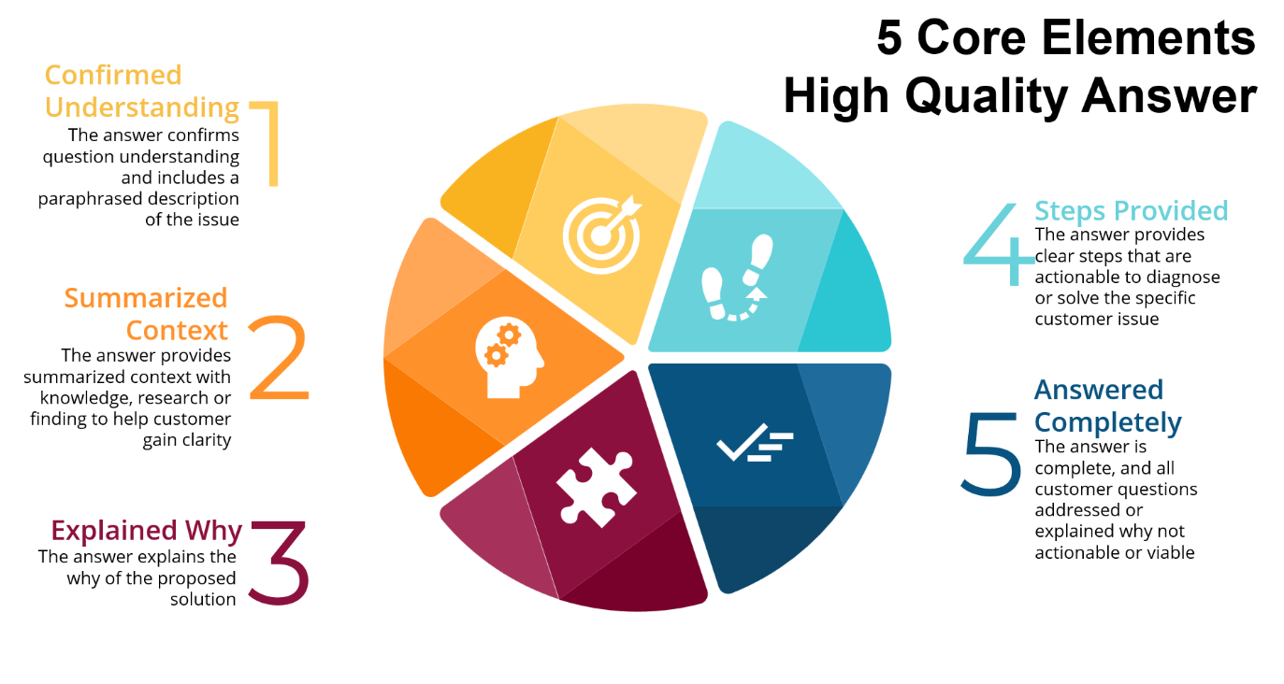
Quality of Answer
Products Champion Program

Slide 16
Final Remarks
Stay Connected:
We will continue to promote and share updates about the program on our LinkedIn.
Follow the Tech Community Hub, here we will be posting, connecting and updating all members.
Invitations to the private group will be sent via email from Notifications@CommunityHub.Microsoft.com
Track Your Progress:
We’ll monitor your monthly contributions and recognize your achievements within the community. Don’t forget to check our posts in the Tech Community
Interested in referring someone?
If you know someone who would be a great fit for this program, encourage them to sign up using this form.
Need Help?
You can reach out to us anytime at Productchampions@microsoft.com.
Products Champion Program

Slide 17

QUESTIONS?
Productchampions@microsoft.com

