Slide 1







IoT Show Deep Dive Azure Digital Twins Updated Capabilities
Speaker: Christian Schormann
Host: Pamela Cortez
Aired June 29th

Slide 2
Agenda
Introduction
Technical Overview
Resources
Notes:
Technical Walkthrough –
Services, SDK & CLI, Modeling, Twin Graph, Graph Queries, Access Control,

Slide 3

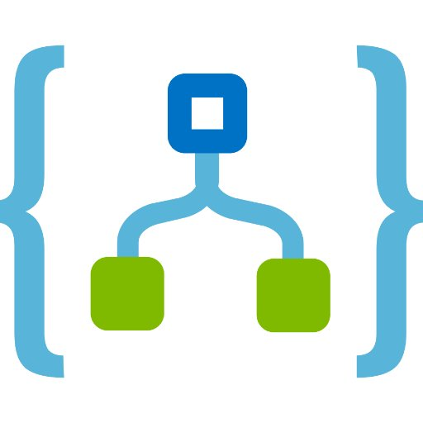

Azure Digital Twins
Create next generation IoT solutions that model the real world.
Track the past, control the present and predict the future.
Open Modeling Language
Live Execution Environment
Input from IoT & Business Systems
Output to TSI, Storage & Analytics
Notes:
That brings us to Azure Digital Twins? Azure Digital Twins is a developer platform for next-generation IoT solutions that model the real world. We will very shortly release an exciting new preview of Azure Digital Twins that brings the Digital Twins platform to a whole new level.
So, why Digital Twins? Let’s talk about an example.
Commercial building managers traditionally know very little about the actual use of their buildings, and as a result it is difficult to manage everything from energy consumption – heating and cooling – to space utilization efficiently. That matters, especially in a world of global warming, given that energy usage of buildings is responsible for somewhere between 30% and 40% of all global emissions. Equipping buildings with a bunch of sensors to enable data-driven decisions therefore seems like a good idea.
However, raw IoT data is not all that interesting and informative. To makes sense of it, we need context information. We need to know what place a given sensor is measuring, where it is located, what other sensors are around it and correlated to it and so on and so forth.
Also, as a building manager, I don’t really care about sensor readings, I want to know which spaces in my building are comfortable, how much different spaces are utilized, how satisfied tenants are with the waiting time for the elevators, or how efficient my HVAC system operates. In other words, customers want to reason about the world in terms that match their understanding of that world. This is really important – I want a software solution that describes the world in my terms.
What we therefore want is a scalable design pattern that allows customers to create software models that represent their real words – the building, floors, rooms, HVAC systems, and so forth for a building manager. Or an power stations, transmission lines and substations for energy grids. Or farms, stables and perhaps even cows for a farming solution.
These software entities then provide the context to interpret IoT sensor data in, and they also provide the vocabulary and framework to present this data to operators. They let developers map from a device centric view of the world into a business centric view.
The core goal of Azure Digital Twins is to allow developers to focus on adding business value and differentiation for their business, instead of having to worry about building and operating complex distributed systems infrastructure at scale.
In summary, the coming ADT preview release is built around the ability to model a perspective of the real-world as a topology of connected entities, an execution environment that is brought to live with data from IoT sensors using a built-in event-driven data processing system, and input and output connectivity. With Azure Digital Twins you can bring the modeled environment to life with data.

Slide 4

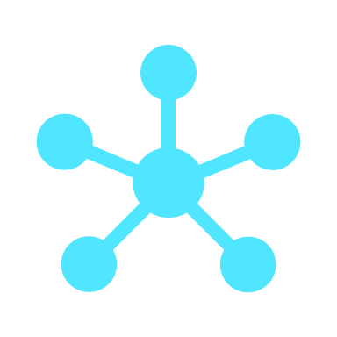

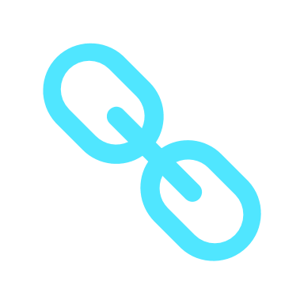

Updated Capabilities with New Version of Azure Digital Twins
PREVIOUS VERSION
NEW VERSION
Flexible Modeling
Smart Spaces use cases focused
Custom models using the Digital Twins Definition Language (DTDL)
Flexible Topology
Trees / hierarchies tailored to Smart Spaces use cases
Flexible general graph topology
Richer Compute
Only Java script and limited debugging
with User Defined Functions (UDFs)
Open compute model – use external compute for event and data processing
Accessible Hub
IoT Hub within Azure Digital Twins
Bring your own IoT Hub to integrate IoT data with Azure Digital Twins
Scalability
Scale limitations for devices, messages, graphs, scale units
New architecture with improved scalability
Notes:
Smart Spaces – The origin of Digital Twins in Azure IoT
Our journey to digital twins began with Smart Spaces with the current version of Azure Digital Twins that a lot of you are probably using today. We received a lot of great feedback from the Public Preview and incorporated a lot of that great feedback into this upcoming version:
Flexible modeling: In addition to Smart Spaces, we found that there is a lot of demand from domains such as energy grids, industrial manufacturing, farming environments, chemical plants, and so on and so forth. With that lens and to drive openness in building IoT solutions, the new Azure Digital Twins also uses an OPEN modeling language based on the JSON-LD standard. This will provide great flexibility, ease of use, and easy integration into other Azure platform offerings such as Azure Hub and Time Series insights.
Flexible Topology
Richer Compute
Accessible Hub
Scalability

Slide 5

Azure Digital Twins Service Overview

Slide 6










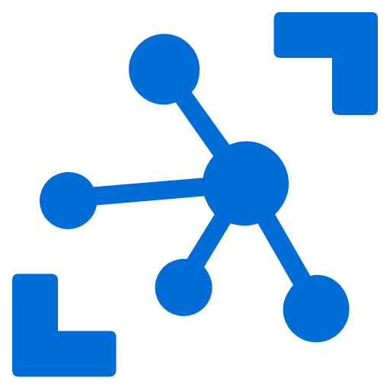


Anatomy of an Azure Digital Twins Solution
CLIENT APPS
Digital Twins solution will typically contain:
A Digital Twins instance
IoT Hub with connected devices
One or more client apps that connect to the DT instance:
Create and manage a graph of twin instances
Extract insight from twin state
A set of Azure functions or other processing resources for custom processing
Downstream services for long-term storage, bulk data analytics, etc.
ƒ
Actions
“is-equipped-with”
ƒ
Room
“contains”
Floor
“contains”
Export
Room
Bldg
“cools”
ƒ
HVAC
Cold Storage
Historical
AZURE DIGITAL TWINS
IoT HUB
Analytics

Slide 7
Core Developer Responsibilities
CLIENT APPS
Model the environment:
Create twin definitions using DTDL and register the definitions with an ADT instance
Write code that generates and maintains a graph of digital twins, using the previously defined models
Process data and update state
Create egress routes to external endpoints (event grid, event hub, service bus)
Apply processing for business logic and data propagation
Send data to downstream services (storage, analytics, MSFT Power Automate etc.)
Write solution-specific frontend / UX code (examples)
Build monitoring dashboards from ADT models and graph state
Create visualizations of the graph
Wire up UX event handlers to drive real time UX updates
Build domain-specific query UX or rules engine UX to enable end-customer defined, domain-specific queries or rules
And many more…
ƒ
Actions
“is-equipped-with”
ƒ
Room
“contains”
Floor
“contains”
Export
Room
Bldg
“cools”
ƒ
HVAC
Cold Storage
Historical
AZURE DIGITAL TWINS
IoT HUB
Analytics

Slide 8



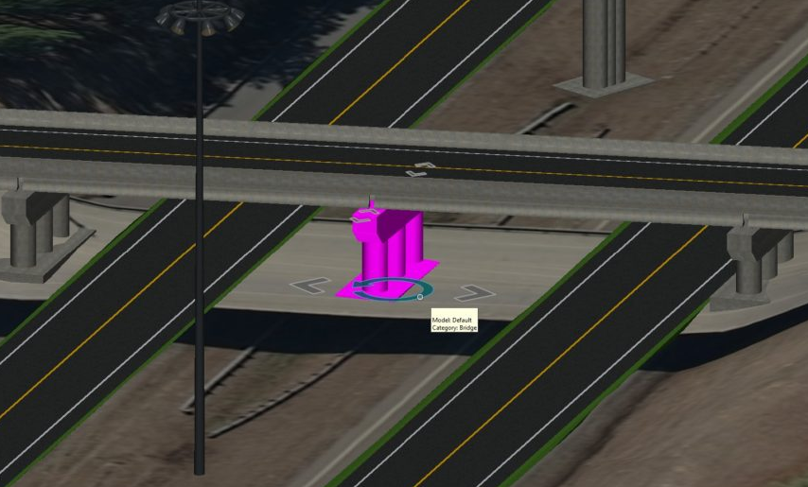

Microsoft & Bentley Systems: An Example Digital Twin Architecture
Continuous / real-time
On demand
6
5
1
2
3
Persist historical values in Azure Time
Series Insights
Display Time Series
Derived Values, Telemetry
Generate Simulated Sensor Values (Telemetry)
Send Telemetry
to IoT Hub
Trigger Azure Function
With Telemetry
Azure Event Hub
App Frontend (iModel.js)
Simulated Sensors
Azure IoT Hub
4
5
4
Compute Derived Values
Update ADT – Derived Values &Telemetry
Pull ADT
Properties/Telemetry
Driven by pace of
engineering change
Azure Digital Twins
4
Sync subset to DTDL
DTDL
1
2
3
Author
Align
Synchronize
3
2
1
Engineering
Tool A
A
ADT Export Agent (iModel.js)
Display iModel
Tiles
Properties
Display Reality
Data Tiles
Display
Background
Map Tiles
Project Start
Current Status
Tiles
Tiles
Tiles
Engineering
Tool B
B
JSON
Desktop tools from
Bentley / 3rd Parties
iModelHub
Azure Cloud Service
App Backend (iModel.js)
Reality Data Service
Background Map Service (Bing)
Notes:
[Green 1] Engineers use a variety of CAD systems to plan and update
[Green 2] The design data gets checked into iTwin.
Supports change management (similar to GitHub)
Supports sustainable workflows for review and reliable project management
[Green 4] Changes in the aggregate iModel trigger an export agent.
Written by the Bentley team for this demo
Creates or updates DTDL model set to match iModel entities
Uploads models to ADT
Generates twin instances representing the iModel
[Purple 3] Front-end app uses Bentley’s iModel.js OSS toolkit
Extensible visualization of iModels
Extensible model to overlay data on 3D model
Designed for rich data representation
Viewer displays ADT info on the 3D model
Currently using polling (10sec interval)
Displays data as overlays in model
Also uses tooltips

Slide 9
Azure Digital Twins SDK & CLI

Slide 10
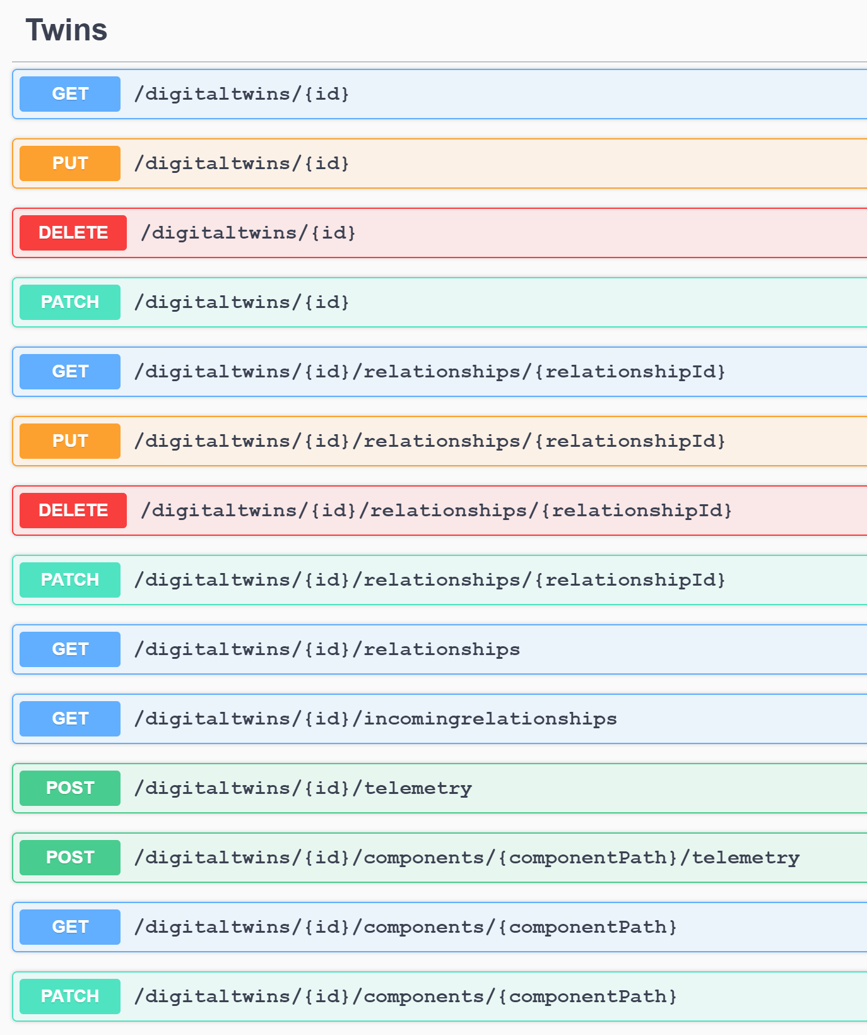
Leveraging the Azure Digital Twin Service
PaaS Service Offering
Setup via Azure Portal, comfortable Azure CLI support
Programmed via REST API surface
SDKs available for C# at Public Preview
Additional SDKs for supported Azure languages will follow
For Public Preview, additional SDKs can be generated by customers using Autorest
Parser library for validation and “reflection” over DTDL
// Initialize twin metadata
var meta = new Dictionary<string, object>
{
{ "$model", "urn:example:Simple:1" },
};
// Initialize the twin properties
var initData = new Dictionary<string, object>
{
{ "$metadata", meta },
{ "data", "Hello World!" }
};
await client.CreateDigitalTwinAsync($“myTwin", JsonSerializer.Serialize(initData));
Console.WriteLine($"Created twin: {prefix}{i}");
} catch(RequestFailedException rex) {
Console.WriteLine($"Create twin error: {rex.Status}:{rex.Message}");
}
}
public async static Task ListRelationships(DigitalTwinsClient client, string srcId)
{
try {
AsyncPageable<string> results = client.GetEdgesAsync(srcId);
Console.WriteLine($"Twin {srcId} is connected to:");
await foreach (string rel in results)
{
var edge = JsonSerializer.Deserialize<BasicEdge>(rel);
Console.WriteLine($" -{edge.Relationship}->{edge.TargetId}");
}
} catch (RequestFailedException rex) {
Console.WriteLine($"Relationship retrieval error: {rex.Status}:{rex.Message}");
}
}

Slide 11
SDK Details
Based on Azure SDK guidelines
General: https://azure.github.io/azure-sdk/general_introduction.html
.NET: https://azure.github.io/azure-sdk/dotnet_introduction.html
Initial support for C#, additional SDKs for supported Azure languages will follow
Idiomatic support for each language
Comfortable authentication
Consistent return types and error handling
Automatic paging
Comfortable authentication
Automatic Paging
// E.g interactive
var credential = new InteractiveBrowserCredential(tenantId, clientId);
client = new DigitalTwinsClient(new Uri(adtInstanceUrl), credential);
// E.g. MSI
ManagedIdentityCredential cred = new ManagedIdentityCredential(adtAppId);
client = new DigitalTwinsClient(new Uri(adtInstanceUrl), cred);
AsyncPageable<ModelData> results =
client.GetModelsAsync(dependencies_for, include_model_definition);
await foreach (ModelData md in results)
{
Console.WriteLine(md.Id);
}

Slide 12
DTDL Parser
Parses and validates DTDL
Provides a C# object model for DTDL models (“reflection” over DTDL)
Handles DTDL model sets (e.g. inheritance, etc.)
Can be used by client software:
To validate models before service update
To find out which properties or methods are defined in a model (taking into account inheritance)
To drive UX generation code for model-driven UX
C# code library distributed via NuGet

Slide 13
Azure CLI with Extensions for ADT
Comfortable CLI commands to create and manage ADT instances
Create, list and delete instances
Manage RBAC
Manage Endpoints
Supports simple data plane commands operations too
Example: AZ CLI commands to set up an ADT instance first time
az login
az account set -s <your-approved-subscription-ID>
az configure --defaults location="West Central US"
az provider register --namespace 'Microsoft.DigitalTwins'
az group create -n <your-resource-group-name>
az dt create --dt-name <name-for-your-Azure-Digital-Twins-instance>
-g <your-resource-group-name>
az dt rbac assign-role -n <your-instance-name> --role owner
-g <your-resource-group> --assignee <service-principal-to-grant-access>

Slide 14
Azure Digital Twins Modeling

Slide 15

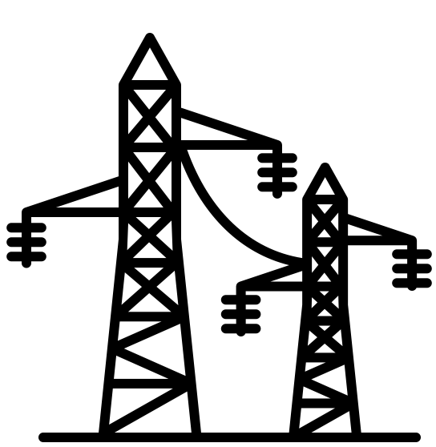
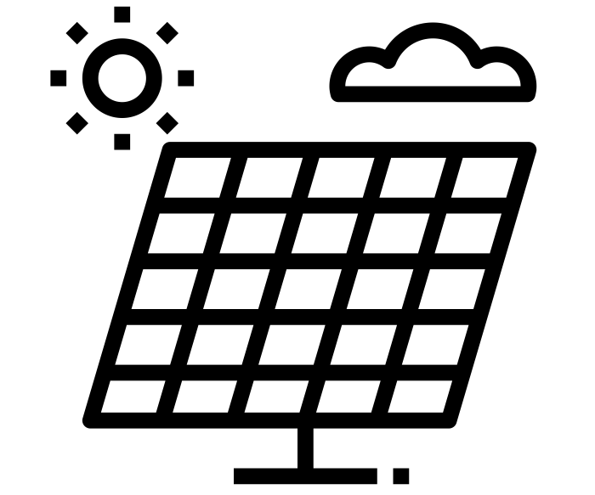
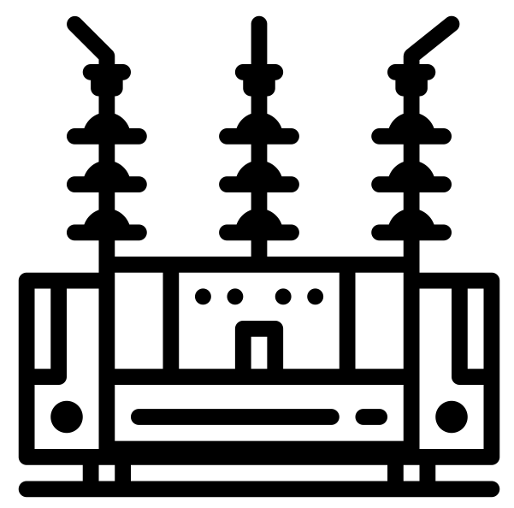
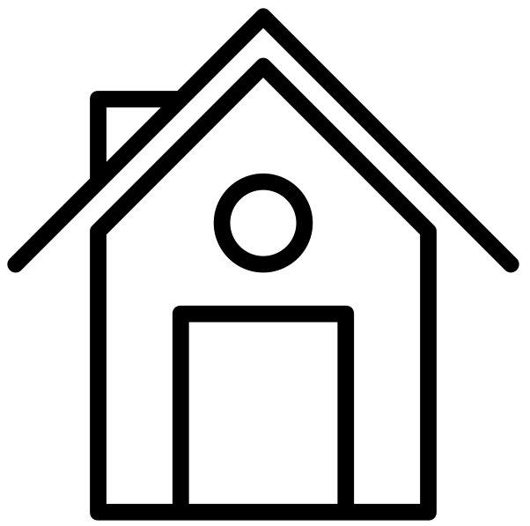
Modeling with Azure Digital Twins
Create a domain vocabulary
Build a model of your environment
Describe the entities and concepts important for your business
Describe how entities relate and connect to each other
Describe data and behavior
Digital Twins Definition Language (DTDL)
Open source specification
Programming language independent
Based on JSON-LD
DTDL is also used to describe IoT devices
Aligned with IoT Plug and Play and Time Series Insights data model
Enables Plug and Play connectivity for device
Consistent programming model from ADT in the cloud to devices
Create instances of the specific entities in your real world
Connect the instances into a topology graph that represents your environment
Define event processing and routing for your environment
Notes:
Flexible modeling allows enterprises to model any asset, environment and business system with Azure Digital Twins. Microsoft is also adopting an open source approach by leveraging an open modeling language based on JSON-LD standard (Digital Twins Definition Language, or DTDL). Using DTDL, customers can model smart buildings, smart stadiums, electric distribution networks, railway networks, entire manufacturing plants including buildings – anything important to a business can be modeled.

Slide 16
Twins Modeling
INTERFACE
SPACE
With DTDL, you can describe your TWIN in terms of:
Properties
Properties are data fields that represent some state of a digital twin
Use properties to represent durable state
Read-only or writable
Telemetry
Telemetry fields represent measurements
Measurement are typically used for the equivalent of sensor readings.
Commands [Not supported in ADT yet]
Commands represent methods can be executed on the digital twin
Example: Reset command, or a command to switch a fan on or off.
Relationships
Relationships lets you model how a given twin is related to other twins
Relationships can represent different semantic meanings, e.g. “floor contains room”, “hvac cools rooms”, “Compressor is-billed-to user” etc.
Components
Component lets you build your model from other interfaces. Use a component to describe something that is a part of your model. Use a relationship to describe something that relates to your model.
E.g. a phone that is made up of a front camera and a back camera. Phone has an interface which has two components: front camera and back camera.
INTERFACE
ROOM
INTERFACE
MEETINGSPACE
INTERFACE
CONFERENCE ROOM
TWIN INSTANCE
ROOM-29
DTDL supports inheritance
Notes:
DTDL = Twin types are described using a simple markup language
An interface describes a complete entity, such as a physical device or a space (like a room) and has a set of interfaces implemented by the entity.
Interfaces describe digital twin capabilities, Interfaces can inherit from other interfaces
Telemetry, Properties, and Commands
Digital twins can implement many interfaces
Most digital twins will define one interface for their core capabilities
STM32 Nucleo with environmental sensor expansion board
Azure MXChip IoT DevKit
Room interface for a room in a building
Parts of interfaces can be shared and reused
Telemetry, properties, commands
Schemas and semantic data types

Slide 17
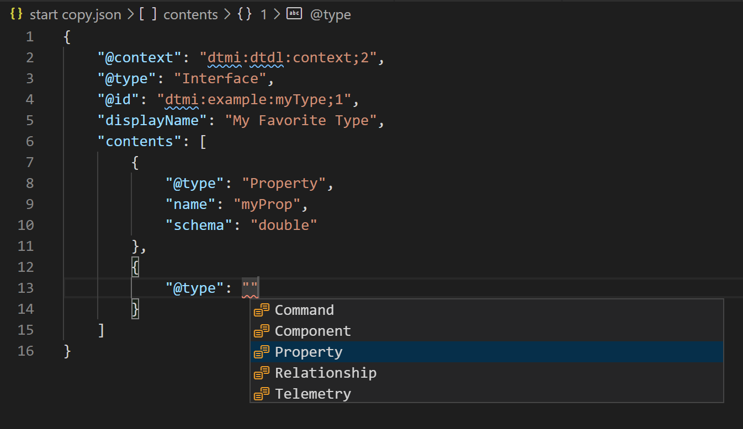
DEMO: DTDL EDITING IN VS CODE

Slide 18
Simple Interface Example
{
"@id": "dtmi:example:ConferenceRoom;1",
"@type": "Interface",
"contents": [
{
"@type": "Property",
"name": "occupied",
"schema": "boolean"
},
{
"@type": "Telemetry",
"name": "temperature",
"schema": "double"
},
{
"@type": "Property",
"name": "Sqft",
"schema": "float"
}
],
"@context": "dtmi:dtdl:context;2"
}
The following example shows a simple room
The top level of any twin description is called an interface.
At the top level, the twin description has a number of necessary fields
@id
@type
contents
@type
name
schema
@context
Notes:
The top level of any twin description is called an interface.
At the top level, the twin description has a number of necessary fields:
@id is a unique id in form of a simple Uniform Resource Name or URN.
@type states that this definition is, in fact, an interface for a digital twin. For a valid DTDL digital twin description, the top-level type always needs to be interface.
contents holds an array of descriptions of telemetry, properties, commands, and relationships.
@context enables an interface processor to make sense of the format of DTDL and is used to specify the version of DTDL used to write the interface.
In this simple example,we have two properties and a telemetry. The minimal field description is very simple:
@type specifies the type of content – Telemetry, Property, Command or Relationship
name provides the name for the property.
schema identifies the data type for the property. This value can be one of a number of primitive values, such as double, integer, boolean or string.

Slide 19
Types
Properties and telemetry fields can use simple and complex types
"contents": [
{
"@type": "Telemetry",
"name": "rotation",
"schema": {
"@type": "Object",
"fields": [
{
"name": "roll",
"schema": "double"
},
{
"name": "pitch",
"schema": "double"
},
{
"name": "yaw",
"schema": "double"
}
]
}
}
]
Schema attribute for properties, telemetry and command arguments defines data type
Simple types are primitives:
Integer, Boolean, double, string, etc.
Optional displayUnit attribute to indicate a unit for display
Complex Types
A complex type holds an array of fields
Fields can be of simple or complex types themselves
Complex types can be defined inline or as re-usable types
Notes:
Complex types could be array, maps, objects, etc.

Slide 20
Relationships
Relationships lets you model how a given twin is related to other twins.
{
"@id": “dtmi:example:Floor;1",
"@type": "Interface",
"contents": [
{
"@type": "Relationship",
"name": "contains",
"target": “dtmi:example:Room;1"
},
{
"@type": "Relationship",
"name": “isAssociatedWith",
},
...
],
"@context": "dtmi:dtdl:context;2"
}
Relationships are uni-directional
Bi-directional relationships can be modeled as relationship pairs
Relationships can be queried
Relationship attributes:
Name: Identifies the meaning of the relationship
Target: the type of interface the relationship targets
Interfaces may define many different relationships

Slide 21
Inheritance (Specialization)
A twin might need to be specialized for a given use case – This can be done via simple interface inheritance
{
"@id": “dtmi:example:Room;1",
"@type": "Interface",
"contents": [
{
"@type": "Property",
"name": "occupied",
"schema": "boolean"
}
],
"@context": “dtmi:dtdl:context;2”}
Interfaces can inherit from each other
Interface inheritance works largely like in C#
Names inherited from multiple interfaces coalesce
For example, we’d like to have conference rooms, focus rooms, and office spaces that all share common properties.
1
{
"@id": “dtmi:example:ConferenceRoom;1",
"@type": "Interface",
"extends": “dtmi:example:Room;1",
"contents": [
{
"@type": "Property",
"name": "capacity",
"schema": "integer"
}
],
"@context": “dtmi:dtdl:context;2”
}
{
"@id": “dtmi:example:ExecutiveConferenceRoom;1",
"@type": "Interface",
"extends": “dtmi:example:ConferenceRoom;1",
"contents": [
{
"@type": "Property",
"name": "vpName",
"schema": "string"
}
],
"@context": “dtmi:dtdl:context;2”}
2
3

Slide 22
Model API Overview
Create (Upload) models
List models
Decommission and delete models
try
{
List<string> dtdlList = new List<string>();
for (int i = 0; i < filenameArray.Length; i++)
{
filename = Path.Combine(consoleAppDir, filenameArray[i]);
StreamReader r = new StreamReader(filename);
string dtdl = r.ReadToEnd();
r.Close();
dtdlList.Add(dtdl);
}
Response<IReadOnlyList<ModelData>> res =
await client.CreateModelsAsync(dtdlList);
Console.WriteLine($"Model(s) created successfully!");
}
catch (RequestFailedException e)
{
Log.Error($"Response {e.Status}: {e.Message}");
}
try
{
List<ModelData> reslist = new List<ModelData>();
AsyncPageable<ModelData> results =
client.GetModelsAsync(dependencies_for, include_model_definition);
await foreach (ModelData md in results)
{
Console.WriteLine(md.Id);
if (md.Model!=null)
PrintModel(md.Model);
reslist.Add(md);
}
Console.WriteLine("");
Console.WriteLine($"Found {reslist.Count} model(s)");
}
catch (RequestFailedException e)
{
Log.Error($"Error {e.Status}: {e.Message}");
}

Slide 23
Azure Digital Twins Twin Graph

Slide 24
Hospital Use Case Example
Goals:
Measure diligence of hand-washing on a hospital floor
Support facilities operation with maintenance information
Hospital Floor 1
Interface: HospitalFloor
Property: VisitDispnseRatio
EH: VisitDispenseRatioUpdated
Hospital Floor 2
ƒ
‘contains”
Zone 1A
Interface: Zone
Property: VisitDispenseRatio
Zone 1B
EH: VisitDispenseRatioUpdated
ƒ
‘manages”
PatientRoom 102
PatientRoom 101
Interface: PatientRoom
Property: FootTrafficCount
Property: DispenseCount
Property: VisitDispenseRatio
Interface: MotionSensor
D2C message when someone passes the door
EH: SoapDispensed
ƒ
EH: MotionDetected
ƒ
Interface: ConnectedDispenser
Property: BatteryLevel
Telemetry: Dispensed

Slide 25
Building Topology Sample
DigitalTwinsClient client = new DigitalTwinsClient(...);
// Connect to MSFT graph and open spreadsheet from OnDrive
// ...
// Read excel spreadsheet using MSFT graph APIs
var range = msgraphclient.Me.Drive.Items["BuildingsWorkbook"]
.Workbook.Worksheets["Building"].usedRange;
JsonDocument jdoc = JsonDocument.Parse(range.values);
Dictionary<string, string> parentDictionary = new Dictionary<string, string>();
foreach (JsonElement row in jdoc.RootElement.EnumerateArray())
{
string type = row[0].GetString();
string id = row[1].GetString();
string parent = row[2].GetString();
// Initialize twin data
BasicDigitalTwin twinData = new BasicDigitalTwin();
twinData.Metadata.ModelId = type;
twinData.Id = id;
// Initialize additional properties from spreadsheet
// twinData.CustomProperties.Add(..., ...);
client.CreateDigitalTwin(id, JsonSerializer.Serialize(twinData));
// While creating the twins, record which relationships are needed for later
if (parent != "")
parentDictionary.Add(id, parent);
}
// After creating all twins, now create the relationships…
foreach (string childId in parentDictionary.Keys)
{
BasicRelationship rel = new BasicRelationship();
rel.TargetId = childId;
rel.Name = "contains";
string parentId = parentDictionary[childId];
client.CreateRelationship(parentId, $"{parentId}-{childId}", JsonSerializer.Serialize(rel));
}
The example code to the right builds a topology from data in an excel file (example below)
This is a common use case for customers
Type | Id | Parent | OtherData | OtherData
floor | Floor01 |  | … | …
room | Room10 | Floor01 | … | …
room | Room11 | Floor01 | … | …
room | Room12 | Floor01 | … | …
floor | Floor02 |  | … | …
room | Room21 | Floor02 | … | …
room | Room22 | Floor02 | … | …

Slide 26
Twin API Overview
Twins
Create, Read, Patch/Update, Delete
Relationships
Create, Read, Patch/Update, Delete
List incoming and outgoing relationships on twins
// Initialize twin metadata
var meta = new Dictionary<string, object>
{
{ "$model", “dtmi:example:Simple;1" },
};
// Initialize the twin properties
var initData = new Dictionary<string, object>
{
{ "$metadata", meta },
{ "data", "Hello World!" }
};
await client.CreateDigitalTwinAsync($“myTwin", JsonSerializer.Serialize(initData));
Console.WriteLine($"Created twin: {prefix}{i}");
} catch(RequestFailedException rex) {
Console.WriteLine($"Create twin error: {rex.Status}:{rex.Message}");
}
}
public async static Task ListRelationships(DigitalTwinsClient client, string srcId)
{
try {
AsyncPageable<string> results = client.GetRelationshipsAsync(srcId);
Console.WriteLine($"Twin {srcId} is connected to:");
await foreach (string rel in results)
{
var r = JsonSerializer.Deserialize<BasicRelationship>(rel);
Console.WriteLine($" -{r.RelationshipName}->{r.TargetId}");
}
} catch (RequestFailedException rex) {
Console.WriteLine($"Relationship retrieval error: {rex.Status}:{rex.Message}");
}
}

Slide 27
Azure Digital Twins Ingress, Routes and Events

Slide 28
Ingress
Drive ADT using the REST API surface
Any source that can call REST APIs can drive ADT
Typical scenario:
Event handler function attached to IoT Hub
Set properties on twins in response to telemetry messages
Can be used with sources such as Event Hubs or Event Grids
Can be used with Logic Apps and other tools that call REST APIs

Slide 29
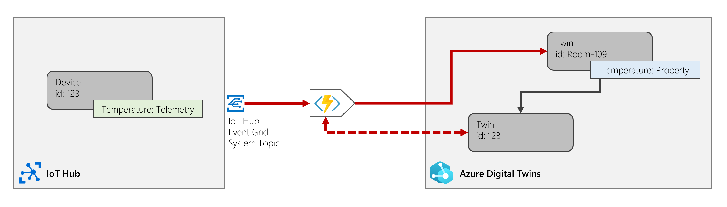
Programming Example: Ingest Telemetry
Use case: Set a property on a “logical” twin room based on telemetry from a connected device
Example: Set room temperature in response to thermostat telemetry
Not shown: Common items such as function creation, function security setup, etc.
Azure Function
[FunctionName("ProcessHubToDTEvents")]
public async void Run([EventGridTrigger]EventGridEvent eventGridEvent, ILogger log)
{
ManagedIdentityCredential cred = new ManagedIdentityCredential(adtAppId);
client = new DigitalTwinsClient(new Uri(adtInstanceUrl), cred);
if (client != null
{
if (eventGridEvent != null && eventGridEvent.Data != null)
{
// Reading deviceId from message headers
JObject job = (JObject)JsonConvert.DeserializeObject(eventGridEvent.Data.ToString());
string deviceId = (string)job["systemProperties"]["iothub-connection-device-id"];
// Extracting temperature from device telemetry
byte[] body = System.Convert.FromBase64String(job["body"].ToString());
var value = System.Text.ASCIIEncoding.ASCII.GetString(body);
var bodyProperty = (JObject)JsonConvert.DeserializeObject(value);
var temp = bodyProperty["Temperature"];
// Find parent using incoming relationships and update parent twin
string parentId = await FindParent(deviceId, log);
await AdtUtilities.UpdateTwinProperty(client, parentId, "/Temperature", temp, log);
}
}
}

Slide 30
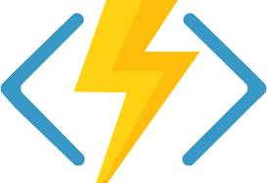


An Overview of Event Processing in ADT v2
All events incoming to ADT or generated by ADT flow into a common event stream
Devs can define routes to pick a subset of data items of the event stream and send them to endpoints
Stay tuned for additional event processing features…
CUSTOMER CLIENT
(CALLING ADT APIs)
TELEMETRY
REST API
ROUTE
EVENT STREAM
ENDPOINTS
ROUTE
To downstream services…

Slide 31
Routes Example & Route Filtering
Creating, listing and deleting Routes
Route Filtering
const string endpointName = "test-endpoint01";
try
{
Console.WriteLine("Create a route:");
var er = new EventRoute(endpointName)
{
Filter = "type = 'microsoft.iot.telemetry'",
};
await client.CreateEventRouteAsync(endpointName, er);
Console.WriteLine("Create route succeeded. Now listing routes:");
AsyncPageable<EventRoute> routes = client.GetEventRoutesAsync();
await foreach (EventRoute route in routes)
{
Console.WriteLine(route.Id);
}
Console.WriteLine("Deleting routes:");
foreach (EventRoute route in routes)
{
Console.WriteLine($"Deleting route {route.Id}:");
await client.DeleteEventRouteAsync(route.Id);
Console.WriteLine("Delete route succeeded.");
}
}
catch (RequestFailedException ex)
{
Console.WriteLine($"*** Error {ex.Status}/{ex.ErrorCode} in event route:
{ex.Message}");
}
ADT Messages use cloud event format
Route filters today can filter against any combination of CE header fields
Example of a filter to only include telemetry
type = 'microsoft.iot.telemetry'
Example of a filter to only include one component
Subject = 'thermostat67'
Example Message (Twin Update)
{
"specversion" : "1.0",
"type" : "Microsoft.<Service RP>.Twin.Update",
"source" : "https://mydigitaltwins.westcentralus.azuredigitaltwins.net",
"subject" : "123",
"id" : "A234-1234-1234",
"time" : "2018-04-05T17:31:00Z",
"datacontenttype" : "application/json",
"data" : {
"modelId": "dtmi:example:SimpleModel;1",
"patch": [
{ "op": "replace", "path": "/myComp/prop1", "value": {"a": 3}}
]
}
}

Slide 32
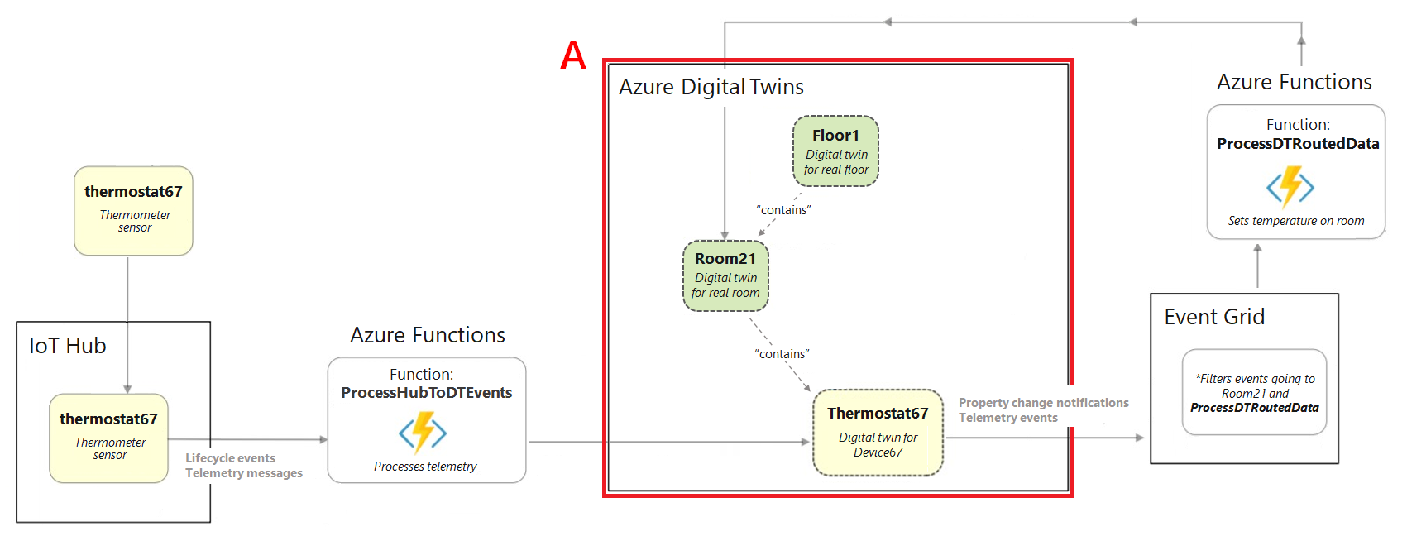
Example Scenario

Slide 33
Azure Digital Twins Graph Queries

Slide 34
Public Preview Query Overview
SQL-LIKE query language to search twins and relationships
Get twins by properties
Get twins by Model type
Get twins by relationship properties
Get twins using relationship traversal
Any combination of above (AND, OR, NOT operator) of properties, interfaces, relationship properties and traversing
Continuation support with variable page size in REST API. SDK provides continuous access (no need for explicit paging)
Support for query comparison operators: AND/OR/NOT, IN/NOT IN, STARTSWITH/ENDSWITH, =, !=, <, >, <=, >=
Scalar Functions support: IS_BOOL, IS_DEFINED, IS_NULL, IS_NUMBER, IS_OBJECT, IS_PRIMITIVE, IS_STRING, STARTS_WITH, ENDS_WITH
Query API Example
AsyncPageable<string> result = client.QueryAsync("Select * From DigitalTwins");
await foreach (string twin in result)
{
Console.WriteLine(twin);
BasicDigitalTwin bt = JsonSerializer.Deserialize<BasicDigitalTwin>(twin);
foreach (KeyValuePair<string, object> prop in bt.CustomProperties)
Console.WriteLine($"Property {prop.Key}: {prop.Value}");
}
Notes:
Digital Twins and relationships are described via DTDL as interfaces
User-defined properties are accessed directly or via interface alias
E.g. WHERE T.propertyName = 50 (for non-devices with inheritance)
E.g. WHERE T.[component-name].firmwareVersion = “1.3” (No inheritance on interfaces, for devices)
Built-in properties are marked with
$ WHERE T.$dtid = <some id>
T.$metadata.$modeld= "urn:example.com:cm:PatientRoom:1"
Query Devices, Digital Twins, and Relationships
JOIN queries allows for relationship traversal
Relationships have properties and they support filtering as well
Named relationships (“contains”, “servedBy”)
Relationships carry properties as well (“active”, “serviceCount”)
Queryable for operations scenarios
“Find the active and on-call service worker for generator X”
“Display the current load on all generators connected to feeder X”

Slide 35
Queries Examples
Get twins by properties | Get twins by model | Get twins by traversing relationships
SELECT * FROM DigitalTwins WHERE $dtid in [‘123’, ‘456’] AND firmwareVersion = ‘1.1’ | SELECT * FROM DigitalTwins WHERE IS_OF_MODEL (‘dtmi:contosocom:DigitalTwins:Space;3’) AND roomSize > 50 | SELECT device FROM DigitalTwins space JOIN device RELATED space.has WHERE space.$dtid = ‘Room 123’ AND device.$metadata.model = ‘dtmi:contosocom:DigitalTwins:MxChip:3’ AND has.role = ‘Operator’

Slide 36
Additional Queries Examples
Description | Query
Get twins which property “Location” is defined | SELECT * FROM DIGITALTWINS WHERE IS_DEFINED(Location)
Get twins of this model and id which property Temperature is a numeric value | SELECT * FROM TWINS WHERE IS_OF_MODEL(‘dtmi:contosocom:DigitalTwins:Space;10') AND IS_NUMBER(T.Temperature)
Get twins which have a relationship named “Contains” with another twin with id = ‘id1’ | SELECT Room FROM DIGITIALTWINS Room JOIN Thermostat ON Room.Contains WHERE Thermostat.$dtId = ‘id1'
Get rooms with this model which are on this floor and the floor has a “Contains” relationship with the room | SELECT Room FROM DIGITALTWINS Floor JOIN Room RELATED Floor.Contains WHERE Floor.$dtId = 'floor11' AND IS_OF_MODEL(Room, ’dtmi:contosocom:DigitalTwins:Room;1')
Notes:
SELECT * FROM TWINS T
WHERE IS_STRING(T.name) AND T.temp > 50
: IS_DEFINED
| IS_NULL
| IS_BOOL
| IS_NUMBER
| IS_STRING
| IS_OBJECT
| IS_PRIMITIVE

Slide 37
Azure Digital Twins Access Control

Slide 38
Access Control
Role Based Access Control support in ADT aligned with Azure RBAC
Coarse-grain access control with two built-in roles for authorizing access to ADT resources
Azure Digital Twins Owner
Azure Digital Twins Reader
Support for custom roles to meet specific access control needs
Customize roles by allowing actions (CRUD) from different permissions scopes
Permission scope for control over:
Model Create Read Update Delete
Digital Twins CRUD
Digital Twins Relationships CRUD
Query operations
Event routes CRUD
Capability used for directing events to an endpoint
E.g. Event Hub, Event Grid, or Service Bus.

Slide 39
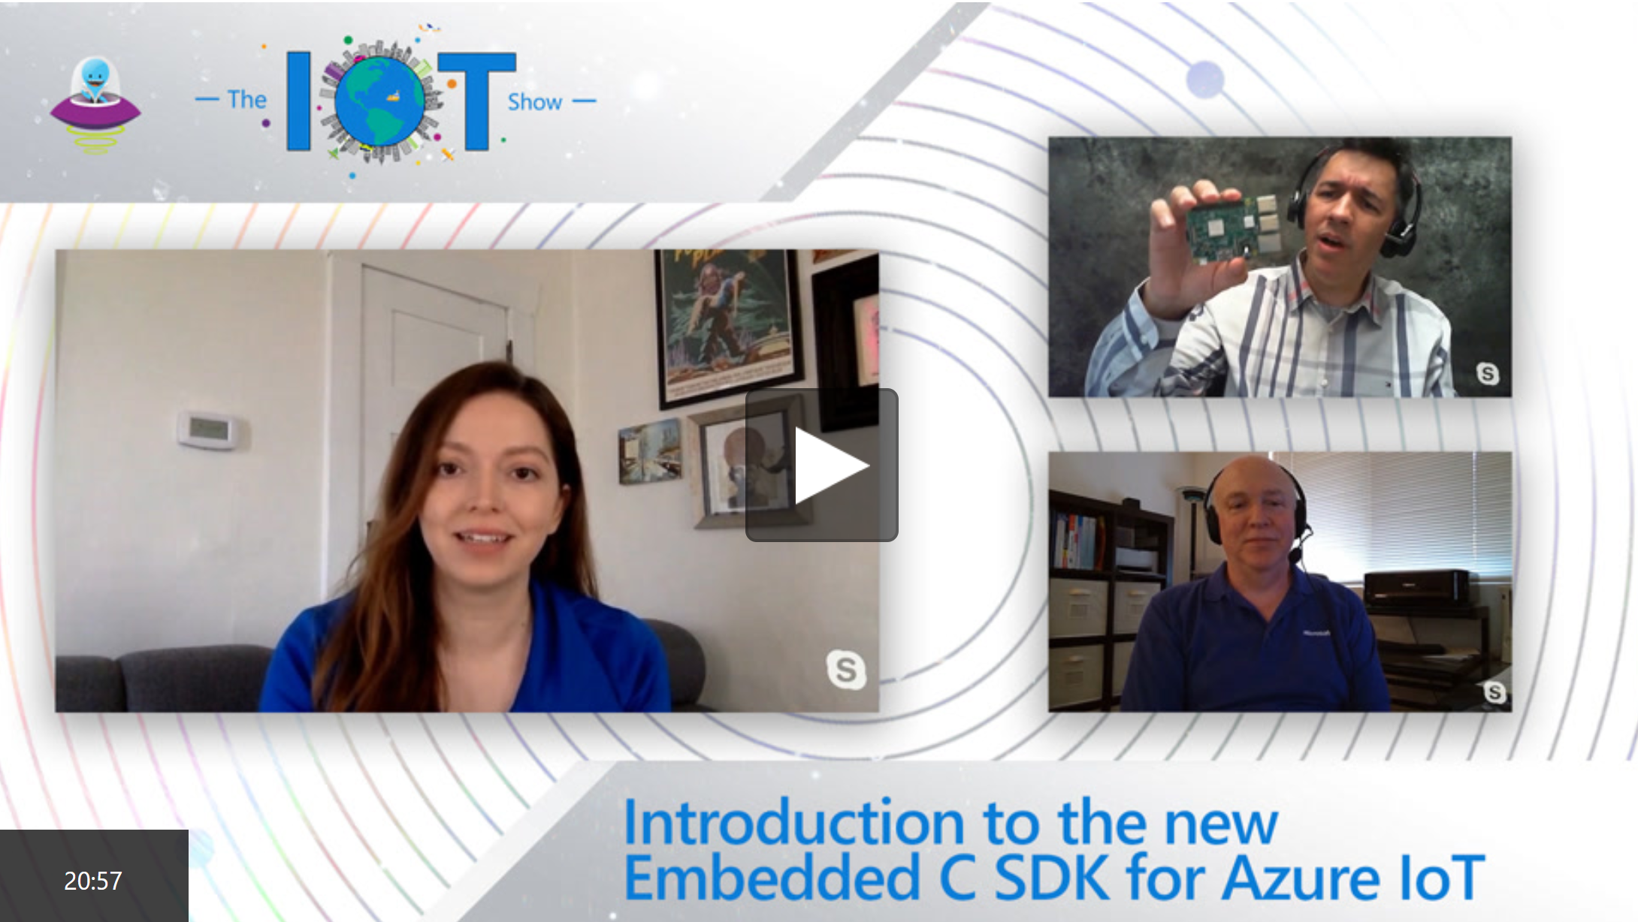
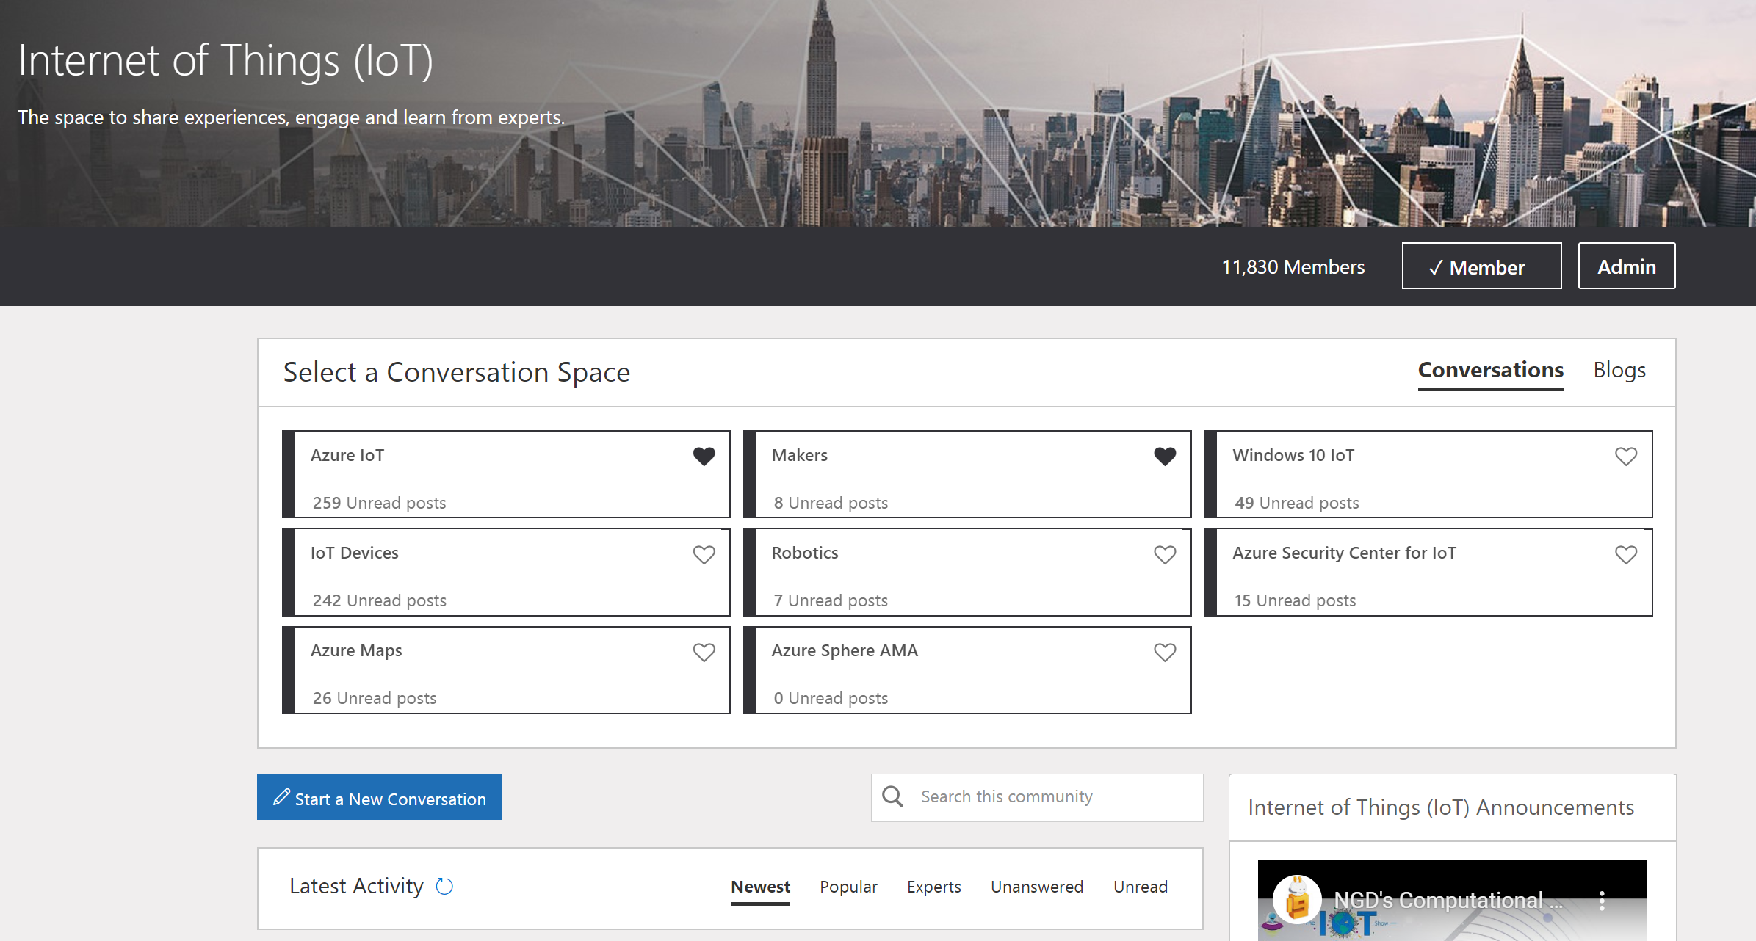
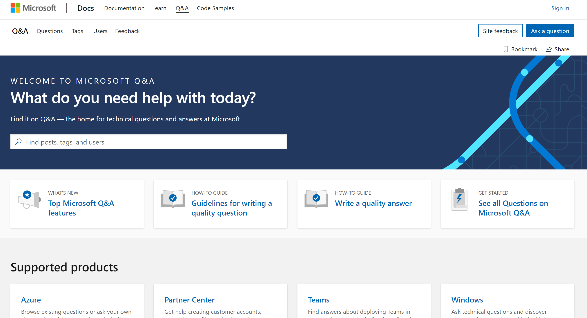
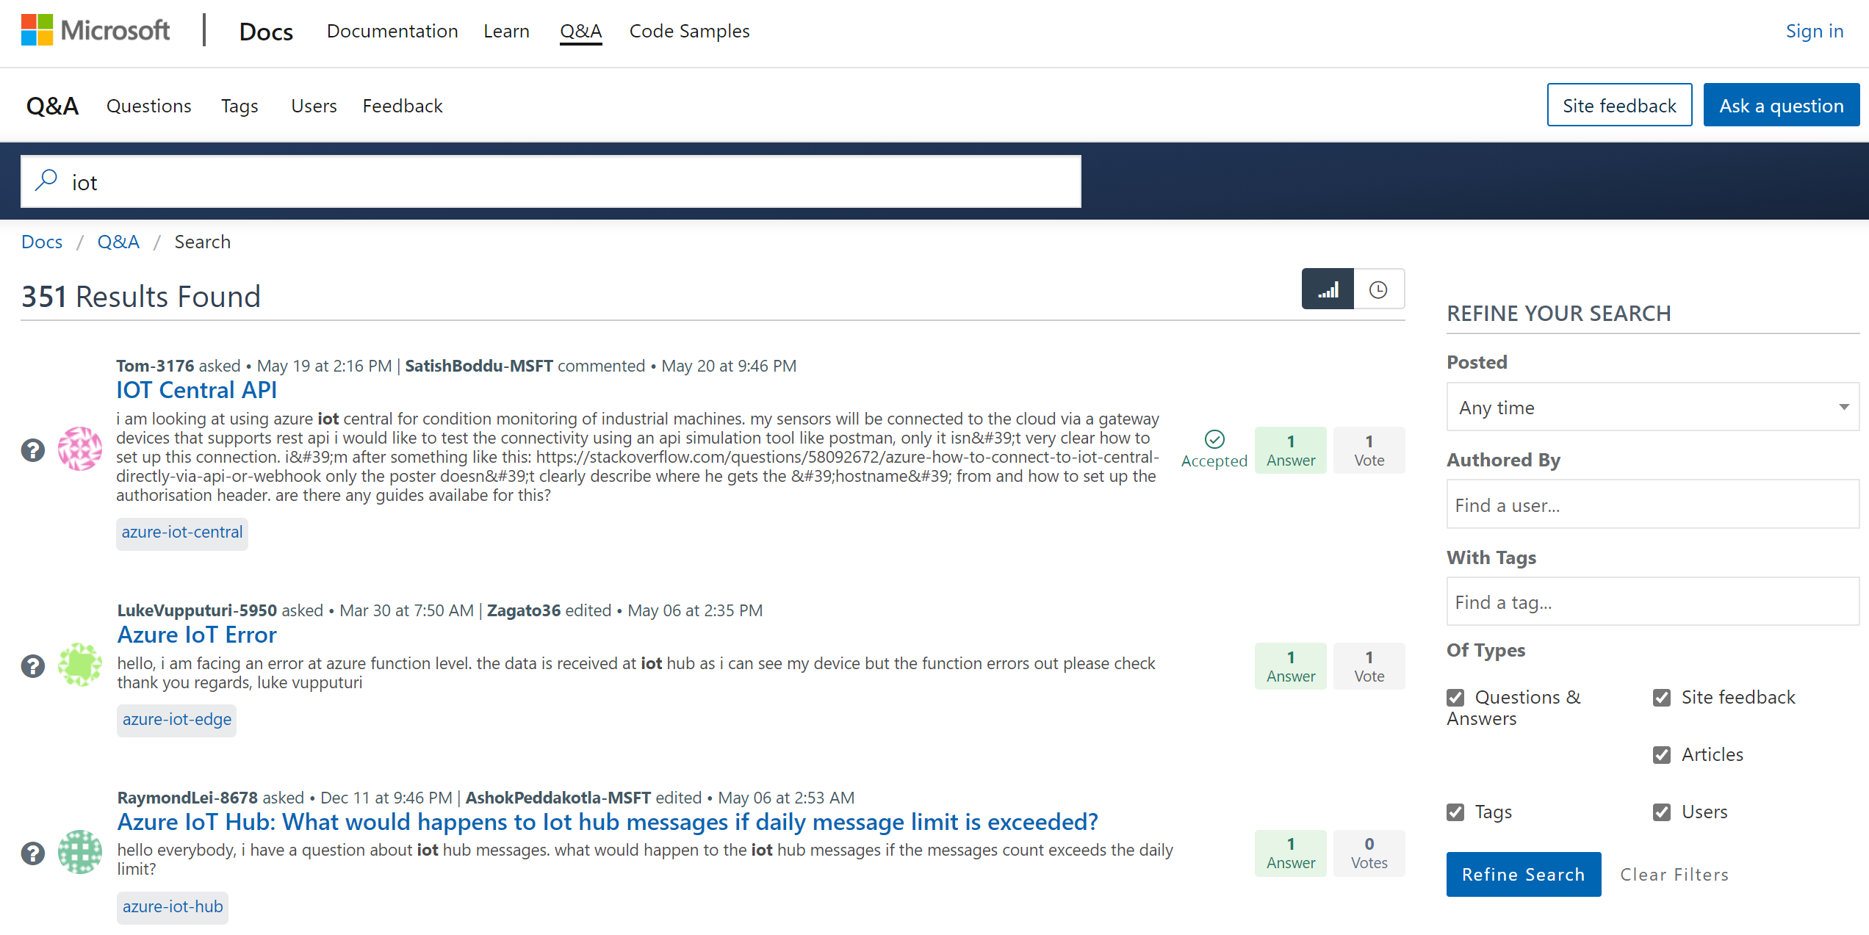
Resources
Hear the latest updates
aka.ms/iotshow
Share your projects and reach out to the team on
aka.ms/iottechcommunity
Azure Digital Twins
https://azure.microsoft.com/services/digital-twins/
Build - Azure Digital Twins: Powering the Next Generation of IoT
https://mybuild.microsoft.com/home
Microsoft Q&A
https://docs.microsoft.com/answers/products/

Slide 40
THANK YOU Q&A

Slide 41

AZURE DIGITAL TWINS Deep Dive June 2020

