Slide 1
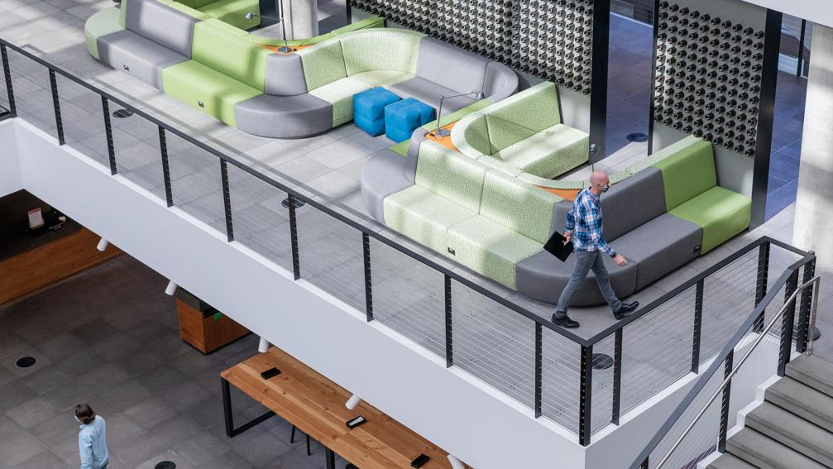

Using M365 Insights to Promote Well-being, Create Resilience and Accelerate Transformation
John Allen
Jesse Howard
Microsoft Corporation

Slide 2








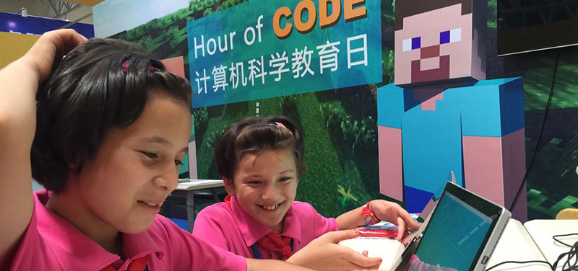
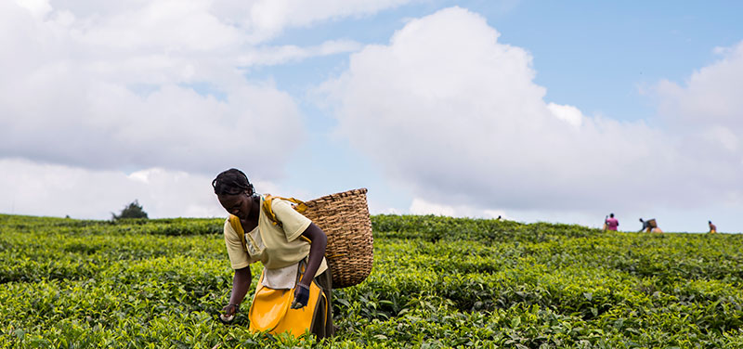
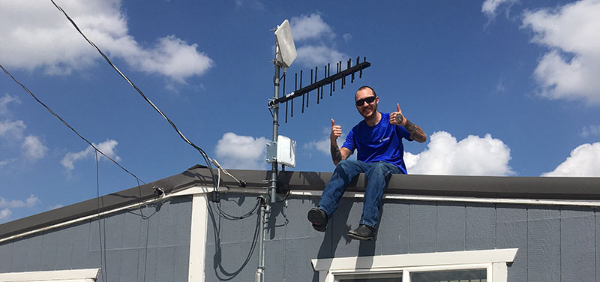
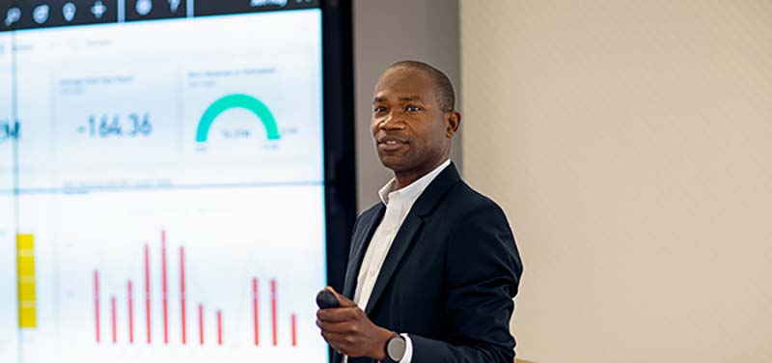
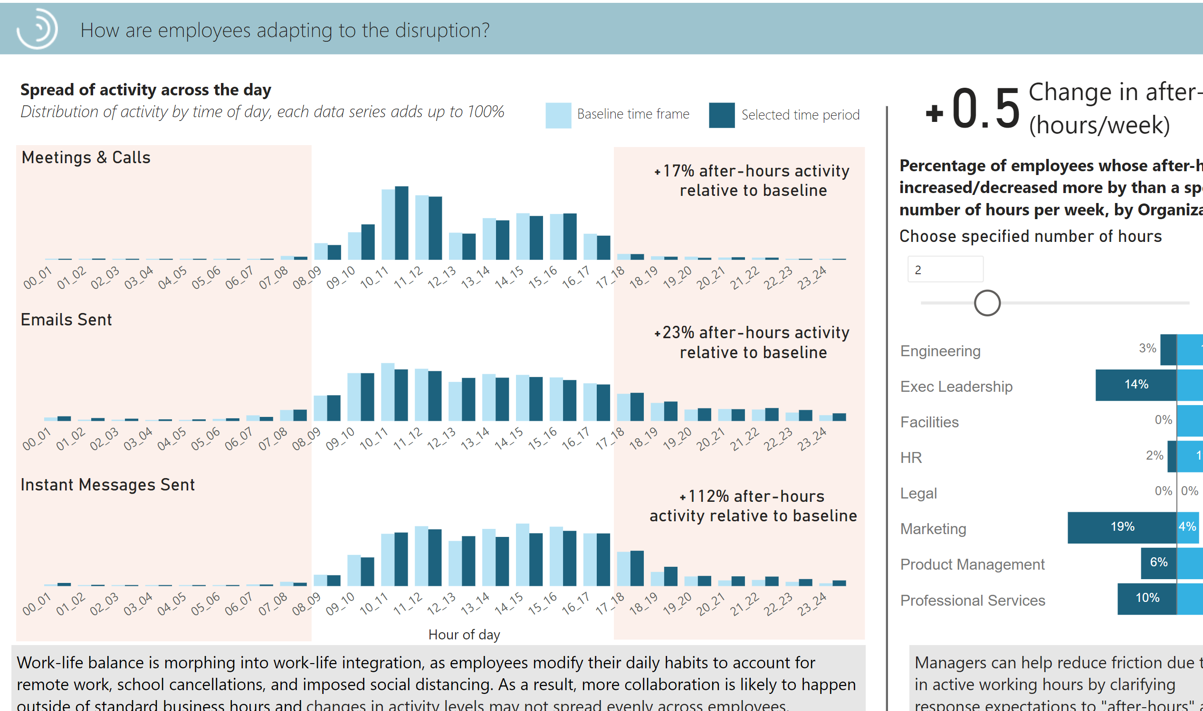
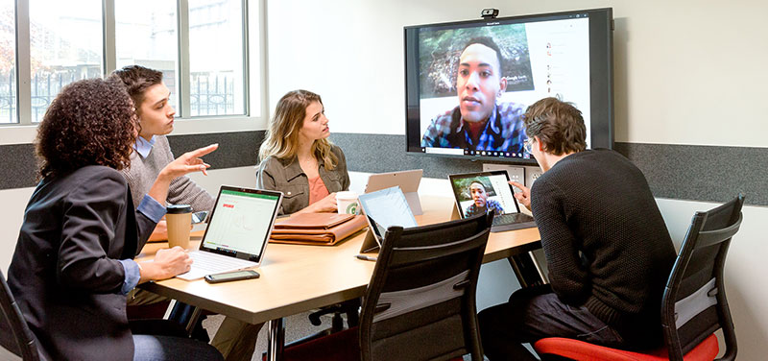
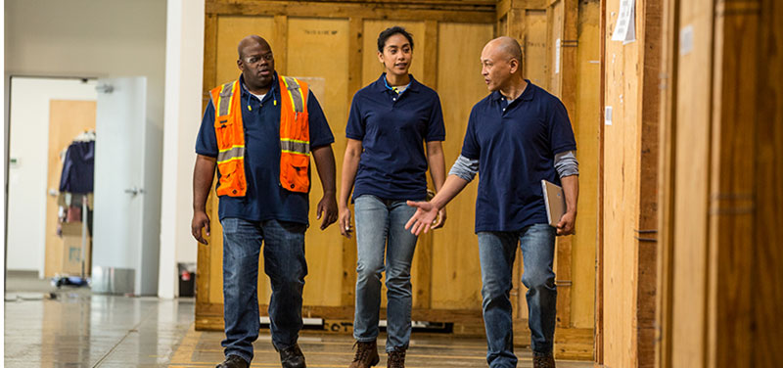


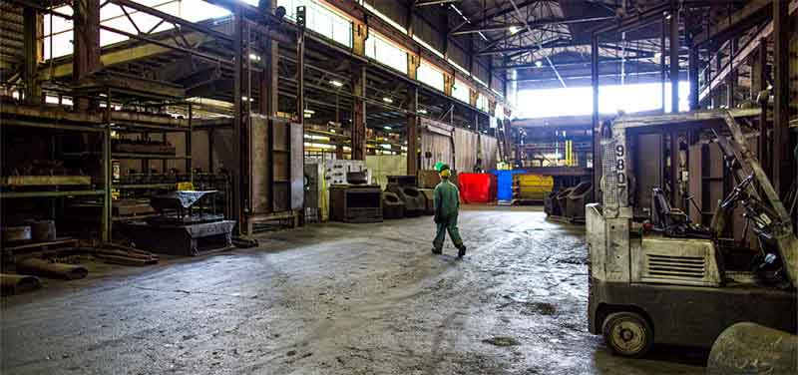

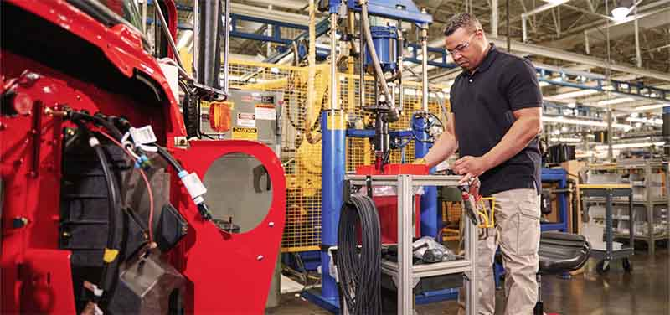


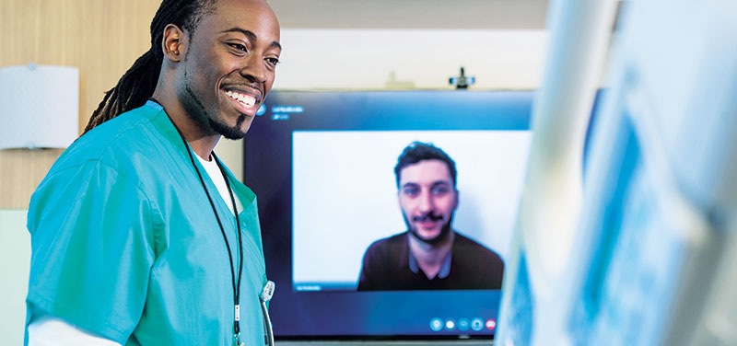


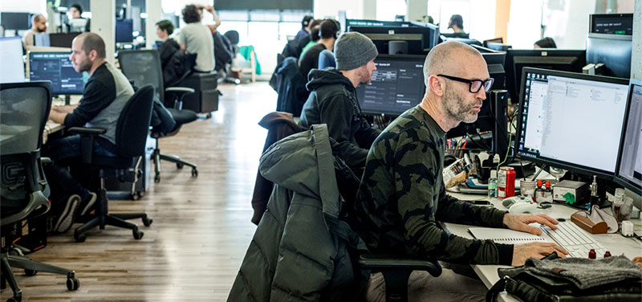




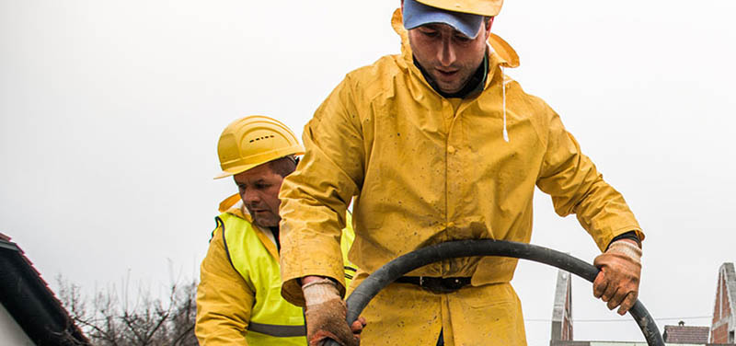







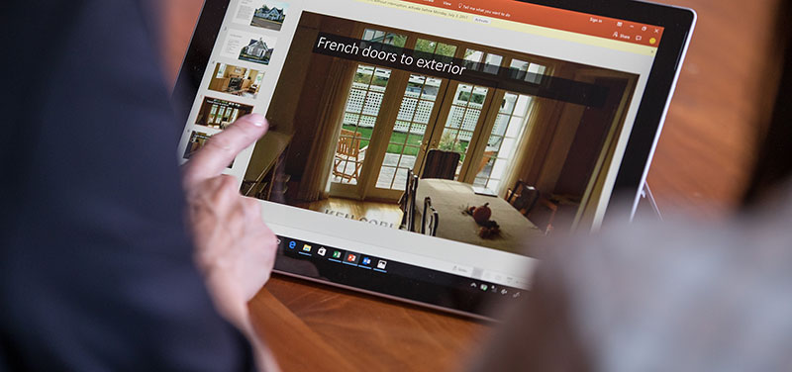









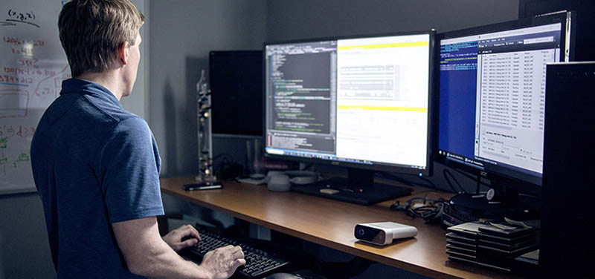


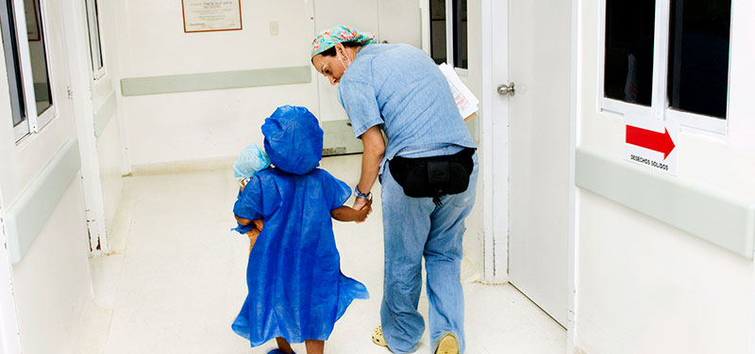



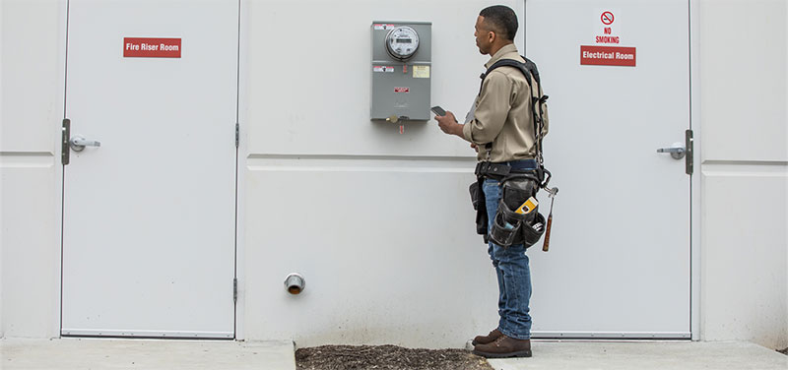








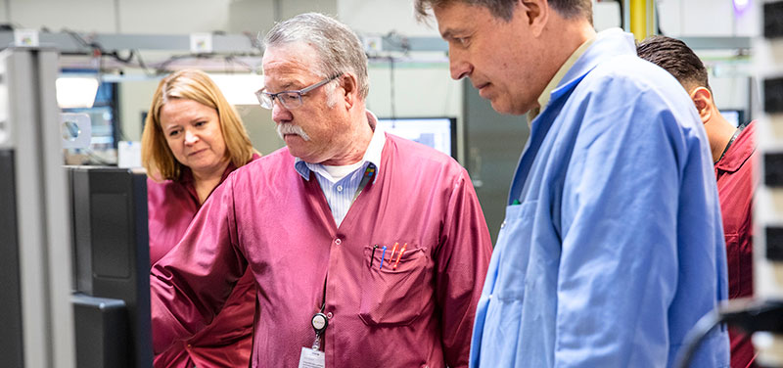
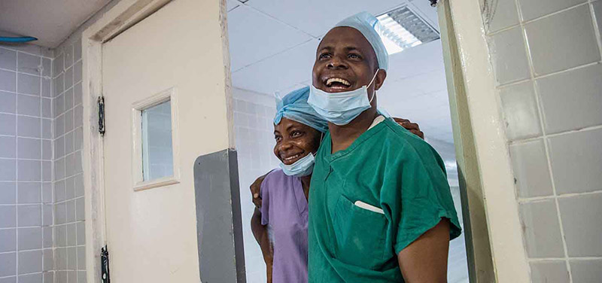










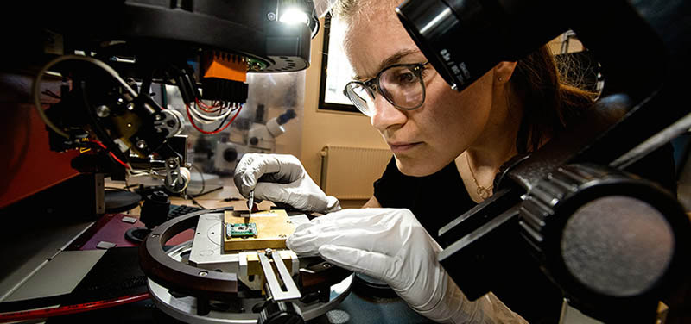
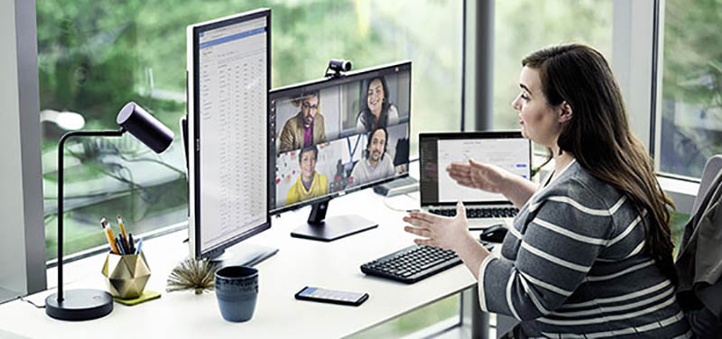

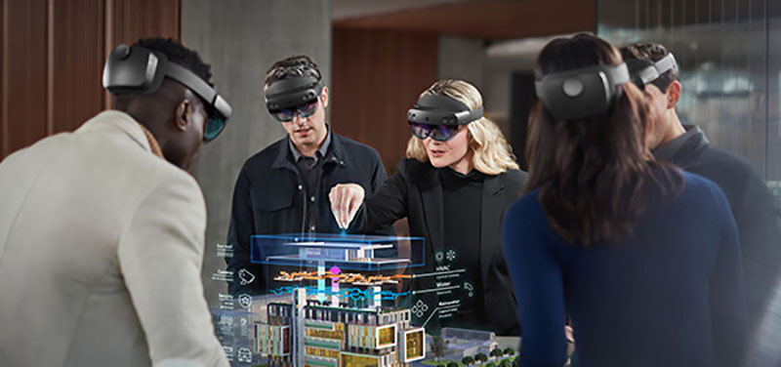














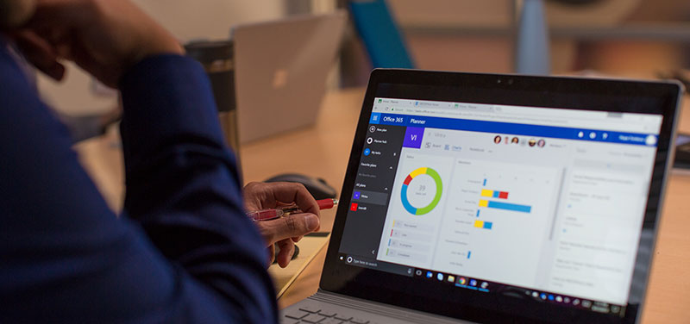

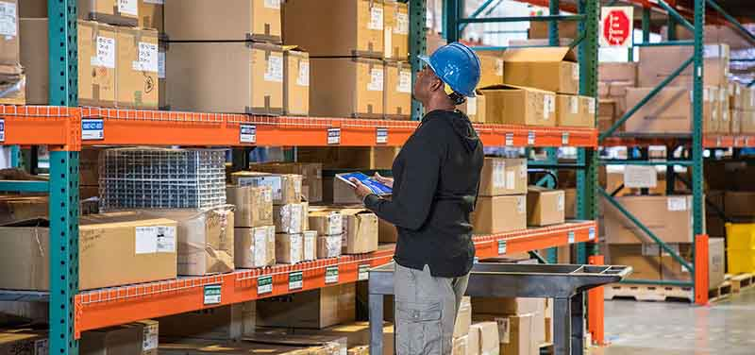




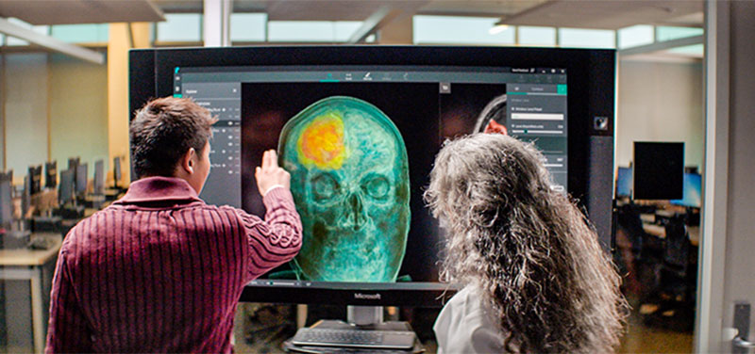




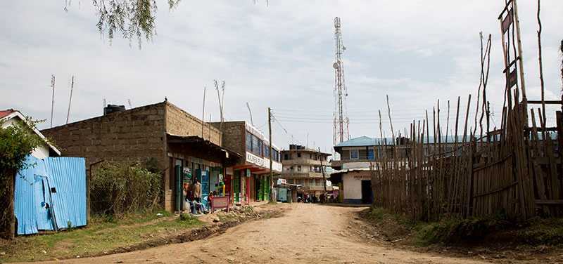

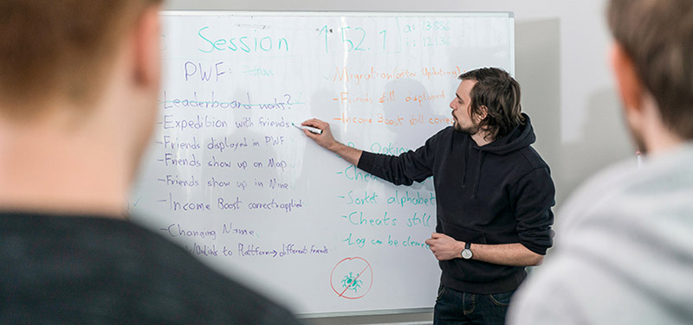









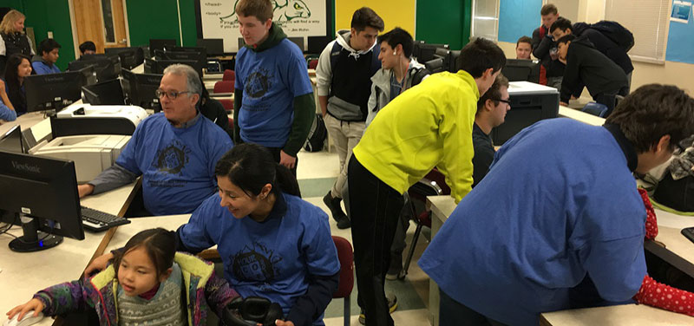
















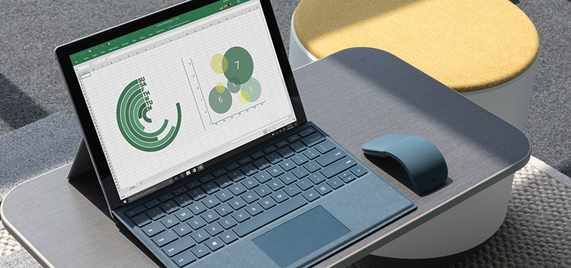




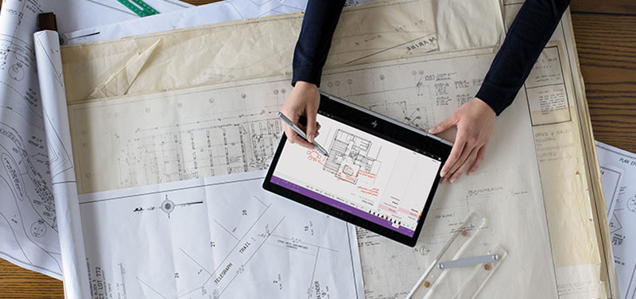



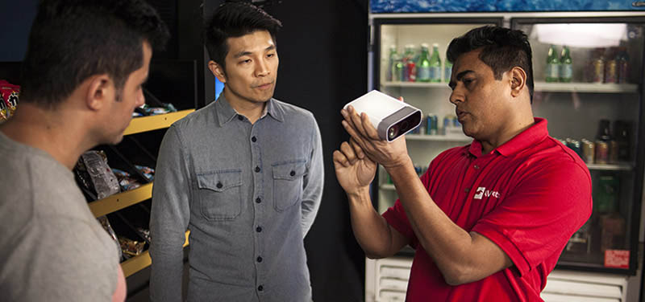


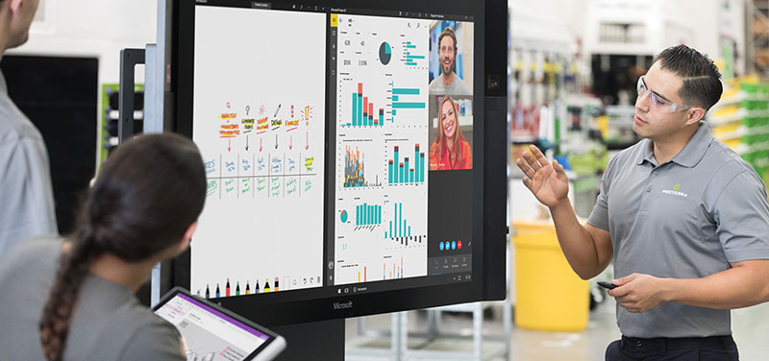





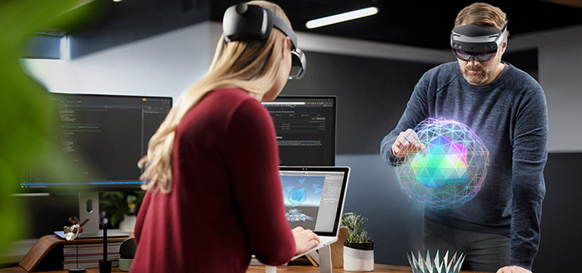
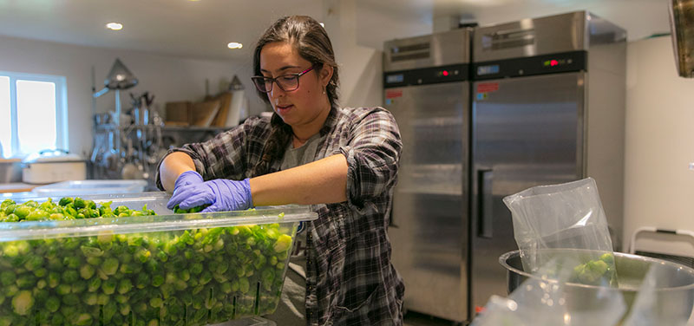
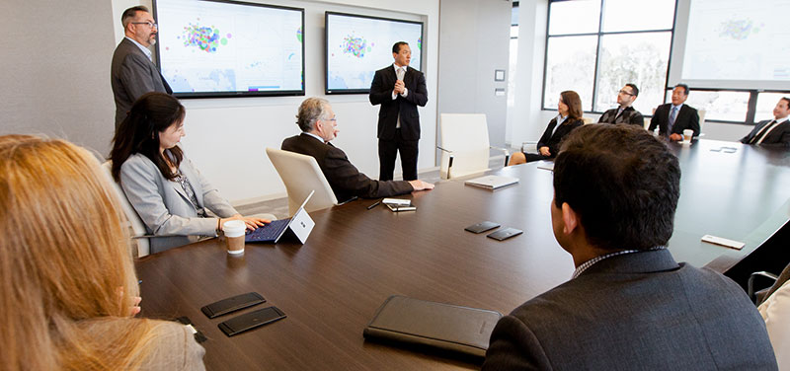
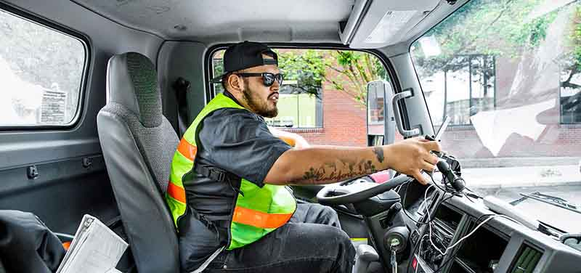
Mask
Disruption: The new normal

Slide 3

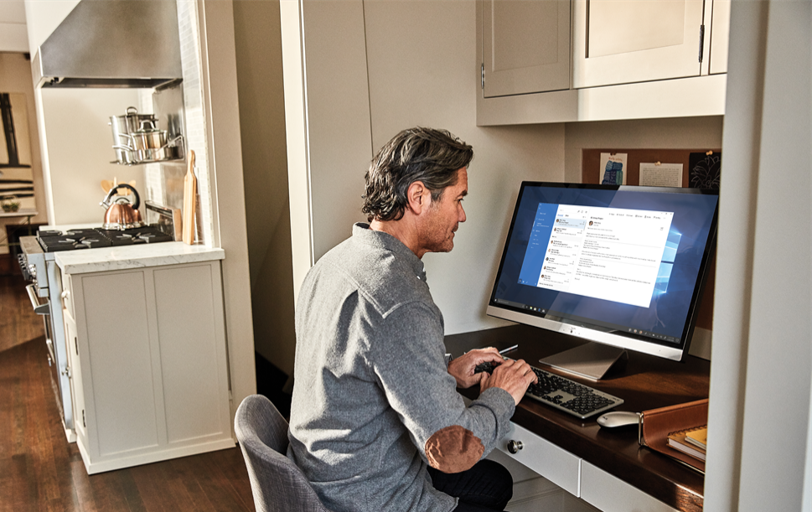

Organizations are adjusting in today’s business world
Organizations generally reacted well to the sudden remote shift…
…however, the initial effective response may have come at cost of your employees’ wellbeing…
…with managers bearing an even bigger collaboration load.
82%
59%
40%
of managers expect to have more flexible WFH policies
of employees expressed concern about burnout
report decreased mental health
Source: Remote work trend report, Glint Insights Report / May, Qualtrics report: The other COVID-19 crisis

Slide 4

Microsoft’s Findings: What happens when work goes remote?
Case Study – Microsoft’s Findings: What happens when work goes remote?
Home | Work
Findings
All blog articles
Workdays are getting longer
When office work goes remote, what will we learn?
In China, managing relationships, teams, and more meetings from home
The rise of 30-minute meetings, and other ways collaboration is changing
Balancing work and life under one roof
The human side of business continuity
The new manager 1:1: nurturing employee resiliency during disruption and change
Uncovering resilience: measuring organizational networks during crisis
Supporting customer and supplier relationships in uncertain times
Lessons from China: A return to the office, but not to the old way of working
*Related publication: HBR article highlighting top findings
1
After-hours collaboration increased by
+30%
Nearly 7 out of 10 people experiencing workweeks that expanded by
+3hrs
A research project and blog series chronicling the use of Workplace Analytics by Microsoft teams to measure how our working lives are impacted by the shift to 100% remote work in response to Covid-19
Managers bearing a high collaboration
load
2
65%
increase of time spend in chats
2x
increase in time spend in Teams calls
Microsoft Proprietary and Confidential

Slide 5



The rise of 30-minute meetings, and other ways collaboration is changing
Case Study – Microsoft’s Findings: Teams and organizations
Home | Work
Findings
Meeting time jumped for all roles
The nature of meetings changed:
1
2
+10%
in weekly meeting time
11%
less longer meetings
22%
more shorter meetings
(30 minutes or less)
Core Business Challenge
A study of changes in collaboration patterns among the Modern Workplace Transformation team investigates how meetings and tool reliance have shifted and digs into the importance of socialization at work
Scheduled catch-ups increased to fill a gap created by remote work
Instant messages surged
3
4
+18%
increase in 1:1
+72%
increase in instant messages sent, with the largest increase spanning from 10 AM to 5 PM

Slide 6
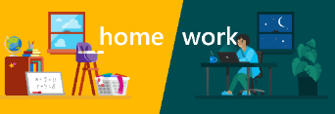


Balancing work and life under one roof
Case Study – Microsoft’s Findings: Individual Employees
Home | Work
Findings
Workdays are getting longer
7 out of 10 people
a workweek that expanded by at least
1
+3hrs
with
We analyzed how people, now working in a home environment, are integrating work and life in the Modern Workplace Transformation team in the wake of a major work disruption
Workdays with heavy collaboration in the evening hours
2
+52%
increase in chat messages sent between 6pm and midnight
Increased weekend collaboration
3
3x
10 percent of the population that previously had the least weekend collaboration—less than 10 minutes—now saw their weekend collaboration triple

Slide 7



Your business depends on people
  Teams and
  organizations
  Organizational resilience
  Individual employees
  External stakeholders

Slide 8







A rapid shift to remote work introduces new questions for the business and its employees.
How are collaboration activities changing?
What are the impacts of work-life integration?
Are external relationships being maintained?
Are employees engaged and connected?
How are work patterns evolving?
How can work effectiveness be improved?

Slide 9
Equip leaders to respond to this disruption, plan their recovery, and reimagine their organization to grow resilient
Respond
Navigate the now
Recover
Plan the comeback
Reimagine
Shape the future
Solutions that support …
  … individual employees:
protect employee wellbeing
enable employee
wellbeing
boost employee engagement and develop effective managers
  … teams and organizations:
sustain org connectivity and digital collaboration
manage the ‘return to office’ and enhance operational effectiveness
improve agility and
foster innovation
  … external stakeholders:
maintain customer and supplier continuity
strengthen customer and supplier relationships
reinvent customer and supplier journeys

Slide 10
Informing return-to-the-workplace plans objectively using Workplace Analytics
Case Study
Core Business Challenge
Workplace Analytics Solution
Action & Impact
Determine who would benefit most from returning to the workplace first, factoring in constrained capacity
Provide a perspective that aims to maximize effective collaboration and responsiveness
Provide an objective measure of prioritization that can be combined with critical factors like the ability to safely open up workplaces and employee circumstances and preferences.
Gave insight into the dependencies of individuals and teams on within-team and within-office collaboration to determine who would benefit from returning to the workplace the most.
Created 2 approaches: 1) Allocating a proportion of each team to return based on individual collaboration patterns and 2) Selecting teams with highest benefit from returning.
Proposed approach reduced turnaround of return-to-office plans from multiple weeks to 1 day
Data-driven methodology removed the politics from the decision
The new plan improved efficiency and responsiveness of those individuals and team that were highly dependent of the office to get their work done.
Key Solution
Rethinking the office as a place to collaborate and providing a data-driven perspective on top of survey and badging data took out the subjectivity in the creation of return-to-office plans and made the workspace transformation team more efficient.
With the new solution “high collaborators” along with key “cross-functionals” were identified and brought back first, “insular collaborators” where allowed back on an alternating schedule and “low collaborator” teams delayed their return to office.
    Individuals-based return-to-office approach based on 65% of prior capacity
    2. Team-based return-to-office approach
    Recommended % of assigned seats by team
Cross-functionals
Benefit the most if they work closely with the High collaborators
High collaborators
Benefit the most from moving back to the office
    Collaboration time with other teams in the same office
Insular collaborators
Need a space to meet but only with their own team
Low Office X collaborators
Lower collaboration benefit from moving back to office
    Collaboration time with own team in the office
Data illustrative of findings, modified to protect privacy

Slide 11


At Microsoft, Sales Managers were internally focused
Internal collaboration
External collaboration
RoB
27%
20%
People
23%
28%
Managers spent most of their time in non-selling internal activities
→ talking about the business
Workplace intelligence revealed opportunities to streamline non-sales related activities
→ gain time for seller coaching and customer focus
Customer escalations
13%
12%
Forecast
12%
5%
Strategy
10%
14%
Team event
5%
11%
Learning & readiness
4%
6%
Deal
3%
2%
Local initiative
1%
1%

Slide 12

How does it work?
Native Microsoft Office 365 data
+
Control and governance
+
Business context
=
Insights and change
Start with aggregated behavioral data from everyday work in collaboration tools.
Help protect your data with flexible privacy and compliance controls.
Reveal patterns of success with an overlay of organizational descriptors and business outcomes.
Use powerful insights to make better business decisions and transform your organization.

Slide 13





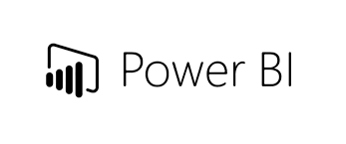

How Workplace Analytics works
Work activities generate data | Executives use the data to make better decisions | Analysts and advisors activate prediction and integration | Employees and managers monitor and improve
Workplace
Analytics
MyAnalytics
Office gives us 20+ hours of time use data
Personal data to support individual decision making
HR
Dashboards, queries and MyAnalytics integration
Organizational context adds relationships
WpA Azure Templates
Pre-built models, reporting and analysis apps, and integration with other datasets
Integrated monitoring dashboards
CRM
HRIS
AI
Meaningful business outcomes add predictive power
AI-powered workflows
Organizational Network Analysis

Slide 14

Gathering insights is the first step
  “Through 2022, only 20% of analytic insights will deliver business outcomes.”
Gartner Predicts 2019: Analytics and BI Solutions

Slide 15
The success framework to take insights to action
Analyze and plan
Operationalize
Realize value across enterprise
Value
Assess your organization’s collaboration patterns and plan
how to quickly improve them.
Time
Embed insights into a regular cadence of decision-making.
Realize insight-driven decision making
and Microsoft 365 Insights expertise
across the enterprise.
Go Deep
Go Broad
Conduct a comprehensive analysis within a pilot population.
Identify new high-potential populations and use cases across your organization while scaling analysis expertise.

Slide 16


Insights-driven work transformation
Reference pattern
Performance Models
Benchmarks and models inform,
and data science and ML enrich performance models and measurement
Data
Science
ML
Models
Benchmarks
Change
Levers
A new operating model for the workplace
Leverage the full extent of passive signals available from apps and devices
Operationalize insights throughout
the organization; drive empowerment and accountability through transparency around behaviors and performance
Change programs are targeted and instrumented to improve efficiency
Continuous iteration accelerates transformation and drives outcomes
2
Employee and
Organizational Data
People generate both intentional and behavioral data
1
3
Instrumented Change
Changes are accelerated through programs and systems powered by data and performance context
Apps
Surveys
and Polls
Devices
Targeted
Solutions
Empowered
Leadership
Change
Practices

Slide 17
The Modern Work Insights and Action Motion
Drive measurable employee experience outcomes by combining insight-full collaboration data with actionable change management.
Assess your organization’s collaboration patterns and plan how to quickly improve them.
Operationalize key metrics and define prioritized set of change initiatives to establish a rhythm of business
Leverage agile change management approach to change behavior in the organization.
Prepare
Analyze
Operationalize
Realize
Guide the Customer in reviewing relevant uploaded organizational data.
Conduct workshops to gather relevant organizational context.
Conduct interviews to identify key stakeholders, sponsors, and organization initiatives; define measures of success.
Analyze collaboration and engagement data.
Transform insights into a stakeholder-ready customer presentation.
Review findings, actionable change plan and opportunity roadmap with the business sponsor and key stakeholders.
Establish an outline for implementing change initiatives.
Develop executive and operational scorecards to track ongoing progress of change initiatives.
Integrate executive and operational scorecards into the decision-making cadence.
Identify and formulate opportunities which generate ROI recognition.
Design and run a change workstream that will change user behavior for 1 scenario, for up to 1,000 users.
Create a strategy that addresses adoption and change through behavioral insights, sponsorship, and more.
Create and use a measurement scorecard to monitor performance, compared to initial baseline.
1-2 weeks
~4 weeks
1-2 weeks
~4-6 weeks
Typical duration: ~14 weeks end-to-end
Microsoft Consulting Services

Slide 18

Driving agility with process improvement at global energy co.
Core Business Challenge
Workplace Analytics Solution
Action & Impact
Reduce process time dedicated to rhythm of business activities across operations
Understand & monitor meeting spillover time impacts, examining meeting prep time
CFO: How many employee hours does one specific monthly decision-making meeting consume, and can we reduce this? Can we apply what we learn more broadly?
Analysis revealed each monthly session took more than 170 person hours, spread over 70+ days
Deeper analysis found root cause: multiple handoffs due to lack of sub-process ownership
Tracking dashboard gave CFO & cross-functional team ability to monitor go-forward hours impact
CFO and team drove reduction of 40% in prep hours and 85%+ in process days
Equated to hundreds of thousands of dollars in annual savings
Sparked broader enterprise-wide scaling of Workplace Analytics to streamline operations
Key Insights
Initiated by analysis in Workplace Analytics, and using Workplace Analytics to track and measure, the team consolidated meeting prep activity from 70+ days to 8 days
Total employee hours dedicated to prep fell sharply, enabling the company to repurpose hundreds of thousands of dollars in employee work time toward more additive contributions.
^{Meeting Prep Timeline}
70+ business days
8 business days
^{Employee Prep Hours}
-40%
WSJ: Turning Data Into Insights
Data illustrative of findings, modified to protect privacy

Slide 19


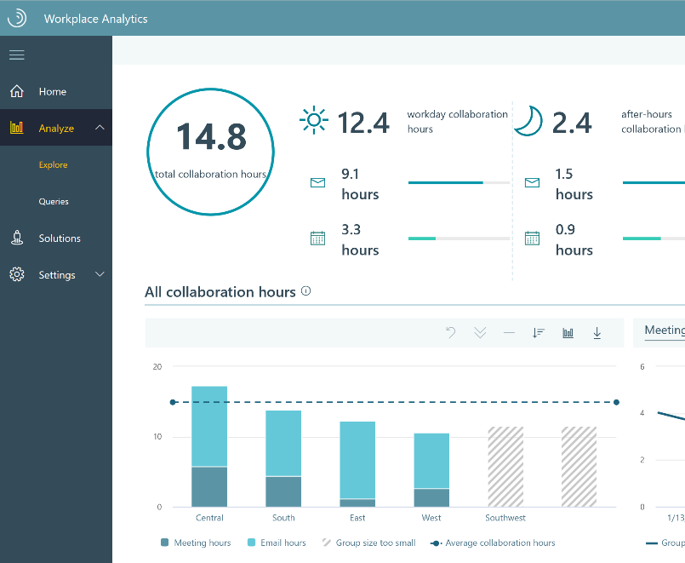


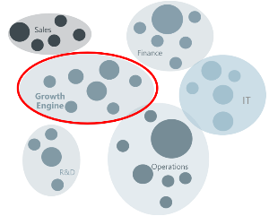
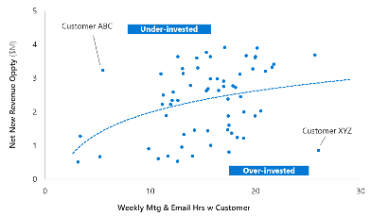


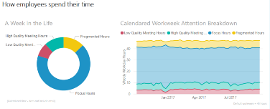
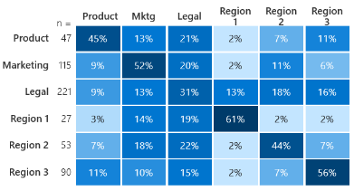


Workplace Analytics drives Patient and Business focused outcomes by providing critical visibility into activities across the care continuumⁱ
External Collaboration
Supply chain coverage
Payor responsiveness and mix
Referral network patterns
Impactful leading indicators
Teaming model by revenue source
Time invested vs. market potential/capture
External engagement with critical supply chain vendors
Organizational Network Analysis
Revenue Cycle Optimization
Internal Collaboration
Mulit-disciplinary team
orchestration
Process optimization
Simplifying org complexity
Engagement with departments across the care continuum
Collaboration time in internal process
Low-quality meeting hours
Employee Experience
Collaboration Time
Coaching & Onboarding
Top performer behaviors
Manager effectiveness
Onboarding & learning impact
Top performer best practices
Manager 1:1s
Change in behavior post-training
ⁱ - data signals are primarily sourced from activities associated with knowledge workers

Slide 20



Real-world research fuels product development
Microsoft Analyzed Data On Its Newly Remote Workforce
To Retain New Hires, Make Sure You Meet with Them in Their First Week
How People Analytics Can Help You Change Process, Culture, and Strategy
If You Multitask During Meetings, Your Team Will, Too
Email & Calendar Data Are Helping Firms Understand How Employees Work
Employee Burnout Is a Problem with the Company, Not the Person
Being Engaged at Work Is Not the Same as Being Productive
Why the French Email Law Won’t Restore Work-Life Balance
What Great Managers Do Daily
Measuring Your Employees' Invisible Forms of Influence
How Microsoft Used an Office Move to Boost Collaboration
The Paradox of Workplace Productivity
What Work Email Can Reveal About Performance and Potential
What Makes Great Salespeople
It’s 10 AM. Do You Know What Your Sales Reps Are Doing?
How to Finally Kill the Useless, Recurring Meeting
A Primer on Measuring Employee Engagement
3 Behaviors That Drive Successful Salespeople
Quantify How Much Time Your Company Wastes
Collect Your Employees' Data Without Invading Their Privacy
Your Scarcest Resource
Visit insights.office.com for research and inspiration

Slide 21
Thank You!
John Allen
Jesse Howard

