Slide 1
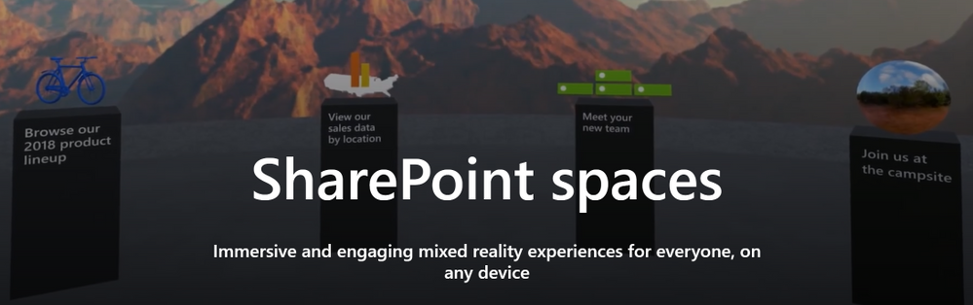
Virtual events using sharepoint spaces
Teams Technical specialists:
Samantha Brown
Michael Gannotti
Notes:
Mike Gannotti

Slide 2






This event is brought to you by the Microsoft Healthcare and Life Sciences Group. Visit us at:
https://aka.ms/HLSBlog
Notes:
Read the text in the blue box to make clear this session is being delivered by the HLS org and be sure to give the aka.ms url to the official blog and call out that folks should follow it to keep up to date with the latest in Microsoft Modern Workplace for Healthcare and Life Sciences.

Slide 3
Before We Start…. Housekeeping
We encourage our attendees to ask questions. So ask!
All questions are moderated. They will not show to the general audience unless the moderator shares/publishes the question out to the Q&A panel for everyone to see.
We love to know who you are and where you are viewing from! Send a shout out in the Q&A panel at any time with your first name and where (state/country) you are viewing from.
At the conclusion of this session the webcast recording will be posted to the Microsoft Healthcare and Life Sciences Blog at https://aka.ms/HLSBlog along with any resources mentioned during the webcast.
Now, how to engage the Q&A panel…..
Notes:
Talk through the bullets to try and get attendees to interact with the broadcast. Make sure

Slide 4
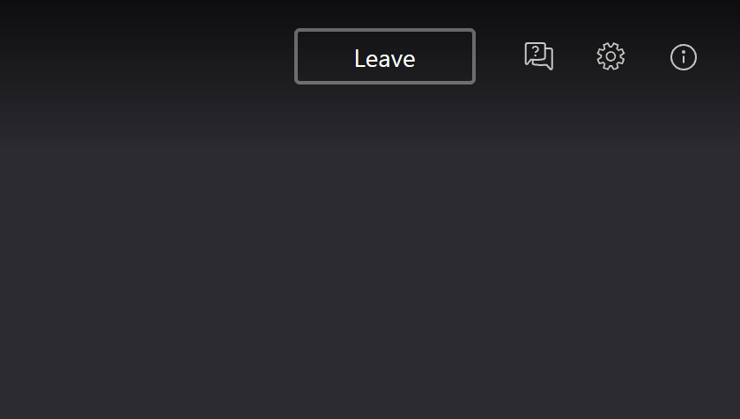
Notes:
For this slide tell users that they can open the Q&A panel by clicking on the little dialogue box with a question mark in it in the upper right hand corner of the webcast

Slide 5
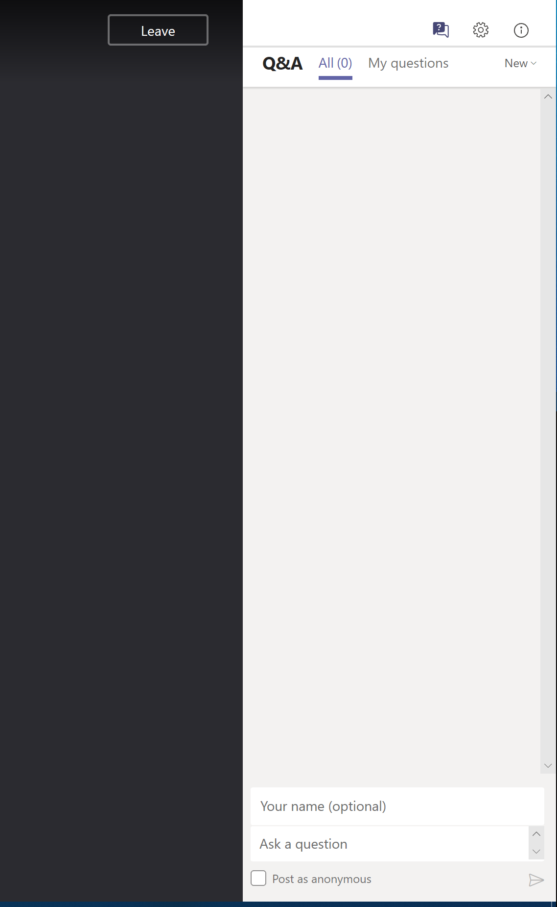
Notes:
For this slide tell users that they can type their question (name is optional) and then click the arrow indicated to post the question/shout-out/comment (we like all these!) And that’s it. Now ready for last slide to kick of the presentation.

Slide 6
On to the presentation!
Notes:
Transition now to the presenter. Re-introduce them and transition to them.

Slide 7
Agenda
What are SharePoint Spaces?
What is a Virtual Conference and how you can get started today?
Resources/Next Steps
Notes:
Mike Gannotti

Slide 8
What are sharepoint spaces?
SharePoint spaces is a web-based, immersive platform, which lets you create and share, secure and extensible mixed reality experiences. Add a new dimension to your intranet by using 2- and 3D web parts to create your mixed reality vision.
Quick demonstration of SharePoint Spaces
Notes:
Samantha Brown

Slide 9
Demonstration
Notes:
Samantha Brown

Slide 10
What is a Virtual Conference and how customers can get started today?
Virtual Conference facilitates anywhere, anytime, any device, access to a multi-session/multi-day event.
Microsoft Virtual Conference solution leverages:
SharePoint Online
SharePoint Spaces (links, 360’images/video, document libraries, and more)
Microsoft 365 Live Events (Stream, Yammer, or Teams)
Microsoft Teams Meetings
Microsoft’s AltspaceVR (optional)
Notes:
Michael Gannotti

Slide 11
Demonstration
Notes:
Michael Gannotti

Slide 12
Resources
SharePoint Space Home
SharePoint spaces support
Create a SharePoint space
SharePoint spaces, a new dimension for your intranet
SharePoint innovations transform content collaboration with mixed reality and AI
Create a Virtual Conference - HLS Show Me How
Create a Microsoft Teams Virtual Facilities Tour with SharePoint Spaces - HLS Show Me How
Immersive 360’ Video Use In SharePoint Spaces - HLS Show Me How
Notes:
Samantha Brown

Slide 13
Questions?
Notes:
All Three

Slide 14
This event is brought to you by the Microsoft Healthcare and Life Sciences Group. Visit us at:
https://aka.ms/HLSBlog
Notes:
Read the text in the blue box to make clear this session is being delivered by the HLS org and be sure to give the aka.ms url to the official blog and call out that folks should follow it to keep up to date with the latest in Microsoft Modern Workplace for Healthcare and Life Sciences.

