Slide 1


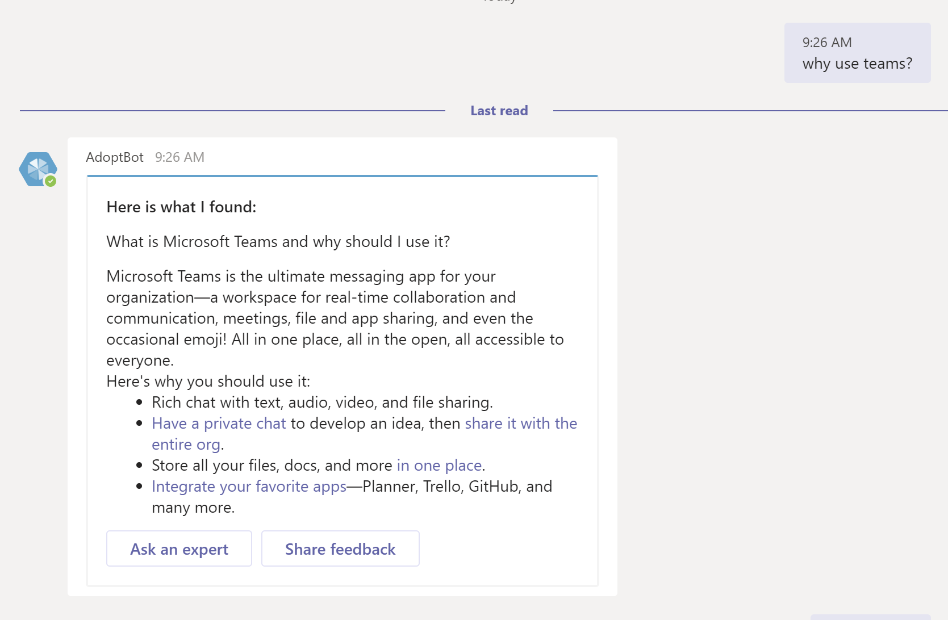

Office 365 Adoption Bot
February 14, 2019

Slide 2
Adoption Bot
Why AdoptBot?
Demo
Offer
Sources
Learning and Resources
Q & A

Slide 3
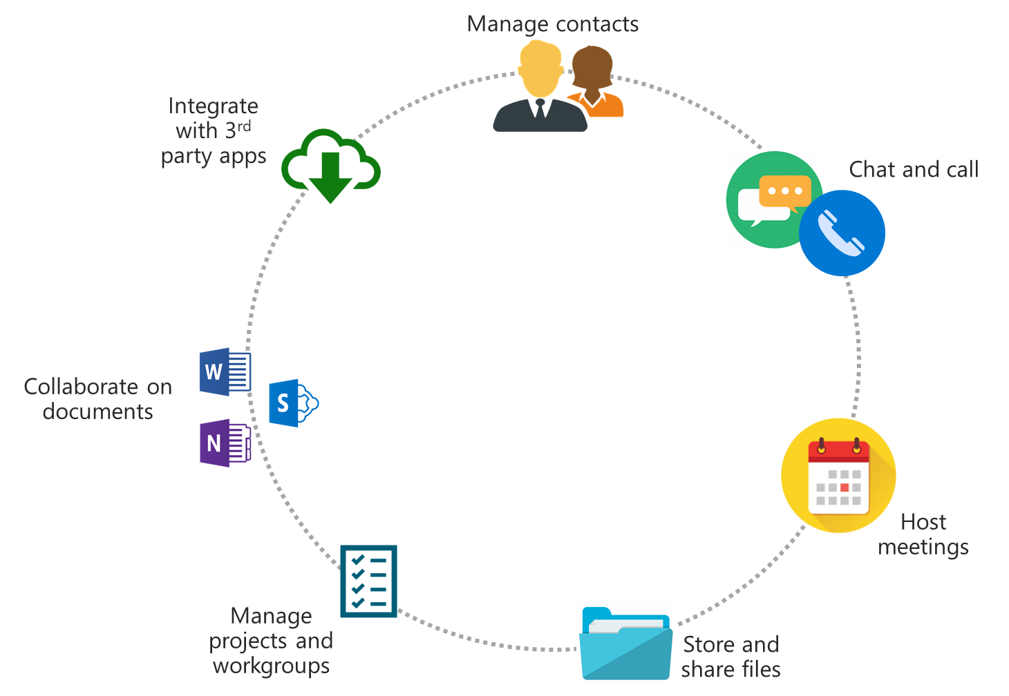
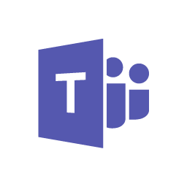
Microsoft Teams creates a hub for teamwork
Microsoft Teams has the power to transform the way users get things done
Empowering users to connect, communicate and collaborate from anywhere within a single interface, streamlining the way users work
Plus, you can work with confidence knowing Teams offers enterprise level security, compliance, and manageability
Notes:
How do you empower your employees to embrace teams as the hub for teamwork

Slide 4



Adoption Bot is part of a Robust Readiness Plan
Design your awareness, training and support plans based on your readiness assessment outcomes. Use a variety of methods for each.
Awareness
Email
Events
Posters
Champions
Signage
Training
In person
Live, online
Videos
User guides
In-product
Support
Self-help/Adopt BOT
Help desk agents
Floor walkers
Feedback loop
Notes:
Integral part of your Training and Adoption/Readiness program = Scale adoption
Reduce Help desk calls
Overcome adoption hurdles quickly by putting the power in your end users hands to help themselves
Intuitive and easy for all levels
Hand off for demo – Dave

Slide 5
Adoption Bot
DEMO

Slide 6
Adoption Bot Offer - How it works
Workshop - Microsoft Customer Success Manager will arrange a workshop to envision how Adoption Bot might be used in your environment. Jointly, we will identify roles, goals, branding and key content to create a corpus of knowledgebase content.
Deployment assistance - Microsoft CSM Team can guide the provisioning of Azure Services and deployment of a custom Adoption Bot to your tenant:
    Enable Azure services
    Configure QnA Maker and/or FAQPlus
    Test bot in Teams and Initial Bot training
Reach out to your account team or CSM Today

Slide 7
Adoption Bot Sources
AdoptBot automatically extracts question-answer pairs from semi-structured content such as FAQs, product manuals, guidelines, support documents, and policies stored as web pages, PDF files, or MS Word doc files . Content can also be added to the knowledge base from structured QnA content files.
Source Type | Content Type | Examples
URL | FAQs (Flat, with sections or with a topics homepage) Support pages (Single page how-to articles, troubleshooting articles etc.) | Plain FAQ, FAQ with links, FAQ with topics homepage Support article
PDF / DOC | FAQs, Product Manual, Brochures, Paper, Flyer Policy, Support guide, Structured QnA, etc. | Structured QnA.doc, Sample Product Manual.pdf, Sample semi-structured.doc, Sample white paper.pdf
Excel | Structured QnA file (including RTF, HTML support) | Sample QnA FAQ.xls
TXT/TSV | Structured QnA file | Sample chit-chat.tsv

Slide 8
Learning and Resources
Customer Success Story by Susana Queiroz from Vale: https://aka.ms/TeamsSHVale
  Using Bots (IT support, HR employee resources, facilities, etc.)
FAQPlus > QnAMaker
  https://github.com/OfficeDev/microsoft-teams-faqplusplus-app
  https://qnamaker.ai
    Documentation:
    https://docs.microsoft.com/en-us/azure/cognitive-services/qnamaker/
    Tutorial:
    https://docs.microsoft.com/en-us/azure/cognitive-services/qnamaker/tutorials/create-publish-query-in-portal#create-a-knowledge-base
Analytics for QnA
https://docs.microsoft.com/en-us/azure/cognitive-services/QnAMaker/how-to/get-analytics-knowledge-base
Additional Teams App Templates
https://docs.microsoft.com/en-us/microsoftteams/platform/samples/app-templates

Slide 9
Adoption Bot
Q&A

