Slide 1


DIGITAL TRANSFORMATION
Wave of technology disruption

Slide 2


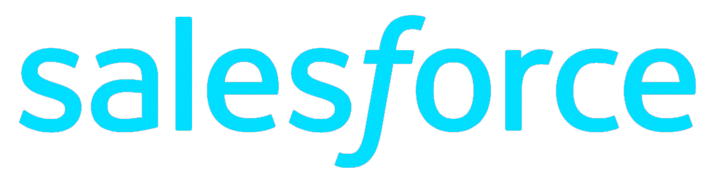


CLOUD APPS AND SAAS SERVICES
On-premises

Slide 3






MOBILE AND PERSONAL DEVICES
On-premises

Slide 4
ORGANIZATION & SOCIAL IDENTITIES
On-premises

Slide 5

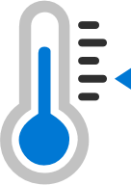
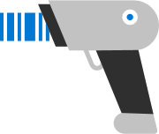
INTERNET OF THINGS (IOT) DEVICES
On-premises
Organization and social identities

Slide 6




On-premises

Slide 7



Identity is the new control plane
Partners &
Customers
Cloud Apps
Employees
Identity
On-premises
& web apps
Devices

Slide 8
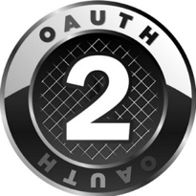



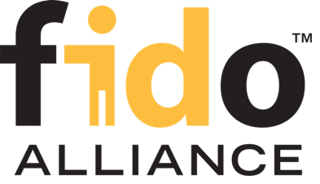

Open Standards
WebAuthn

Slide 9
Azure Active Directory in the Marketplace
Every Office 365 and Microsoft Azure customer uses Azure Active Directory
17.5 M
1.1B
732 K
organizations
identities
3rd party apps
in Azure AD
90 K
8 B
90 %
paid Azure AD /
EMS customers
daily Azure AD authentications
of Fortune 500 companies
Dec 2018

Slide 10

200M
Unique Active Users
Azure AD
November 2019

Slide 11

I started out skeptical about the security of the cloud and Azure AD, but Microsoft helped us figure out how to apply very granular controls to protect our assets.
Gerald Colson
Sr. Director, Information Security
>2.5M
>565K
2,252
>880K
users
groups
apps
SSPR users
Notes:
What convinced Walmart to go to the cloud?
For Walmart, the benefits of storing passwords in the cloud pivoted off a few things:
It would allow them to move away from their federated IDP, Ping, which is uber complex and makes for a really bad user experience.
Walmart wants to be a cloud-centric company and the appearance that goes along with that, compared to their younger competitors.
Improved security (compromised password detection) with our Identity Protection if they synced their passwords to Azure AD.
Consequently, it would give them more security, better user experience, and the appearance of a company born of the cloud like their younger, more nimble competitors.
So it was a win/win/win once they got over their concerns of putting their secrets in the cloud.
DATAPOINTS:
Users in AAD – 2,528,779
Groups in AAD – 565,108
Devices in AAD – 5,037
B2B Users – 731
Users receiving licenses via GBL – 868,000
Users managed via PIM – 177
Registered Applications – 2,252
Users enabled for SSPR – 880,800

Slide 12















Azure Active Directory
3rd party applications
ServiceNow
Google Apps
Workday
SuccessFactors
Schoology
Concur
Salesforce
732K
Workplace by Facebook
26M
Myday
Canvas
active apps integrated with
Azure Active Directory
Cornerstone OnDemand
monthly active users
of 3rd party apps
Blackboard Learn
Clever
Box
Firefly
December 2018
# monthly active users
Notes:
Our usage is growing by leaps and bounds! Checkout some of the biggest hitters for our customers.

Slide 13





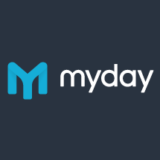





























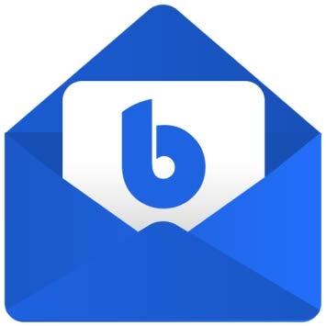

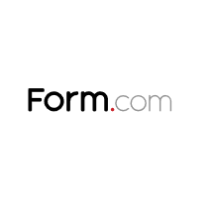



New to the Azure App Marketplace
Federated Connectors
Provisioning Connectors
3rd party native Azure AD apps
Sauce Labs – Mobile and Web testing | SkyHigh Networks | Jamf Pro
Skillport | Palo Alto Networks | Fidelity NetBenefits
OneTrust Privacy Management Software | Adobe Creative Cloud | Adobe Experience Manager
Apptio | Carlson Wagonlit Travel | DigiCert
SAP Cloud Platform Identity Authentication | Form.com | OrgChart Now
Cisco WebEx | Samanage
GitHub | LucidChart
BlueJeans | Zendesk
Tableau Online | ThousandEyes
Pingboard | Slack
Myday | Canvas | Calendly | Templafy
Doodle AG | Smartsheet | Nine for Office365 | K2 for Office365
Exclaimer Cloud | Firefly | Insights | Cronofy
Flipgrid | Edmodo | Boomerang | Bluemail
…and more added each month
Notes:
Message:
Check out the hot new apps we’ve added based off of listening to our customers. More are coming every day!
@Jeevan–Could you please provide:
Sauce Labs - Mobile and Web Testing
SkyHigh Networks
Jamf Pro
Skillport
Palo Alto Networks
Fidelity NetBenefits
OneTrust Privacy Management Software
Adobe Creative Cloud
Adobe Experience Manager
Apptio
Carlson Wagonlit Travel
DigiCert
SAP Cloud Platform Identity Authentication
Form.com
OrgChart Now
@Zhen–Could you please provide:
Top5-10hottest / most requestedprovisioning connectors that we want to highlight
@Jen/@Colleen–Could you please provide:
Top10-20 hottest new 3rd party native AAD apps developed in last 12 months
@Melanie–Ithink what would be best is a slide that showsa “sea of logos” withthese called out

Slide 14
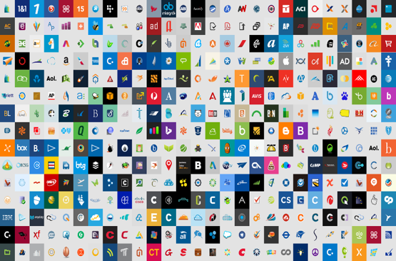
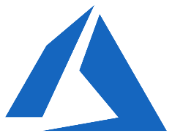





Azure AD for your digital estate
Cloud SaaS
apps
Microsoft
Cloud
Azure Active
Directory
Android
On-premises
& web apps
MacOS
iOS
Windows

Slide 15

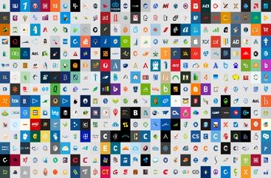





Azure AD for all your applications
Moving your apps to Azure AD
Azure Active
Directory
Office 365
Azure AD App proxy
  Access to internal apps, no VPN required
Improved Token transformation
  BYO certificate
  Enhanced SAML claims
  Token encryption
Tools and guidance
  Migration scripts and solution guides
Active Directory
and ADFS
Cloud SaaS apps
On-premises
& web apps
Notes:
All coming soon items will be in Public Preview in FY19Q2

Slide 16
Azure AD for all your applications
Cloud SaaS apps
Moving your apps to Azure AD
Azure AD App proxy
  Access to internal apps, no VPN required
Improved Token transformation
  BYO certificate
  Enhanced SAML claims
  Token encryption
Tools and guidance
  Migration scripts and solution guides
Office 365
Azure Active
Directory
Application
Proxy
Active Directory
and ADFS
https://aka.ms/migrateapps
VPN
On-premises
& web apps
Notes:
All coming soon items will be in Public Preview in FY19Q2

Slide 17
Why you should use Azure AD for all your apps
World-class security
Strong authentication
Seamless collaboration

Slide 18

Why Azure AD
World-class security

Slide 19

6.5 trillion correlated signals per day
Shared threat data from partners, researchers, and law enforcement worldwide
Microsoft Intelligent Security Graph
OneDrive
930M
threats detected on devices every month
Outlook
400B
emails
analyzed
1.2B
devices scanned each month
200+
global cloud consumer
and commercial
services
Botnet data from Microsoft Digital Crimes Unit
Windows
Enterprise security for 90% of Fortune 500
Azure
Microsoft
accounts
18B+ Bing web pages scanned
Bing
450B
monthly
authentications
1.1B+ Azure user accounts
Xbox Live
Notes:
The center piece of our investment in intelligence is the Microsoft Intelligent Security Graph. This is how we describe the way that we synthesize a vast amount of data from a huge variety of sources. 400 billion emails get analyzed by our Outlook.com and Office 365 email services every month.
1.2 billion devices get scanned every month by Windows Defender. That gives us a great deal of signal into what's happening on endpoints, and where are the attacks, and what do they look like these days?
We operate 200-plus global cloud, consumer, and commercial services. Everything from outlook.com to Xbox Live to Office 365 to Azure, and so on. And with all of those services, we have a tremendous amount of surface area that we defend. Enterprise Security from Microsoft is employed by 90% of the Fortune 500.
And so, we see more attacks than most other companies on any given day. We get a lot of information from defending against those attacks.
750 million plus Azure user accounts give us tremendous insight into how people authenticate to Azure. And that, combined with the 450 billion monthly authentications that we do with Azure Active Directory and Microsoft Account, really give us some tremendous insight into what is normal behavior when it comes to sign-ins and authentications, and what is abnormal behavior, and how often is it that someone has the right password, but they're not the person they say they are. We learn a lot about defending that really important control point, the identity, by looking across that set of data.
Bing scans about 18 billion web pages every month, giving us really great insight into what people are doing with web scripting technologies when it comes to attacks and phishing campaigns. And we have a great way to look at that and understand how we should help customers defend based on that information.
On top of all of that we layer shared threat data that we get from our partners, from the researchers here at Microsoft who are part of our 3,500-plus people that are full time on security, and law enforcement agencies that we partner with worldwide through our digital crimes unit, as well as botnet data that we collect through the digital crimes unit. All of that intelligence makes up the Intelligent Security Graph.
And why is it a graph? It's a graph because what's really important is connecting these pieces of intelligence, so that these signals are not just individual points of information. The graph brings them together as something that we can draw patterns across. We can learn from one point of data to influence how we interpret another point of data.
So, the Intelligent Security Graph is something that we are very, very heavily invested in at Microsoft. It's something that we feel is unique to us in this industry.

Slide 20

Azure AD Identity Protection
Already protecting customers in 89 countries around the world
Continuous detection
Connected intelligence
Apply artificial intelligence and human expertise to derive accurate insights
Actionable insights
Observe trillions of
signals and risk events from cloud systems
Send alerts, self-mitigate, and automatically remediate threats
Notes:
Harnessing the power of cloud-based artificial intelligence, our Intelligent Security Graph analyzes all those billions of pieces of data to improve our cloud security defenses and hone responses.
Bing scans 18B web pages
400B emails are scanned for spam and malware
5B distinct malicious threats are detected each month
These security insights are shared across all of our security solutions, helping provide better protection, detection, and response to all of our .
Last month at Microsoft, we saw 23M enterprise account logins that were marked as high risk due to Phishing and other attacks. (March 2018)
We’ve seen 350,000 compromised accounts detected in one month (April 2018).
With this sheer volume of attacks, the only way to prevent compromises is to continuously track normal and abnormal behavior across the broadest set of signals possible, apply artificial intelligence and automate the responses. I’ll talk ore about security later in the presentation.

Slide 21





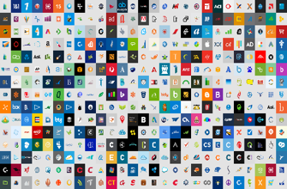


Azure AD
ADFS
Conditions
Controls
MSA
40TB
Google ID
Employee & Partner
Users and Roles
Allow/block
access
Microsoft Cloud
Android
Session
Risk
iOS
Trusted &
Compliant Devices
Machine
learning
3
MacOS
Limited
access
Microsoft
Cloud App Security
Windows
Windows
Defender ATP
Require
MFA
Real time
Evaluation
Engine
Cloud SaaS apps
Force
password
reset
Geo-location
Physical &
Virtual Location
******
Corporate
Network
Policies
Effective
policy
Client apps &
Auth Method
Block legacy
authentication
Browser apps
Client apps
On-premises
& web apps
Notes:
[don’t forget]
SharePoint limited access at a site level based on tagging
OWA support for limited access
Both are in Public preview

Slide 22
Azure
Active
Directory
Identity
Protection
Service
Azure AD & Microsoft Account
Schroedinger's User
Credentials
Classifier
Microsoft Azure
Active Directory
Seems
Good
Seems
Bad
Learner
Analysis
Deploy
10+ TB Logs
Relying parties
Self-reporting
Threat data
Behavior
Update
True
Negative
True
Positive
Analyze
Inputs & Outcomes
We were right!
False
Negative
False
Positive
We were wrong!
MICROSOFT CONFIDENTIAL – FOR DISCUSSION PURPOSES ONLY

